Slide 1
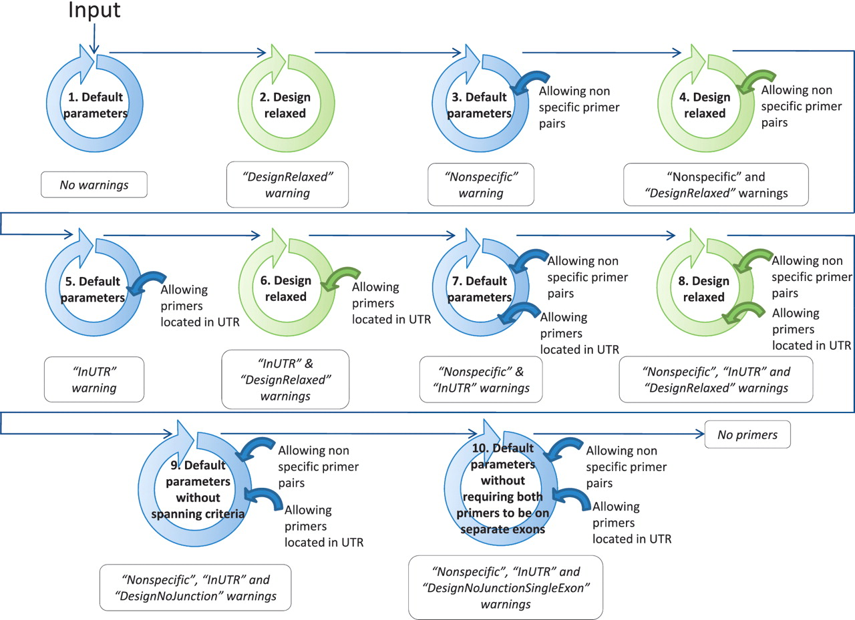
Figure 4. Workflow to find at least one suitable primer pair by relaxing the primer design parameters. The circles ...
Notes:
Figure 4. Workflow to find at least one suitable primer pair by relaxing the primer design parameters. The circles schematize the run of the modified PerlPrimer script and the workflow of the best primer selection indicated in Figure 1. The relaxation of the parameters within the modified PerlPrimer script and the allowed options in the selection of the best primer pairs are depicted in the center and on the right of the circles, respectively. Blue and green circles represent the default parameters and the relaxed design parameters, respectively (Table 2). The arrows symbolize the logical flow. If no primers are found with either set of parameters, the program reports ‘No primers’.
Unless provided in the caption above, the following copyright applies to the content of this slide: © The Author(s) 2011. Published by Oxford University Press.This is Open Access article distributed under the terms of the Creative Commons Attribution Non-Commercial License (http://creativecommons.org/licenses/by-nc/2.5), which permits unrestricted non-commercial use, distribution, and reproduction in any medium, provided the original work is properly cited.

