Slide 1
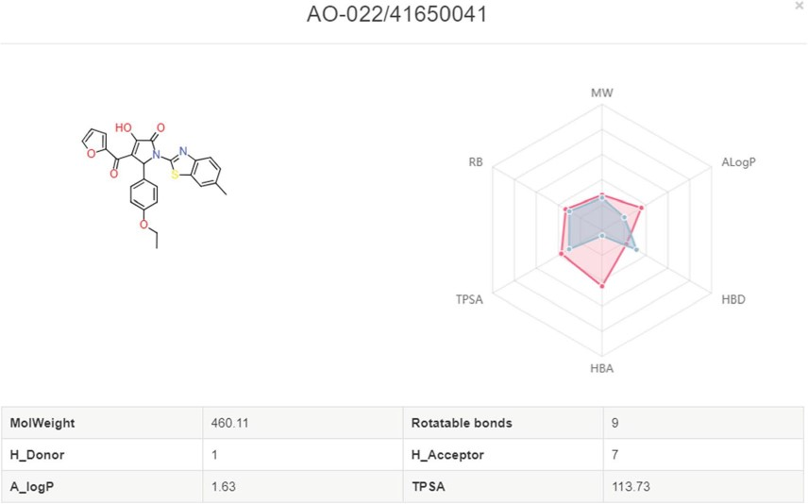
Figure 9 Radar plot of molecules with the drug-like properties. Red present the desired drug-like properties (MW: ...
Notes:
Figure 9 Radar plot of molecules with the drug-like properties. Red present the desired drug-like properties (MW: 500 g/mol, ALogP: 5, HBA: 10, HBD: 5, TPSA: 140, RB: 10) according to the Lipinski’s rule of 5.
Unless provided in the caption above, the following copyright applies to the content of this slide: © The Author(s) 2019. Published by Oxford University Press.This is an Open Access article distributed under the terms of the Creative Commons Attribution License (http://creativecommons.org/licenses/by/4.0/), which permits unrestricted reuse, distribution, and reproduction in any medium, provided the original work is properly cited.

