Slide 1
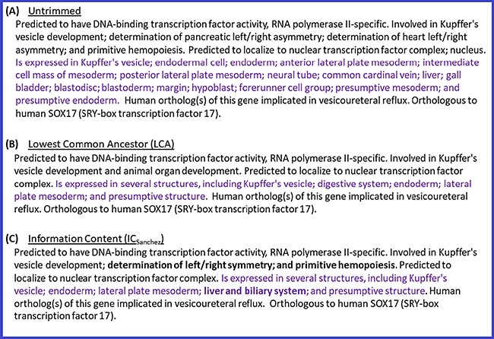
Figure 4 Untrimmed and trimmed summaries for the zebrafish gene sox17. (A) Untrimmed summary that shows all the 25 ...
Notes:
Figure 4 Untrimmed and trimmed summaries for the zebrafish gene sox17. (A) Untrimmed summary that shows all the 25 terms annotated to the gene. (B) The summary trimmed with the LCA-based algorithm. (C) The summary trimmed with the algorithm based on ICSanchez. Text highlighted in purple indicates the tissue expression data category, which has 17 terms in the untrimmed summary. Text in bold shows the difference between (B) and (C).
Unless provided in the caption above, the following copyright applies to the content of this slide: © The Author(s) 2020. Published by Oxford University Press.This is an Open Access article distributed under the terms of the Creative Commons Attribution License (http://creativecommons.org/licenses/by/4.0/), which permits unrestricted reuse, distribution, and reproduction in any medium, provided the original work is properly cited.

