Slide 1
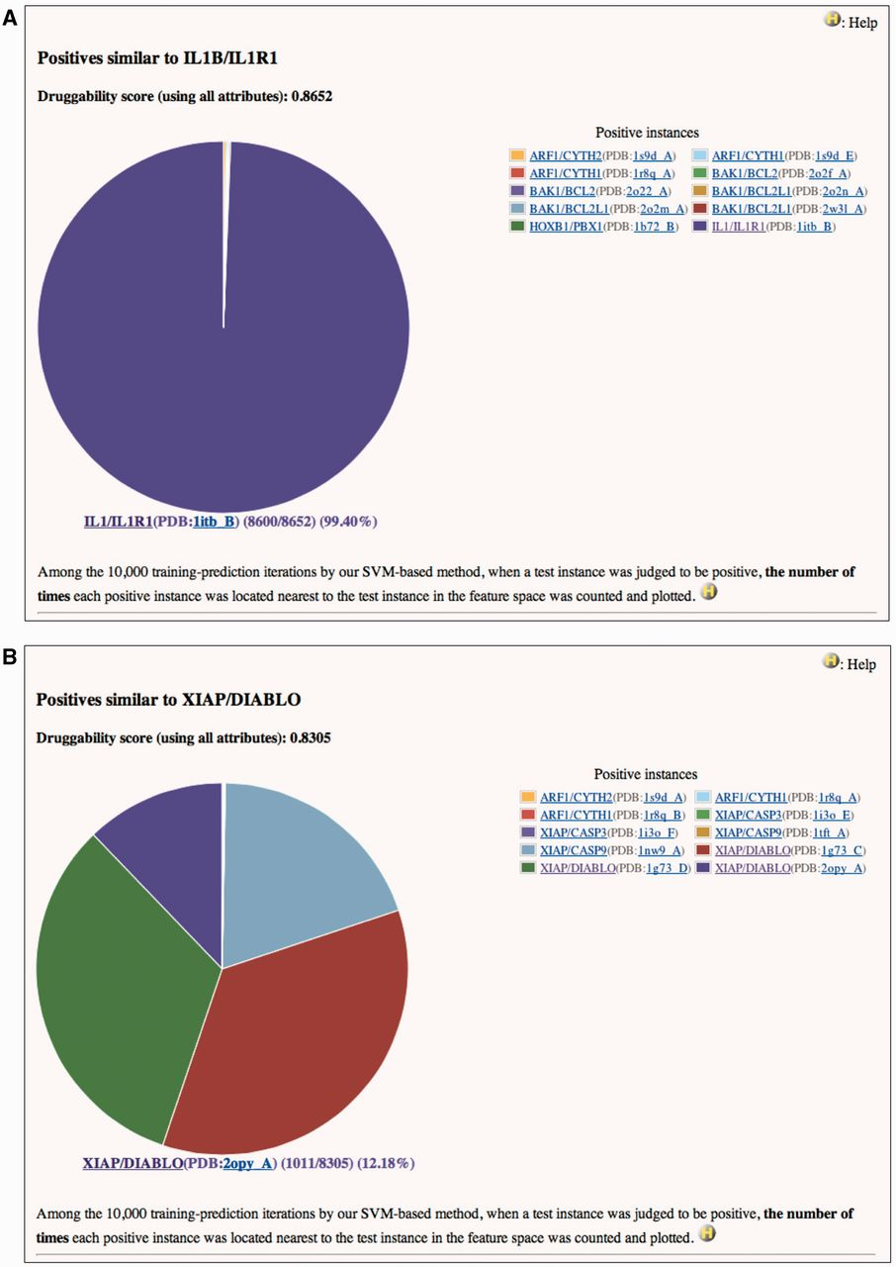
Figure 1 Pie charts of the number of times each positive instance (see ‘Legend’ of the chart) was located nearest to ...
Notes:
Figure 1 Pie charts of the number of times each positive instance (see ‘Legend’ of the chart) was located nearest to (A) IL1B/IL1R1 or (B) XIAP/DIABLO in a feature space, when IL1B/IL1R1 or XIAP/DIABLO was assessed by our SVM-based method. (A) Druggability score (using all attributes) of IL1B/IL1R1 is 0.8652. This means that IL1B/IL1R1 was judged to be positive 8652 times in the 10 000 training-prediction iteration. Among the 8652, IL1B/IL1R1 is 8600 times most closely located to itself in the feature space. Structural attributes are based on the PDB entry 1ITB. This is a screenshot of http://www.drpias.net/view_similar_positives.php?attr=all_attr&interaction_id=28988. (B) Druggability score (using all attributes) of XIAP/DIABLO is 0.8305. This means that XIAP/DIABLO was judged to be positive 8305 times in the 10 000 training-prediction iteration. Among the 8305, 4 positive instances (XIAP/CASP9(PDB:1nw9_A), XIAP/DIABLO(PDB:1g73_C), XIAP/DIABLO(PDB:1g73_D), and XIAP/DIABLO(PDB:2opy_A)) are 1011–2729 times most closely located to XIAP/DIABLO in the feature space. Structural attributes are based on the PDB entry 1G73. This is a screenshot of http://www.drpias.net/view_similar_positives.php?attr=all_attr&interaction_id=3100.
Unless provided in the caption above, the following copyright applies to the content of this slide: © The Author(s) 2012. Published by Oxford University Press.This is an Open Access article distributed under the terms of the Creative Commons Attribution License (http://creativecommons.org/licenses/by/3.0/), which permits unrestricted, distribution, and reproduction in any medium, provided the original work is properly cited.

