Slide 1
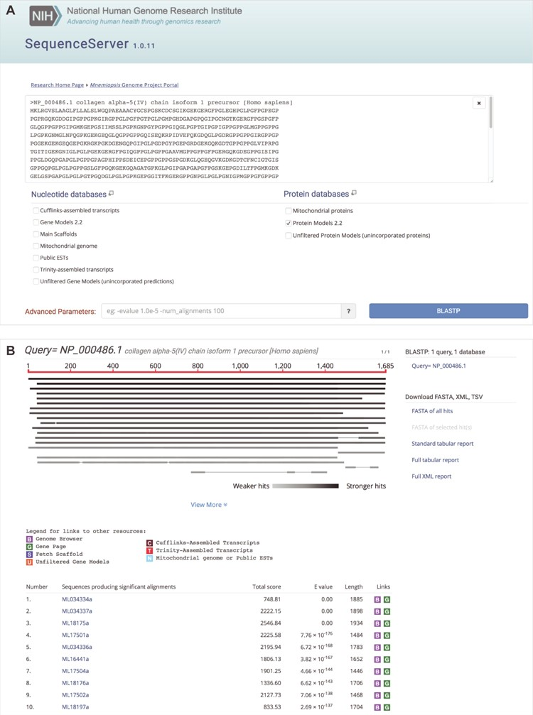
Figure 3 Mnemiopsis BLAST input options with sample output. (A) A user can paste one or more query sequences or drag a ...
Notes:
Figure 3 Mnemiopsis BLAST input options with sample output. (A) A user can paste one or more query sequences or drag a file containing query sequence(s) in FASTA format into the query search box. SequenceServer will automatically detect the sequence type (e.g. protein) and limit menu selections accordingly. Available nucleotide sequence databases include the Mnemiopsis genomic scaffolds (Main scaffolds), consensus gene prediction models (Gene Models 2.2), and Unfiltered Gene Models (unincorporated predictions), all publicly available Mnemiopsis ESTs and mRNAs from GenBank (Public ESTs), the Mnemiopsis mitochondrial genome, Cufflinks-assembled RNA-seq transcripts and Trinity-assembled RNA-seq transcripts. Available protein sequence databases include the translated proteins derived from the Mnemiopsis consensus gene prediction models (Protein Models 2.2), the unincorporated Mnemiopsis proteins derived from unincorporated gene prediction models (Unfiltered Protein Models) and the computationally derived Mnemiopsis mitochondrial proteins. SequenceServer will select the appropriate BLAST program (e.g. BLASTP) based on the input query and selected target database sequence types. Advanced BLAST parameters can be entered into the box at the bottom of the page in standard BLAST command line format. Clicking the ‘BLASTP’ button launches the BLAST search. (B) BLASTP results showing sequence alignments and scores, beginning with a graphical overview of each high-scoring segment pair (HSP). The identity of each HSP in this graphical overview can be seen by moving the mouse over each line in the display. A table containing summary results for each HSP can be found in the table below. Each of the ML sequences identified during this BLASTP search is hyperlinked, and clicking on those links takes the user directly to the pairwise alignment. The BLAST output results also feature customized color-coded boxes that link directly to relevant internal annotation resources, including the Mnemiopsis Genome Browser [B], the wiki-based Mnemiopsis Gene Pages [G], the Scaffold Fetch Tool [S], Unfiltered Gene Models [U], Cufflinks-assembled transcripts [C], Trinity-assembled transcripts [T] and Mitochondrial genome or Public ESTs [N].
Unless provided in the caption above, the following copyright applies to the content of this slide: Published by Oxford University Press 2020.This work is written by US Government employees and is in the public domain in the US.

