Slide 1
Figure 1. Annotation interface for the BioC-BioGRID corpus (5). Overlapping annotation types are shown in yellow in the ...
Notes:
Figure 1. Annotation interface for the BioC-BioGRID corpus (5). Overlapping annotation types are shown in yellow in the interface. Here, gene names appear yellow because they are annotated as both ‘Gene’ and as part of a mention sentence.
Unless provided in the caption above, the following copyright applies to the content of this slide: Published by Oxford University Press 2017. This work is written by US Government employees and is in the public domain in the US.

Slide 2
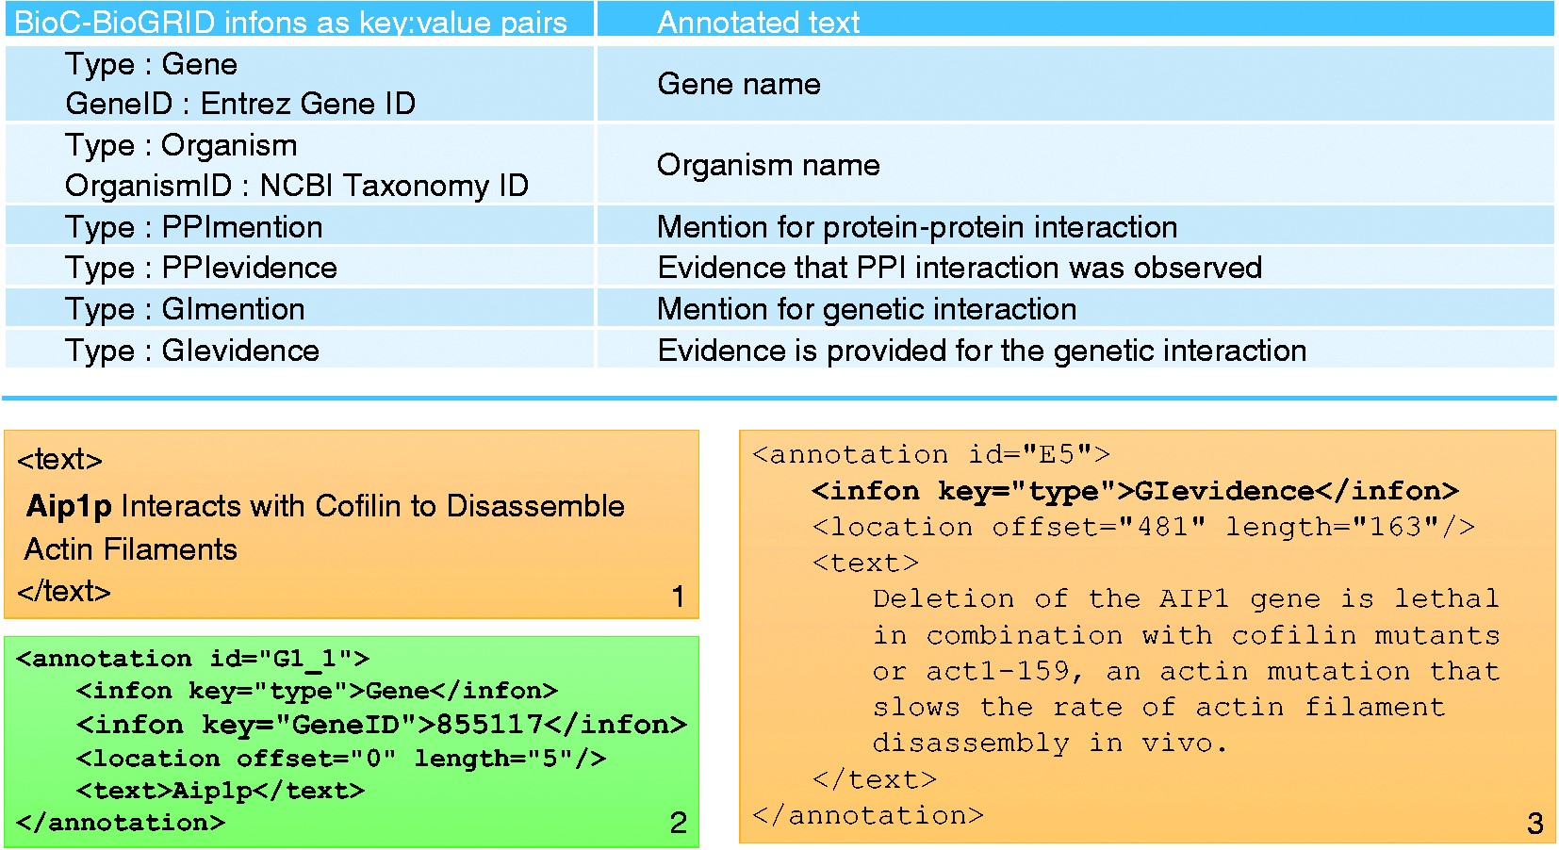
Figure 2. Summary of annotations in the BioC-BioGRID corpus. The table in the top panel lists all types of annotation ...
Notes:
Figure 2. Summary of annotations in the BioC-BioGRID corpus. The table in the top panel lists all types of annotation infons as key:value pairs, along with a short description of what each annotation describes. The bottom panel consists of three text boxes. Text box number 1 contains an example of text from a passage in a document from the corpus. Text box number 2 shows an annotation in that passage for the gene name and its GeneID. Text box number 3 contains an annotation for a GI evidence passage.
Unless provided in the caption above, the following copyright applies to the content of this slide: Published by Oxford University Press 2017. This work is written by US Government employees and is in the public domain in the US.

Slide 3
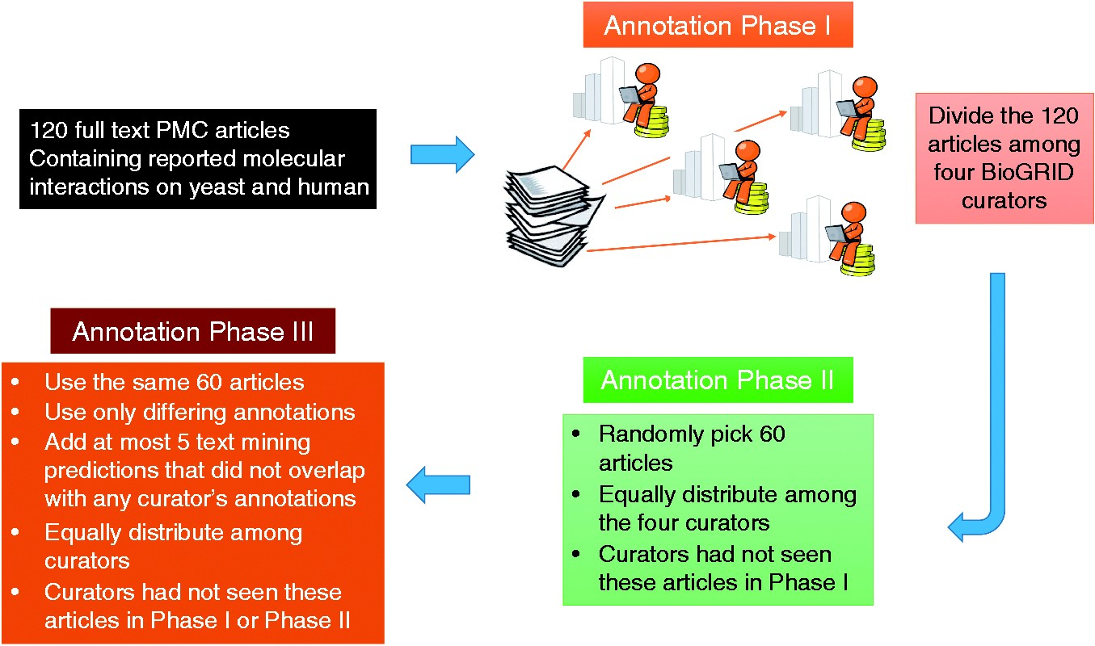
Figure 3. Annotation process for the BioC-BioGRID corpus. Phase I and II equally distributed the articles selected for ...
Notes:
Figure 3. Annotation process for the BioC-BioGRID corpus. Phase I and II equally distributed the articles selected for curation among four curators so that curators had not seen the same article before. Articles contained no annotations, and curators were asked to curate them and mark the useful interactions information using the annotation interface. During Phase III, articles were equally distributed and curators were assigned articles not seen previously. Phase III articles contained pre-highlighted passages: text-mining predictions and passages annotated by only one of the Phases I or II annotators. This annotation phase asked the curators to review the annotations and remove the ones that were not useful for curation.
Unless provided in the caption above, the following copyright applies to the content of this slide: Published by Oxford University Press 2017. This work is written by US Government employees and is in the public domain in the US.

Slide 4
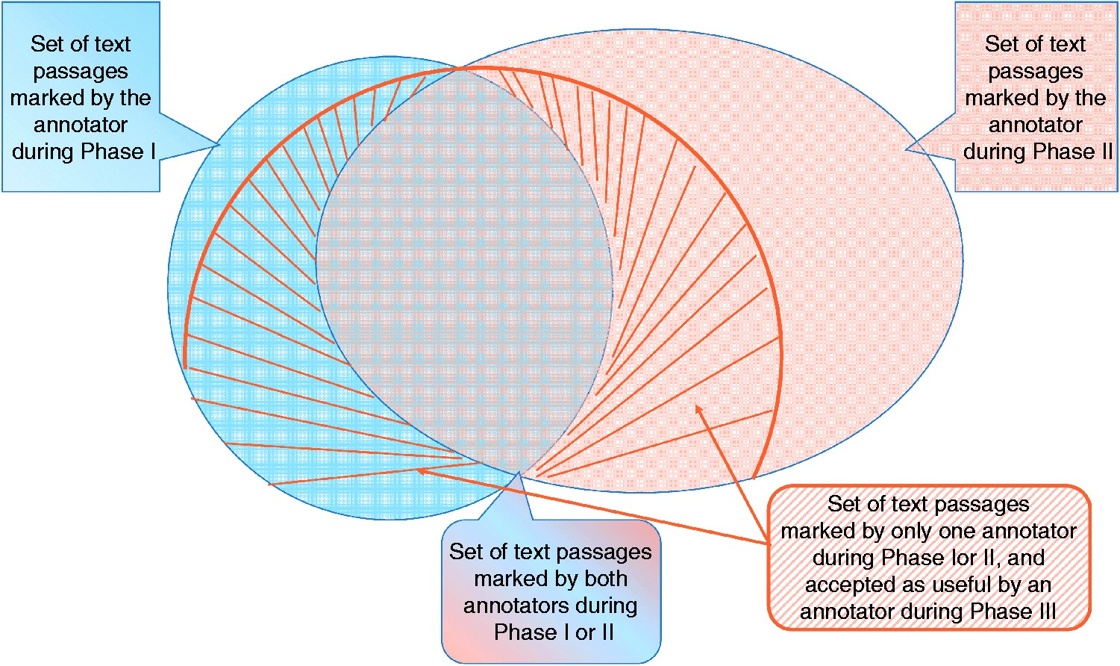
Figure 4. Graphic representation of IAA. For each article, an annotator highlighted several text passages as useful ...
Notes:
Figure 4. Graphic representation of IAA. For each article, an annotator highlighted several text passages as useful annotations for curation during Phase I. A second annotator reading the same article marked a different set of passages (Phase II). The two sets overlap, and also contain differences. Annotations of Phases I and II, which marked sentences that did not overlap, were re-assessed by two different curators in Phase III, where they decided whether that passage was useful or not. The striped area shows the set that was accepted during Phase III.
Unless provided in the caption above, the following copyright applies to the content of this slide: Published by Oxford University Press 2017. This work is written by US Government employees and is in the public domain in the US.

Slide 5
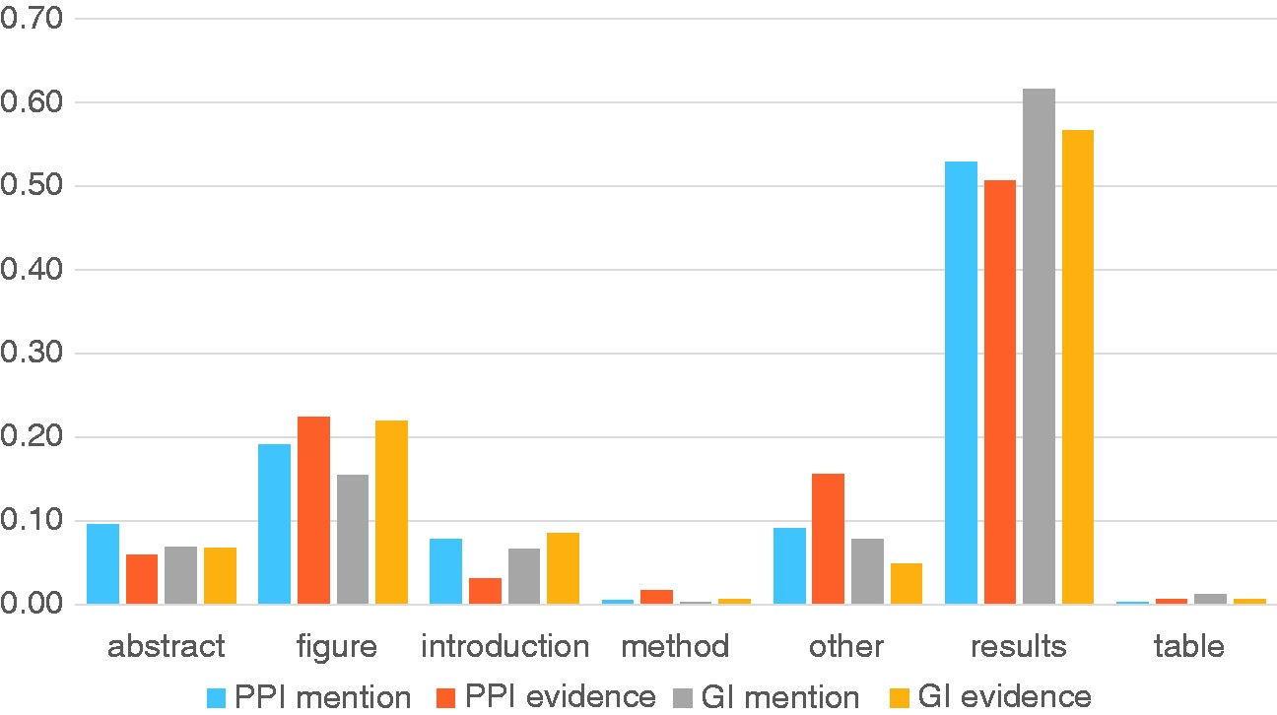
Figure 5. Analysis of section titles of full text articles showing where different annotation types are highlighted by ...
Notes:
Figure 5. Analysis of section titles of full text articles showing where different annotation types are highlighted by curators. The Y-axis shows the proportion of annotations for each annotation type.
Unless provided in the caption above, the following copyright applies to the content of this slide: Published by Oxford University Press 2017. This work is written by US Government employees and is in the public domain in the US.

