Slide 1
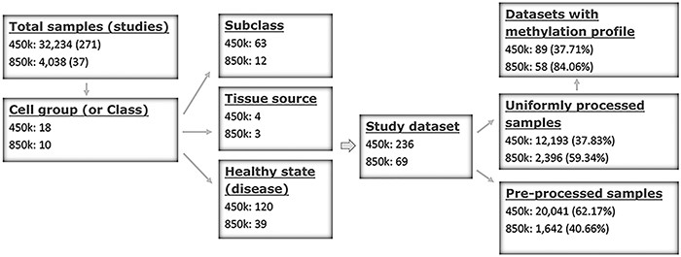
Figure 1. Sample stratification and statistics. (A) Sample or dataset counts are shown beside the platforms: for 450k, ...
Notes:
Figure 1. Sample stratification and statistics. (A) Sample or dataset counts are shown beside the platforms: for 450k, ∼37.83% (12 193/32 234) of all samples are uniformly processed, whereas, for 850k, ∼59.34% (2396/4038) of all samples are uniformly processed. In addition, ∼37.71% (89/236) and ∼84.06% (58/69) of all study datasets had methylation profiles. In total, ∼62.29% (147/236) and ∼15.94% (11/69) of all study datasets for the 450k and 850k platforms, respectively, were not uniformly processed, and for these study datasets, only the preprocessed beta values but not methylation profiles could be analyzed. For more details, please see Supplementary Tables S1 and S2.
Unless provided in the caption above, the following copyright applies to the content of this slide: © The Author(s) 2022. Published by Oxford University Press.This is an Open Access article distributed under the terms of the Creative Commons Attribution License (https://creativecommons.org/licenses/by/4.0/), which permits unrestricted reuse, distribution, and reproduction in any medium, provided the original work is properly cited.

