Slide 1
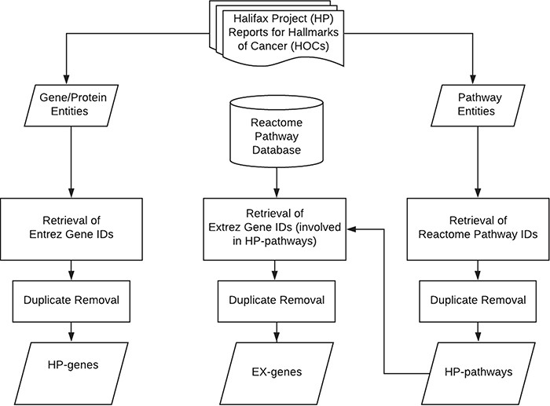
Figure 1 System flow of the curation work for hallmarks of cancer.
Notes:
Figure 1 System flow of the curation work for hallmarks of cancer.
Unless provided in the caption above, the following copyright applies to the content of this slide: © The Author(s) 2020. Published by Oxford University Press.This is an Open Access article distributed under the terms of the Creative Commons Attribution License (http://creativecommons.org/licenses/by/4.0/), which permits unrestricted reuse, distribution, and reproduction in any medium, provided the original work is properly cited.

Slide 2
Figure 2 The number of affected hallmarks of cancer (HOCs) for different groups of IARC chemicals. IARC, international ...
Notes:
Figure 2 The number of affected hallmarks of cancer (HOCs) for different groups of IARC chemicals. IARC, international agency for research on cancer; G1, IARC Group 1 chemicals; G2A, IARC Group 2A chemicals; G2B, IARC Group 2B chemicals; G3, IARC Group 3 chemicals; G4, IARC Group 4 chemicals.
Unless provided in the caption above, the following copyright applies to the content of this slide: © The Author(s) 2020. Published by Oxford University Press.This is an Open Access article distributed under the terms of the Creative Commons Attribution License (http://creativecommons.org/licenses/by/4.0/), which permits unrestricted reuse, distribution, and reproduction in any medium, provided the original work is properly cited.

Slide 3
Figure 3 The number of affected hallmarks of cancer (HOCs) for different groups of National Toxicology Program ...
Notes:
Figure 3 The number of affected hallmarks of cancer (HOCs) for different groups of National Toxicology Program chemicals. NTP, National Toxicology Program; KHC, known to be a human carcinogen; RAHC, reasonably anticipated to be a human carcinogen.
Unless provided in the caption above, the following copyright applies to the content of this slide: © The Author(s) 2020. Published by Oxford University Press.This is an Open Access article distributed under the terms of the Creative Commons Attribution License (http://creativecommons.org/licenses/by/4.0/), which permits unrestricted reuse, distribution, and reproduction in any medium, provided the original work is properly cited.

Slide 4
Figure 4 The number of affected hallmarks of cancer (HOCs) for different groups of Environmental Protection Agency ...
Notes:
Figure 4 The number of affected hallmarks of cancer (HOCs) for different groups of Environmental Protection Agency chemicals. EPA, Environmental Protection Agency; A, Group A chemicals after regroup chemicals classes that previously classified based on the EPA guidelines published in 1986 or 2005; B, Group B; C, Group C; D, Group D; E, Group E.
Unless provided in the caption above, the following copyright applies to the content of this slide: © The Author(s) 2020. Published by Oxford University Press.This is an Open Access article distributed under the terms of the Creative Commons Attribution License (http://creativecommons.org/licenses/by/4.0/), which permits unrestricted reuse, distribution, and reproduction in any medium, provided the original work is properly cited.

