Slide 1
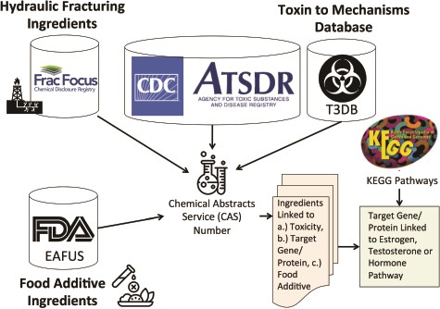
Figure 2 Method for linking hydraulic fracturing ingredients (i.e. chemicals) with information on toxicity (ATSDR), ...
Notes:
Figure 2 Method for linking hydraulic fracturing ingredients (i.e. chemicals) with information on toxicity (ATSDR), gene and protein targets (T3DB) and food additives Everything Added to Food in USA (EAFUS). We linked the hydraulic fracturing ingredients to information on toxicity, gene and protein targets for each chemical and whether or not the chemical was a food additive using their Chemical Abstracts Service (CAS) numbers. We further linked the gene/proteins to estrogen, testosterone or hormone pathways using KEGG pathways.
Unless provided in the caption above, the following copyright applies to the content of this slide: © The Author(s) 2020. Published by Oxford University Press.This is an Open Access article distributed under the terms of the Creative Commons Attribution License (http://creativecommons.org/licenses/by/4.0/), which permits unrestricted reuse, distribution, and reproduction in any medium, provided the original work is properly cited.

