Slide 1
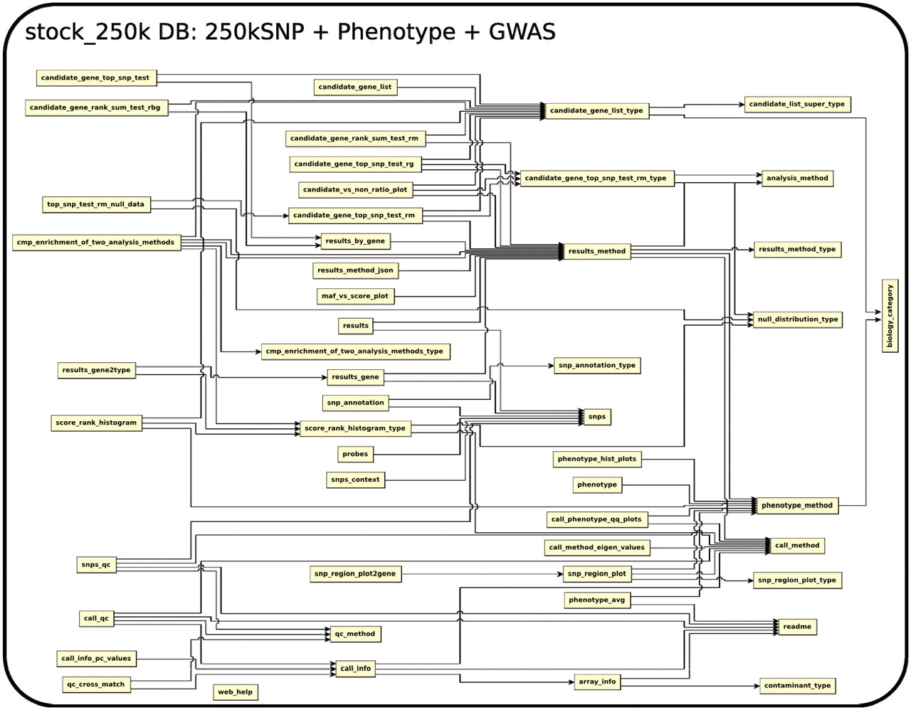
Figure 1. The relationship among tables in subdatabase stock_250k.
Notes:
Figure 1. The relationship among tables in subdatabase stock_250k.
Unless provided in the caption above, the following copyright applies to the content of this slide: © The Author(s) 2011. Published by Oxford University Press.This is Open Access article distributed under the terms of the Creative Commons Attribution Non-Commercial License (http://creativecommons.org/licenses/by-nc/2.5), which permits unrestricted non-commercial use, distribution, and reproduction in any medium, provided the original work is properly cited.

Slide 2
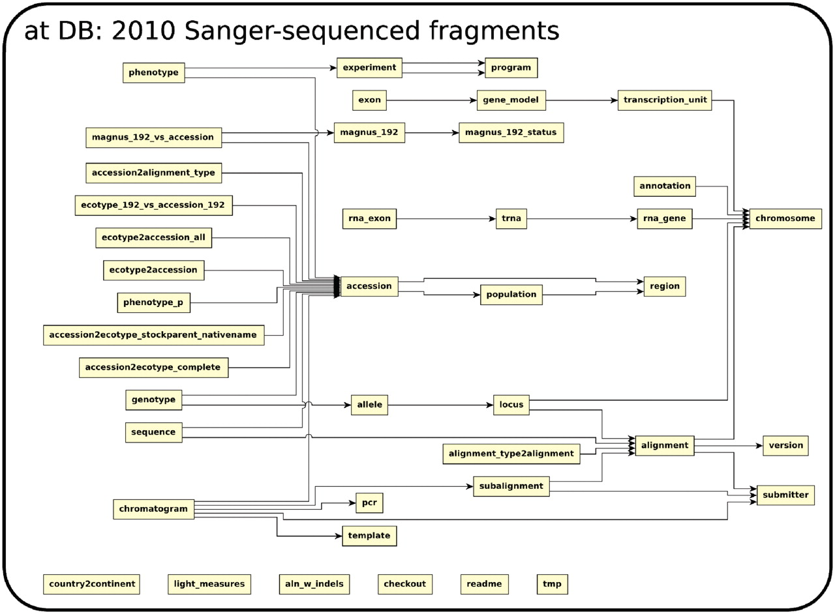
Figure 2. The relationship among tables in subdatabase at.
Notes:
Figure 2. The relationship among tables in subdatabase at.
Unless provided in the caption above, the following copyright applies to the content of this slide: © The Author(s) 2011. Published by Oxford University Press.This is Open Access article distributed under the terms of the Creative Commons Attribution Non-Commercial License (http://creativecommons.org/licenses/by-nc/2.5), which permits unrestricted non-commercial use, distribution, and reproduction in any medium, provided the original work is properly cited.

Slide 3
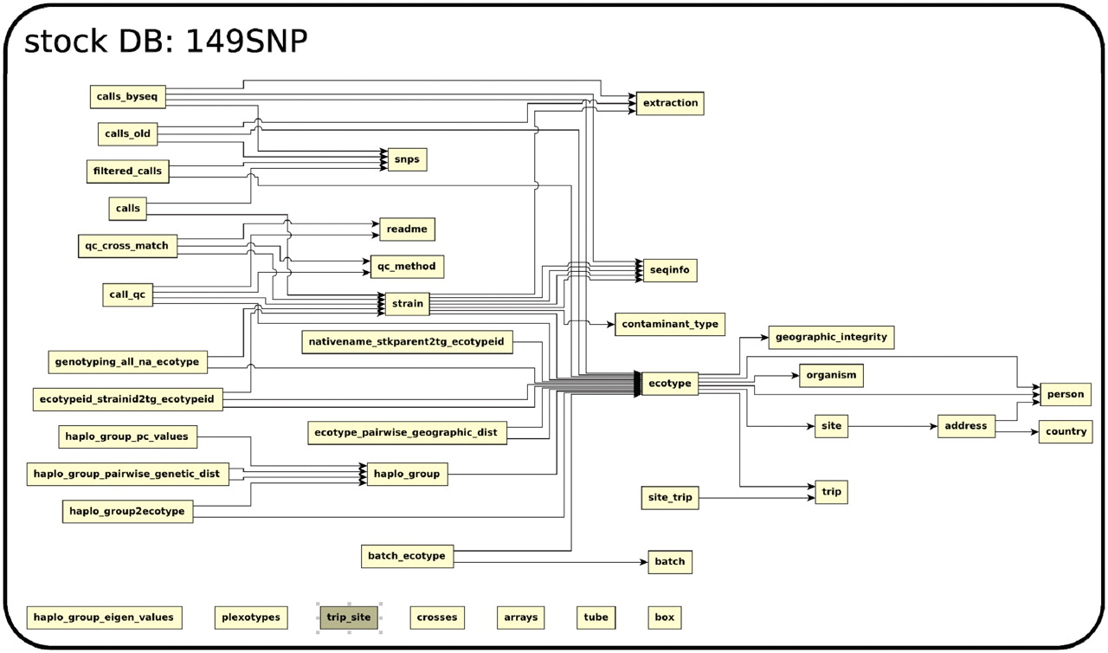
Figure 3. The relationship among tables in subdatabase stock.
Notes:
Figure 3. The relationship among tables in subdatabase stock.
Unless provided in the caption above, the following copyright applies to the content of this slide: © The Author(s) 2011. Published by Oxford University Press.This is Open Access article distributed under the terms of the Creative Commons Attribution Non-Commercial License (http://creativecommons.org/licenses/by-nc/2.5), which permits unrestricted non-commercial use, distribution, and reproduction in any medium, provided the original work is properly cited.

Slide 4
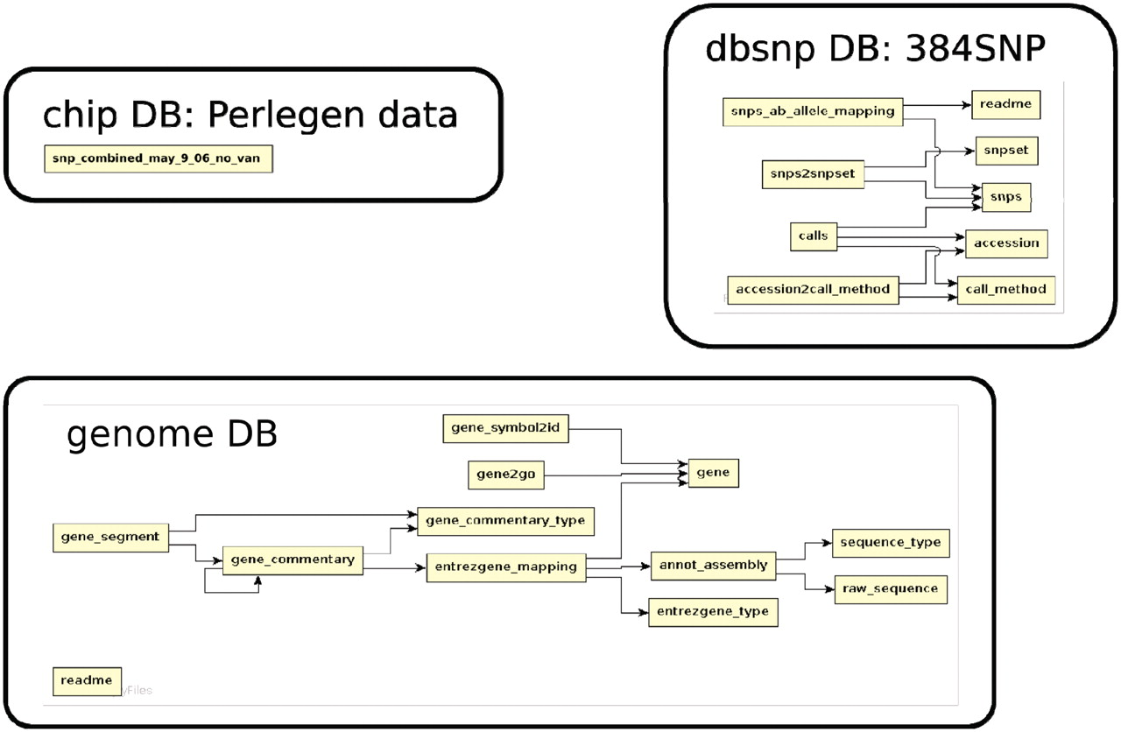
Figure 4. The relationship among tables in subdatabase chip, dbsnp and genome.
Notes:
Figure 4. The relationship among tables in subdatabase chip, dbsnp and genome.
Unless provided in the caption above, the following copyright applies to the content of this slide: © The Author(s) 2011. Published by Oxford University Press.This is Open Access article distributed under the terms of the Creative Commons Attribution Non-Commercial License (http://creativecommons.org/licenses/by-nc/2.5), which permits unrestricted non-commercial use, distribution, and reproduction in any medium, provided the original work is properly cited.

Slide 5
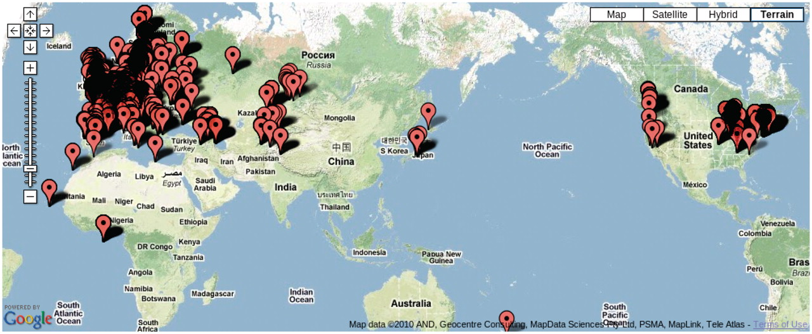
Figure 5. Map showing the location of 7075 accessions genotyped in the 149SNP data set.
Notes:
Figure 5. Map showing the location of 7075 accessions genotyped in the 149SNP data set.
Unless provided in the caption above, the following copyright applies to the content of this slide: © The Author(s) 2011. Published by Oxford University Press.This is Open Access article distributed under the terms of the Creative Commons Attribution Non-Commercial License (http://creativecommons.org/licenses/by-nc/2.5), which permits unrestricted non-commercial use, distribution, and reproduction in any medium, provided the original work is properly cited.

Slide 6
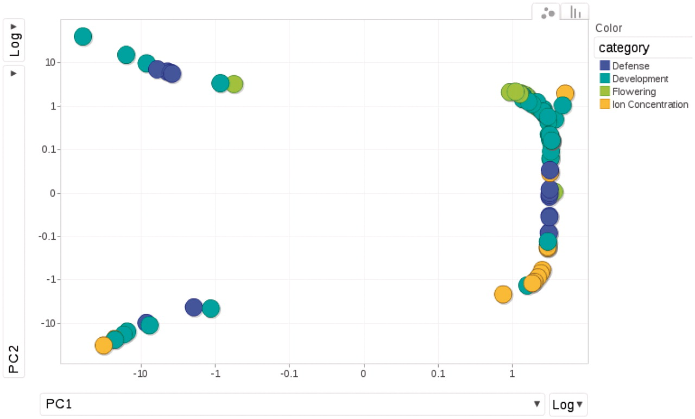
Figure 6. Relationships among phenotypes is plotted by the first and second princi pal components from PCA (Principal ...
Notes:
Figure 6. Relationships among phenotypes is plotted by the first and second princi pal components from PCA (Principal Component Analysis). Each dot represents one phenotype, colored according to the category to which it belongs.
Unless provided in the caption above, the following copyright applies to the content of this slide: © The Author(s) 2011. Published by Oxford University Press.This is Open Access article distributed under the terms of the Creative Commons Attribution Non-Commercial License (http://creativecommons.org/licenses/by-nc/2.5), which permits unrestricted non-commercial use, distribution, and reproduction in any medium, provided the original work is properly cited.

Slide 7
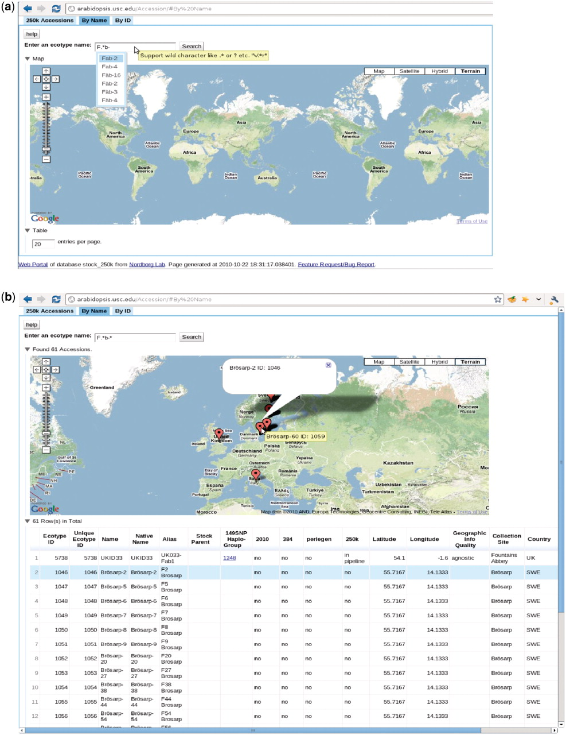
Figure 7. http://arabidopsis.usc.edu/Accession/ (a) Accession search interface, with auto-completion in action and ...
Notes:
Figure 7. http://arabidopsis.usc.edu/Accession/ (a) Accession search interface, with auto-completion in action and support of regular-expression search. (b) Table of accessions returned.
Unless provided in the caption above, the following copyright applies to the content of this slide: © The Author(s) 2011. Published by Oxford University Press.This is Open Access article distributed under the terms of the Creative Commons Attribution Non-Commercial License (http://creativecommons.org/licenses/by-nc/2.5), which permits unrestricted non-commercial use, distribution, and reproduction in any medium, provided the original work is properly cited.

Slide 8
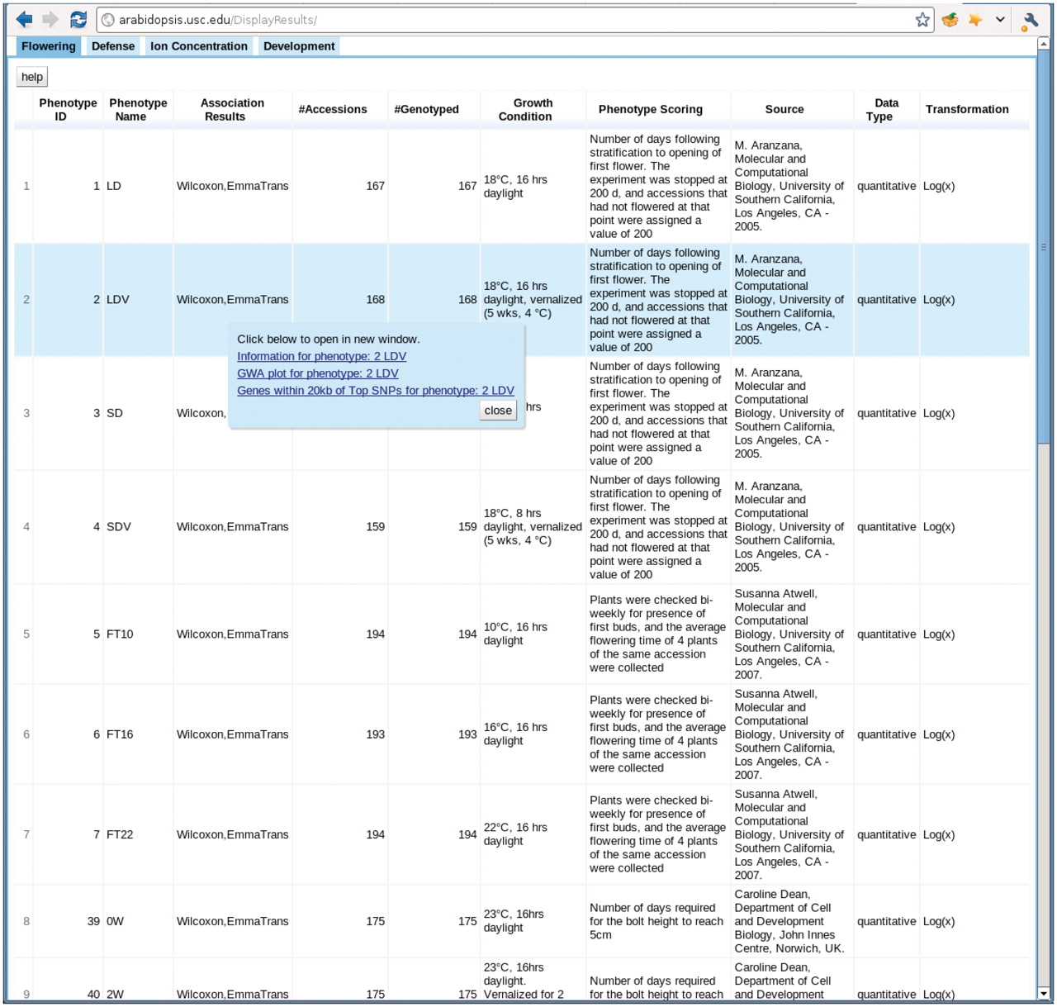
Figure 8. http://arabidopsis.usc.edu/DisplayResults/ One tab for each category of phenotypes. Under each tab is a ...
Notes:
Figure 8. http://arabidopsis.usc.edu/DisplayResults/ One tab for each category of phenotypes. Under each tab is a dynamic table filled with phenotypes. Clicking on each phenotype shows a popup with links to detailed phenotype information, GWAS plots (Figure 7) and genes adjacent to top associations.
Unless provided in the caption above, the following copyright applies to the content of this slide: © The Author(s) 2011. Published by Oxford University Press.This is Open Access article distributed under the terms of the Creative Commons Attribution Non-Commercial License (http://creativecommons.org/licenses/by-nc/2.5), which permits unrestricted non-commercial use, distribution, and reproduction in any medium, provided the original work is properly cited.

Slide 9
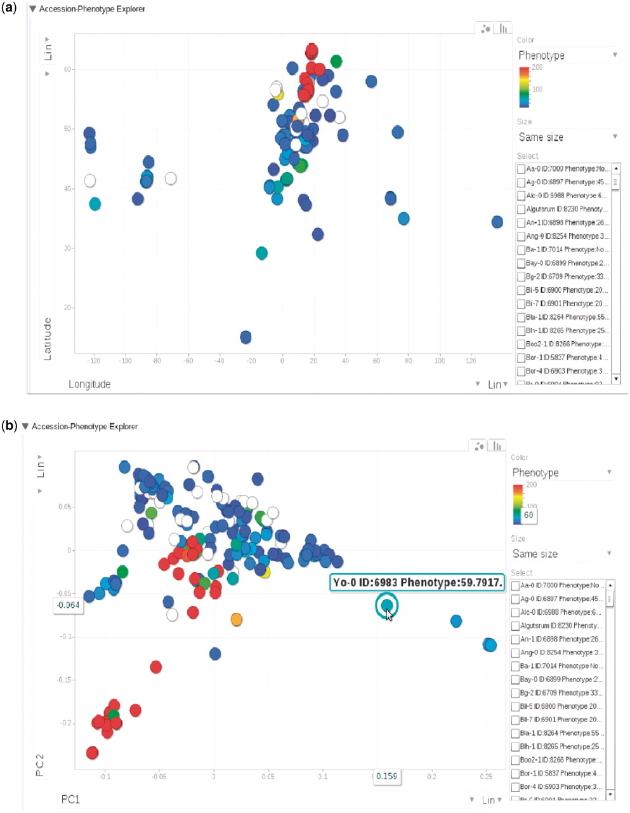
Figure 9. (a) Phenotype for each accession, represented by dots, plotted by longitude and latitude. The plot is ...
Notes:
Figure 9. (a) Phenotype for each accession, represented by dots, plotted by longitude and latitude. The plot is visualized through Google Motion Chart. (b) Change the two axes in (a) to the first two principal components from PCA analysis on the genotype matrix. Mouse-over or clicking each dot in the chart displays the information for that accession. This dynamic widget is available in any phenotype page. The example used here is at http://arabidopsis.usc.edu/DisplayResults/showGWA?call_method_id=32&phenotype_method_id=1.
Unless provided in the caption above, the following copyright applies to the content of this slide: © The Author(s) 2011. Published by Oxford University Press.This is Open Access article distributed under the terms of the Creative Commons Attribution Non-Commercial License (http://creativecommons.org/licenses/by-nc/2.5), which permits unrestricted non-commercial use, distribution, and reproduction in any medium, provided the original work is properly cited.

Slide 10
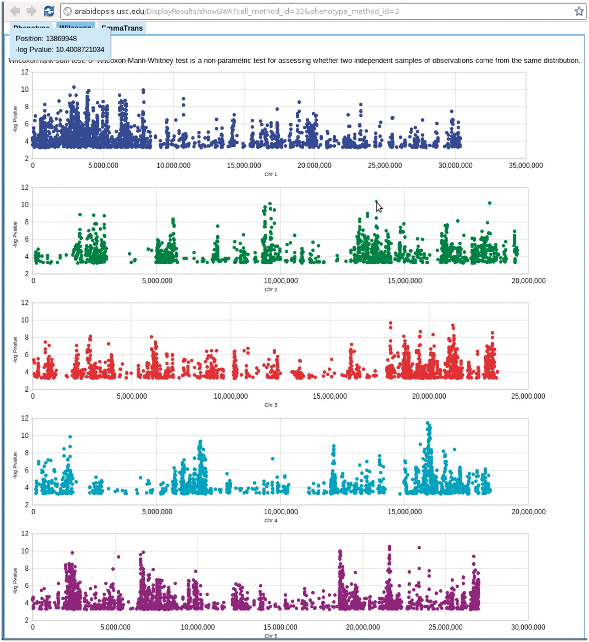
Figure 10. Genome-wide association P-values plot. Mouse-over each dot shows the position and P-value of the SNP. ...
Notes:
Figure 10. Genome-wide association P-values plot. Mouse-over each dot shows the position and P-value of the SNP. Clicking each dot results an 80 kb zoom-in SNP page (Figure 8). This visualization is done by Google Visualization Scatter Chart. This visualization is available in any phenotype page. The example used here is at http://arabidopsis.usc.edu/DisplayResults/showGWA?call_method_id=32&phenotype_method_id=2.
Unless provided in the caption above, the following copyright applies to the content of this slide: © The Author(s) 2011. Published by Oxford University Press.This is Open Access article distributed under the terms of the Creative Commons Attribution Non-Commercial License (http://creativecommons.org/licenses/by-nc/2.5), which permits unrestricted non-commercial use, distribution, and reproduction in any medium, provided the original work is properly cited.

Slide 11
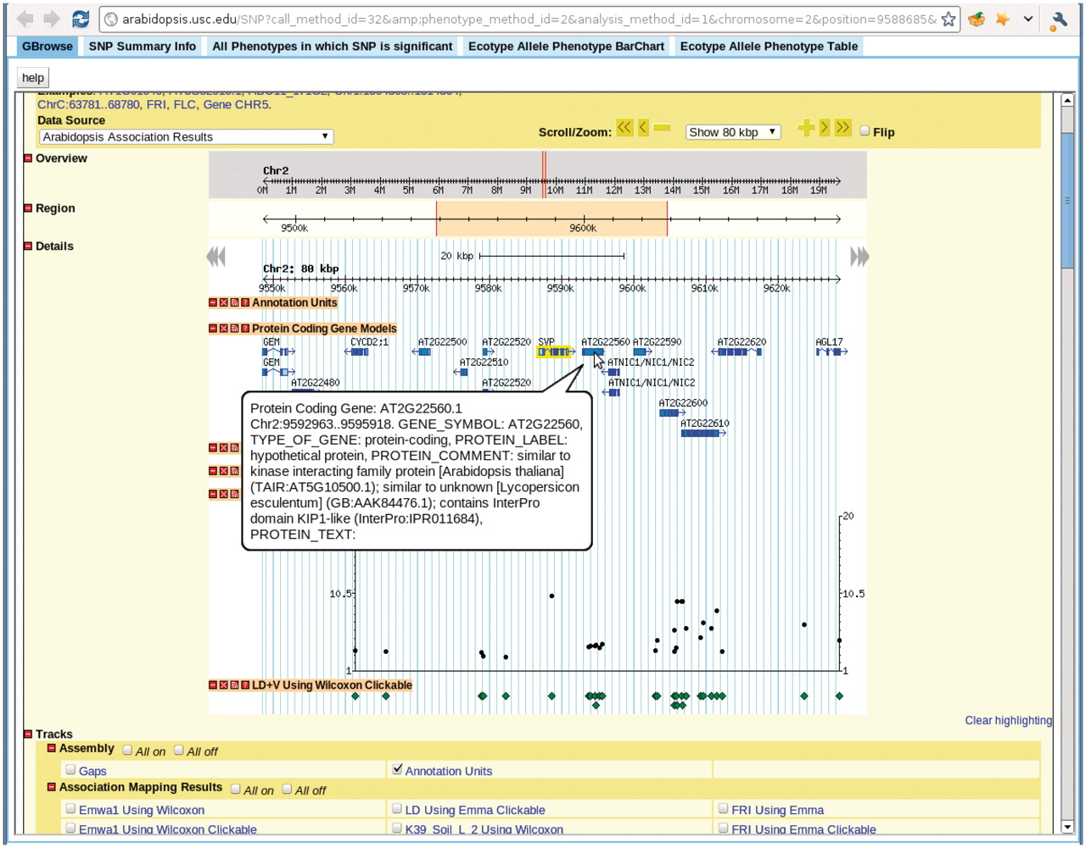
Figure 11. View for the SNP selected in Figure 7. There are five tabs in the view. First tab, GBrowse, is a close-up of ...
Notes:
Figure 11. View for the SNP selected in Figure 7. There are five tabs in the view. First tab, GBrowse, is a close-up of the association around the SNP. The ‘SNP Summary Info’ tab lists the position, P-value, annotation of the SNP. The ‘All Phenotypes in which SNP is significant’ tab lists other phenotypes in which this SNP is among the top 1000 associations. The ‘Ecotype Allele Phenotype BarChart’ is described in Figure 9. The ‘Ecotype Allele Phenotype Table’ is a table listing which accession carries which allele and the corresponding phenotype. This example is from http://arabidopsis.gmi.oeaw.ac.at:5000/SNP/?call_method_id=32&amp;phenotype_method_id=2&analysis_method_id=1&chromosome=2&position=9588685&score=10.1255444864.
Unless provided in the caption above, the following copyright applies to the content of this slide: © The Author(s) 2011. Published by Oxford University Press.This is Open Access article distributed under the terms of the Creative Commons Attribution Non-Commercial License (http://creativecommons.org/licenses/by-nc/2.5), which permits unrestricted non-commercial use, distribution, and reproduction in any medium, provided the original work is properly cited.

Slide 12
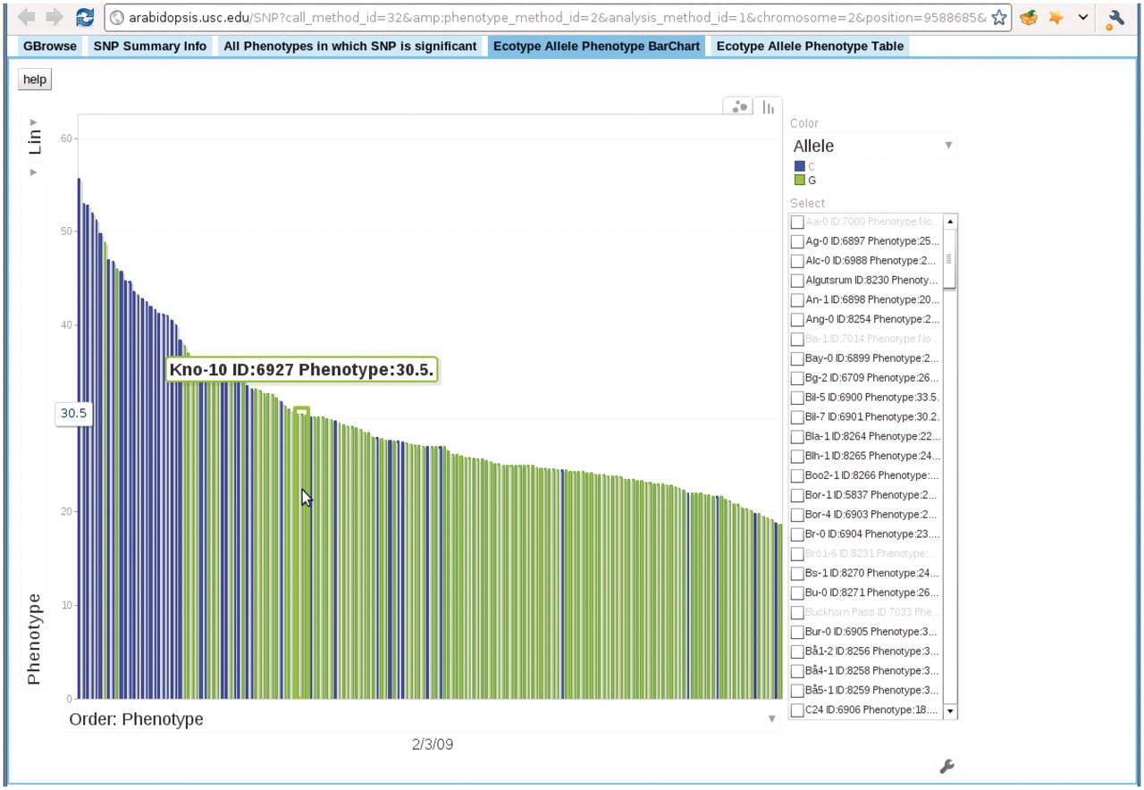
Figure 12. Bar chart depicting the correspondence between accession allele and phenotype. In this bar chart, each bar ...
Notes:
Figure 12. Bar chart depicting the correspondence between accession allele and phenotype. In this bar chart, each bar represents an accession and is colored according to the allele the accession carries. The height of each bar corresponds to the phenotype of the accession. All accessions are sorted horizontally according to their phenotype. Mouse-over each bar displays the information of that accession. This example is from the ‘Ecotype Allele Phenotype Barchart’ tab of http://arabidopsis.gmi.oeaw.ac.at:5000/SNP/?call_method_id=32&amp;phenotype_method_id=2&analysis_method_id=1&chromosome=2&position=9588685&score=10.1255444864.
Unless provided in the caption above, the following copyright applies to the content of this slide: © The Author(s) 2011. Published by Oxford University Press.This is Open Access article distributed under the terms of the Creative Commons Attribution Non-Commercial License (http://creativecommons.org/licenses/by-nc/2.5), which permits unrestricted non-commercial use, distribution, and reproduction in any medium, provided the original work is properly cited.

Slide 13
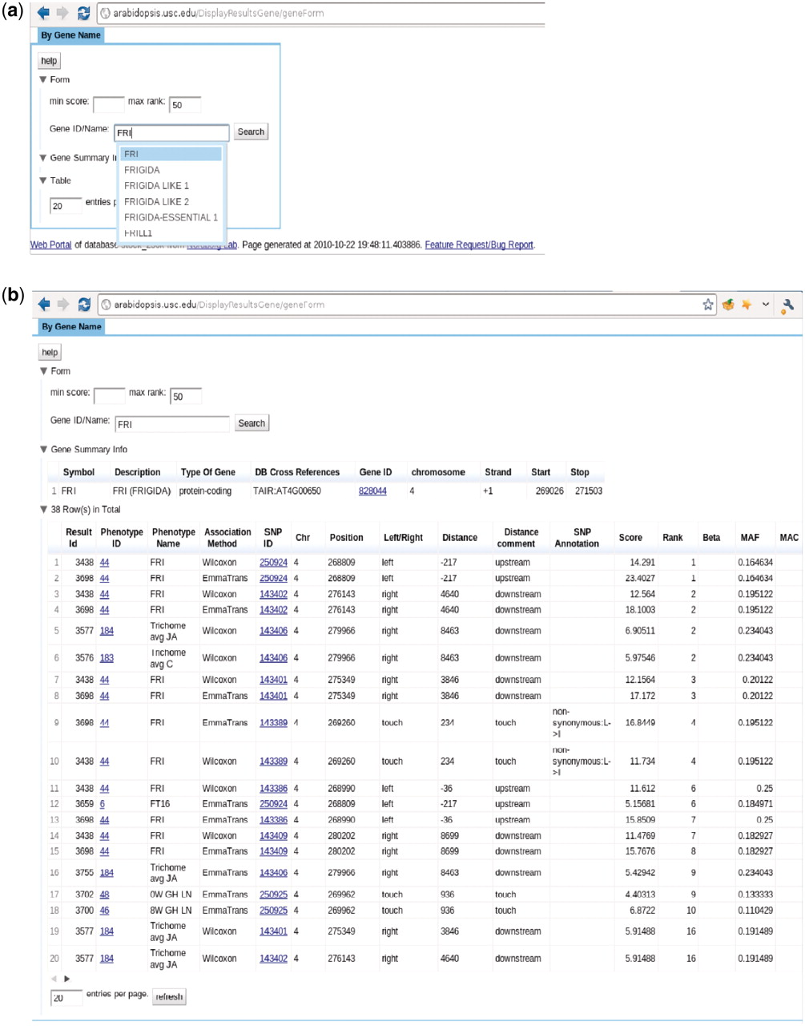
Figure 13. http://arabidopsis.usc.edu/DisplayResultsGene/geneForm/ (a) Search GWAS by gene name with auto-completion in ...
Notes:
Figure 13. http://arabidopsis.usc.edu/DisplayResultsGene/geneForm/ (a) Search GWAS by gene name with auto-completion in action. (b) Table returned from the search.
Unless provided in the caption above, the following copyright applies to the content of this slide: © The Author(s) 2011. Published by Oxford University Press.This is Open Access article distributed under the terms of the Creative Commons Attribution Non-Commercial License (http://creativecommons.org/licenses/by-nc/2.5), which permits unrestricted non-commercial use, distribution, and reproduction in any medium, provided the original work is properly cited.

Slide 14
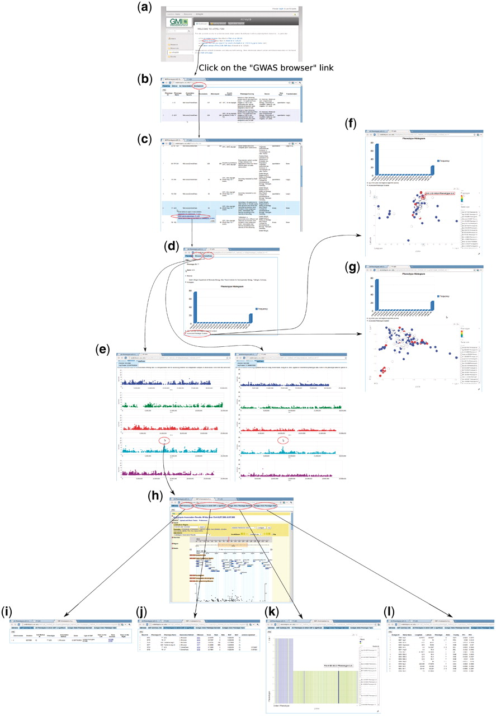
Figure 14. Forward genetics example. The trait of interest is LES (lesioning), which measures the presence of necrotic ...
Notes:
Figure 14. Forward genetics example. The trait of interest is LES (lesioning), which measures the presence of necrotic spots in normal plant leaves. The quest for its underlying genetic cause starts from http://arabidopsis.usc.edu/ (a). Then the researcher finds the trait in the table containing all phenotypes (b and c). Clicking the GWA plot item in the popup menu leads to the phenotype page containing a histogram (d) and genome-wide association plots by two different analysis methods, one that corrects for population structure; the other that does not (e). By clicking the ‘Accession-Phenotype Explorer’ in the phenotype page (d), the user could also explore the geographic distribution of phenotype (f) or check whether the phenotype is confounded by population structure by changing the axis to principal components (g). In this case, there is no population structure confounding, confirmed by the concordance between results by two different analysis methods (e). Clicking the most significant SNP in the association plot (e) leads the user to the SNP page, which displays a zoom-in association plot under the default tab (h). Combined with this SNP’s summary information (i), it points out gene ACD6 as the likely causal locus. The researcher can then find out whether this locus is strongly associated with other phenotypes (j), visually inspect how the phenotype is correlated with two alleles (k), and find out which accession carries which allele to pick accessions for downstream analysis (l).
Unless provided in the caption above, the following copyright applies to the content of this slide: © The Author(s) 2011. Published by Oxford University Press.This is Open Access article distributed under the terms of the Creative Commons Attribution Non-Commercial License (http://creativecommons.org/licenses/by-nc/2.5), which permits unrestricted non-commercial use, distribution, and reproduction in any medium, provided the original work is properly cited.

Slide 15
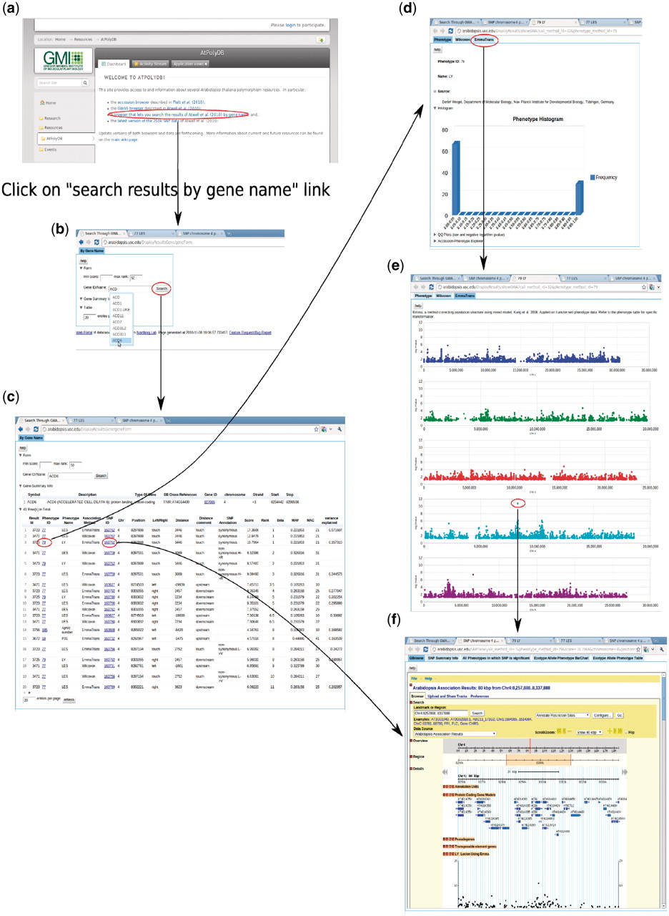
Figure 15. Backward genetics example. The gene of interest is ACD6. It starts from http://arabidopsis.usc.edu (a). Type ...
Notes:
Figure 15. Backward genetics example. The gene of interest is ACD6. It starts from http://arabidopsis.usc.edu (a). Type the gene name in the search-GWAS-by-gene-name interface (b). Auto-completion is supported in case the researcher remembers only part of the name. The interface returns one table containing information about the gene, another table which includes all the associations ranked top in certain phenotypes (c), determined by the ‘max rank’ threshold in the interface. Then user can click either the phenotype ID to go to the phenotype page (d), which leads to a genome-wide association plot (e) as in Figure 10 or the SNP ID to go to the SNP page (f) directly.
Unless provided in the caption above, the following copyright applies to the content of this slide: © The Author(s) 2011. Published by Oxford University Press.This is Open Access article distributed under the terms of the Creative Commons Attribution Non-Commercial License (http://creativecommons.org/licenses/by-nc/2.5), which permits unrestricted non-commercial use, distribution, and reproduction in any medium, provided the original work is properly cited.

Slide 16
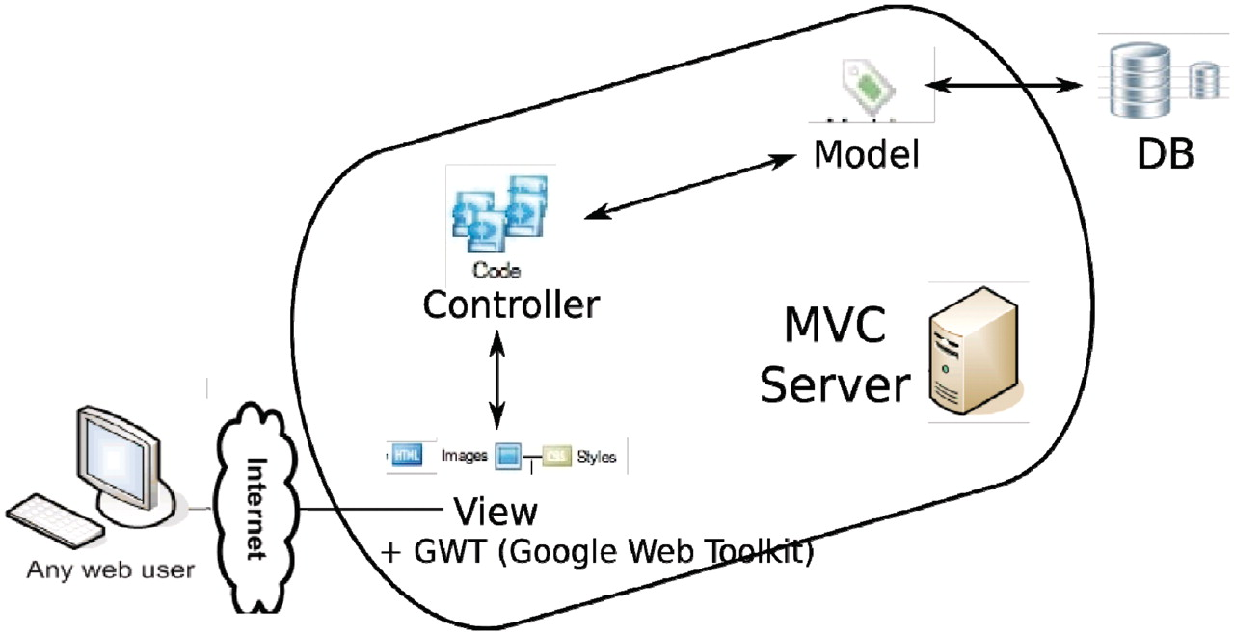
Figure 16. Overall architecture of the web app. An MVC (model-view-controller ...
Notes:
Figure 16. Overall architecture of the web app. An MVC (model-view-controller http://en.wikipedia.org/wiki/Model%E2%80%93view%E2%80%93controller) server, built out of pylons, is employed to separate the logic (model + controller) and user interface (view). The interaction between the MVC server and database server is facilitated by an ORM (object relational mapper) model. GWT is added to the view to enhance the user client experience.
Unless provided in the caption above, the following copyright applies to the content of this slide: © The Author(s) 2011. Published by Oxford University Press.This is Open Access article distributed under the terms of the Creative Commons Attribution Non-Commercial License (http://creativecommons.org/licenses/by-nc/2.5), which permits unrestricted non-commercial use, distribution, and reproduction in any medium, provided the original work is properly cited.

