Slide 1
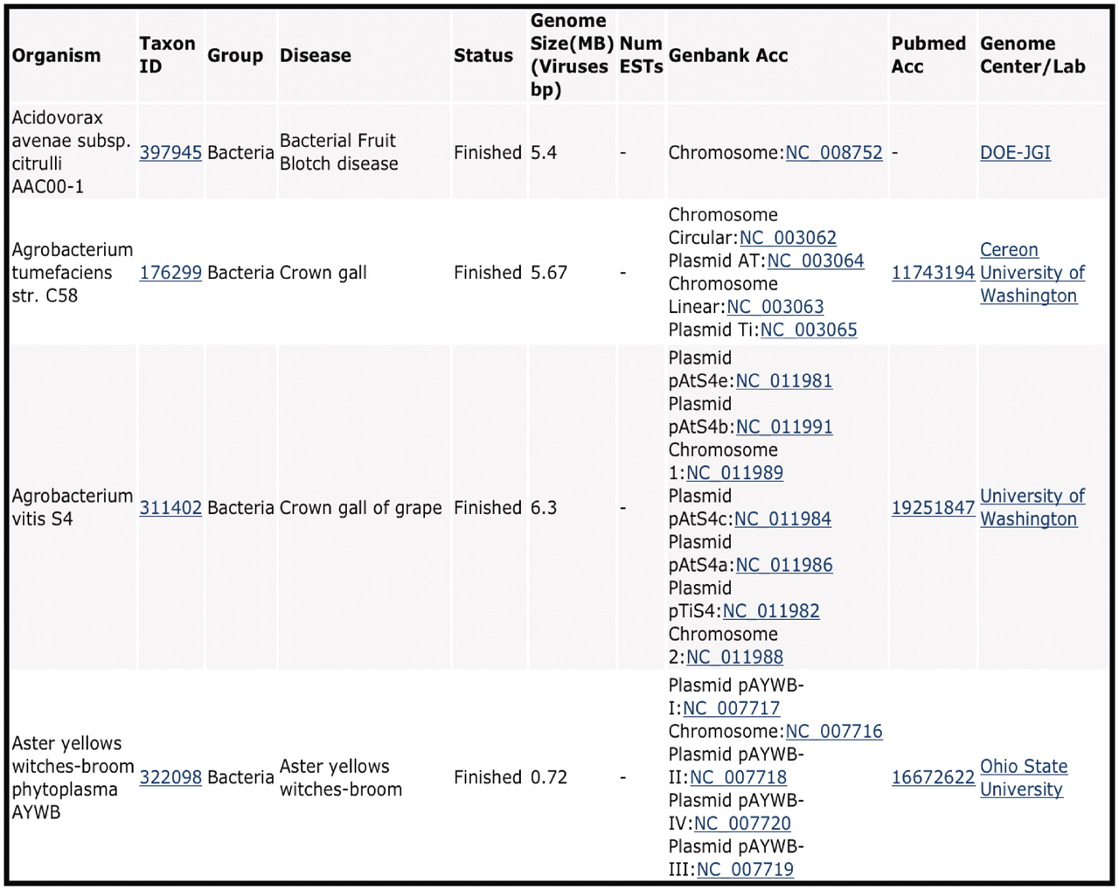
Figure 1. CPGR Warehouse. Output derived from filtering the CPGR Warehouse for bacterial genome projects. The output ...
Notes:
Figure 1. CPGR Warehouse. Output derived from filtering the CPGR Warehouse for bacterial genome projects. The output has been alphabetized based on the organism name and only the first four genome projects are listed. The organism name including strain designation, NCBI Taxon ID (http://www.ncbi.nlm.nih.gov/taxonomy), warehouse group, disease, genome status, genome size, number of ESTs (none in this example as these are genome projects), GenBank accession numbers hyperlinked to GenBank http://www.ncbi.nlm.nih.gov/genbank/), Pubmed accession numbers hyperlinked to Pubmed (http://www.ncbi.nlm.nih.gov/pubmed) and the Genome Center or laboratory that completed the work are provided in the output.
Unless provided in the caption above, the following copyright applies to the content of this slide: © The Author(s) 2011. Published by Oxford University Press.This is an Open Access article distributed under the terms of the Creative Commons Attribution Non-Commercial License (http://creativecommons.org/licenses/by-nc/3.0), which permits unrestricted non-commercial use, distribution, and reproduction in any medium, provided the original work is properly cited.

Slide 2
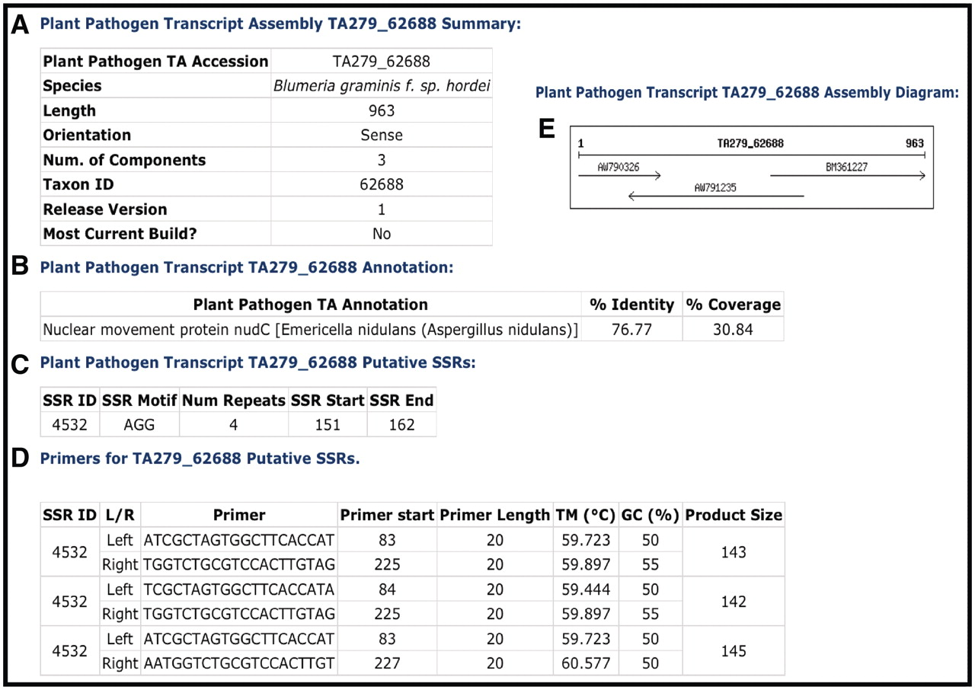
Figure 2. Example of a CPGR plant pathogen transcript assembly. (A) Summary metrics on Blumeria graminis f. sp. hordei ...
Notes:
Figure 2. Example of a CPGR plant pathogen transcript assembly. (A) Summary metrics on Blumeria graminis f. sp. hordei TA279_62688. (B) Annotation of TA279_62688. (C) Putative simple sequence repeats for TA279_62688. (D) Primers predicted with Primer3 for putative SSR 4532. (E) Assembly diagram for TA279_62688.
Unless provided in the caption above, the following copyright applies to the content of this slide: © The Author(s) 2011. Published by Oxford University Press.This is an Open Access article distributed under the terms of the Creative Commons Attribution Non-Commercial License (http://creativecommons.org/licenses/by-nc/3.0), which permits unrestricted non-commercial use, distribution, and reproduction in any medium, provided the original work is properly cited.

Slide 3
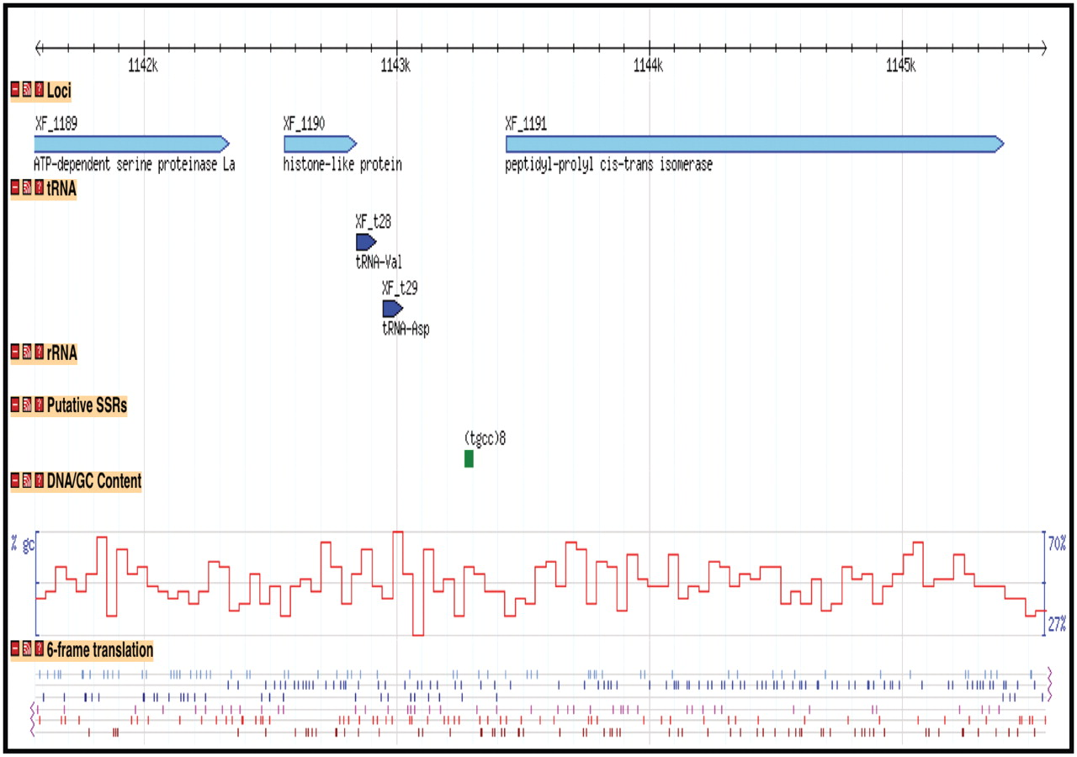
Figure 3. Display of bacterial genome through Genome Browser. A region of the Xylella fastidiosa 9a5c chromosome is ...
Notes:
Figure 3. Display of bacterial genome through Genome Browser. A region of the Xylella fastidiosa 9a5c chromosome is displayed with tracks representing the loci, tRNA genes, putative Simple Sequence Repeats, GC content and 6-frame translation.
Unless provided in the caption above, the following copyright applies to the content of this slide: © The Author(s) 2011. Published by Oxford University Press.This is an Open Access article distributed under the terms of the Creative Commons Attribution Non-Commercial License (http://creativecommons.org/licenses/by-nc/3.0), which permits unrestricted non-commercial use, distribution, and reproduction in any medium, provided the original work is properly cited.

Slide 4
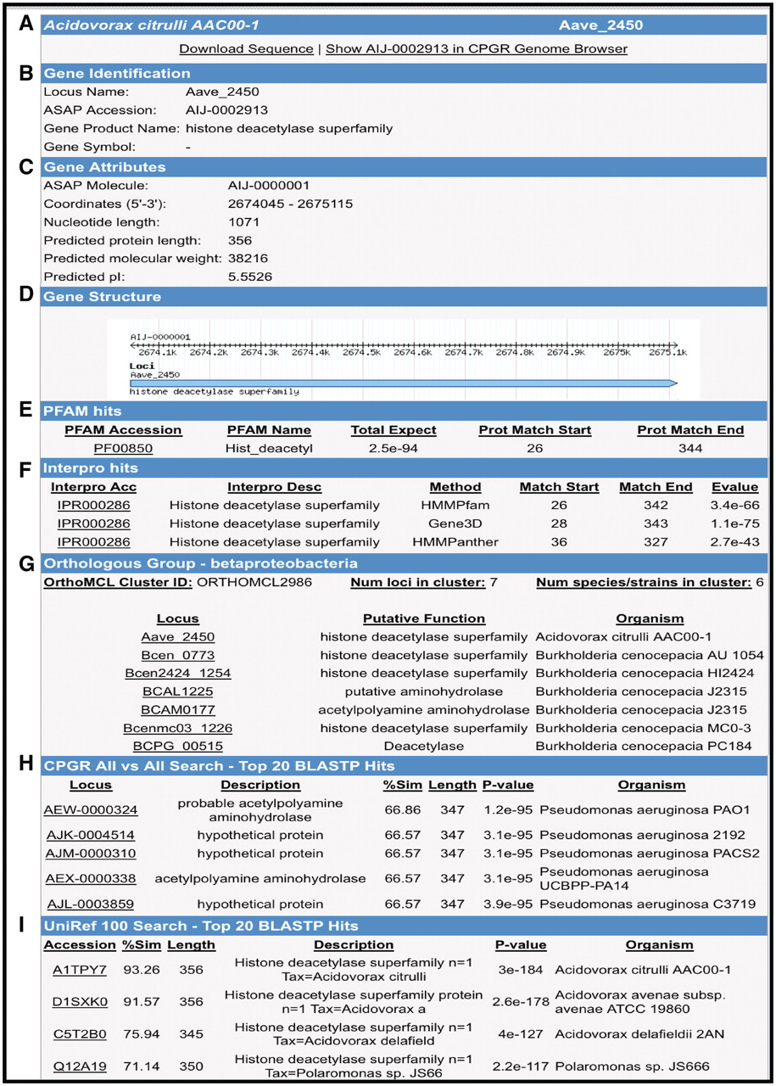
Figure 4. Gene Report Page for Acidovorax avenae subsp. citrulli AAC00-1 Aave_2450. (A) Hyperlinks to download gene ...
Notes:
Figure 4. Gene Report Page for Acidovorax avenae subsp. citrulli AAC00-1 Aave_2450. (A) Hyperlinks to download gene sequence and genome browser display of the locus. (B) Locus name, functional annotation and gene name (if available). (C) Gene attributes including molecule location (chromosome, plasmid), coordinates and protein metrics. (D) Gene structure. (E) Pfam domain matches with scores. (F) InterPro hits including position of matches and E-value. (G) Orthologous groups from β-Proteobacteria clustering. (H) BLASTP search results from an all versus search of bacterial proteins within the CPGR. (I) Partial listing of UniRef100 top matches.
Unless provided in the caption above, the following copyright applies to the content of this slide: © The Author(s) 2011. Published by Oxford University Press.This is an Open Access article distributed under the terms of the Creative Commons Attribution Non-Commercial License (http://creativecommons.org/licenses/by-nc/3.0), which permits unrestricted non-commercial use, distribution, and reproduction in any medium, provided the original work is properly cited.

Slide 5
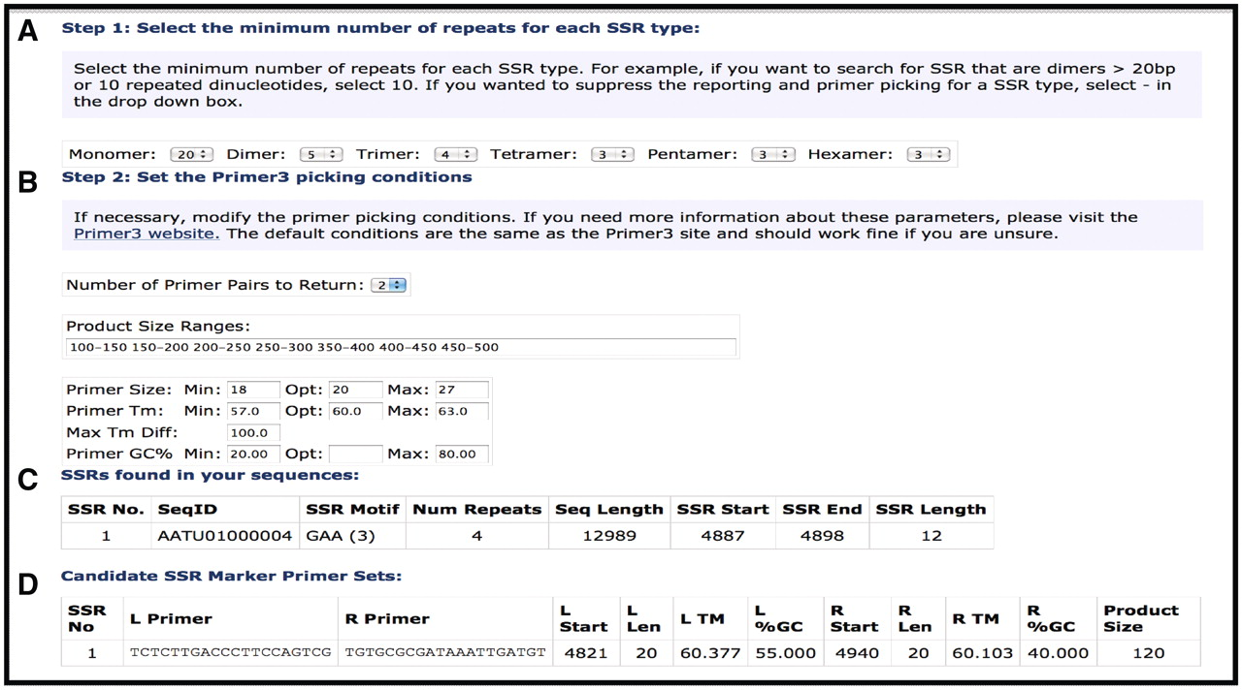
Figure 5. Simple Sequence Repeat search tool. (A) Selection options for SSR type and length. (B) Primer selection ...
Notes:
Figure 5. Simple Sequence Repeat search tool. (A) Selection options for SSR type and length. (B) Primer selection criteria for putative SSRs. (C) SSR Report page showing SSRs identified, motif, number of motifs and position of start/stop. (D) Predicted primers for putative SSR.
Unless provided in the caption above, the following copyright applies to the content of this slide: © The Author(s) 2011. Published by Oxford University Press.This is an Open Access article distributed under the terms of the Creative Commons Attribution Non-Commercial License (http://creativecommons.org/licenses/by-nc/3.0), which permits unrestricted non-commercial use, distribution, and reproduction in any medium, provided the original work is properly cited.

