Slide 1
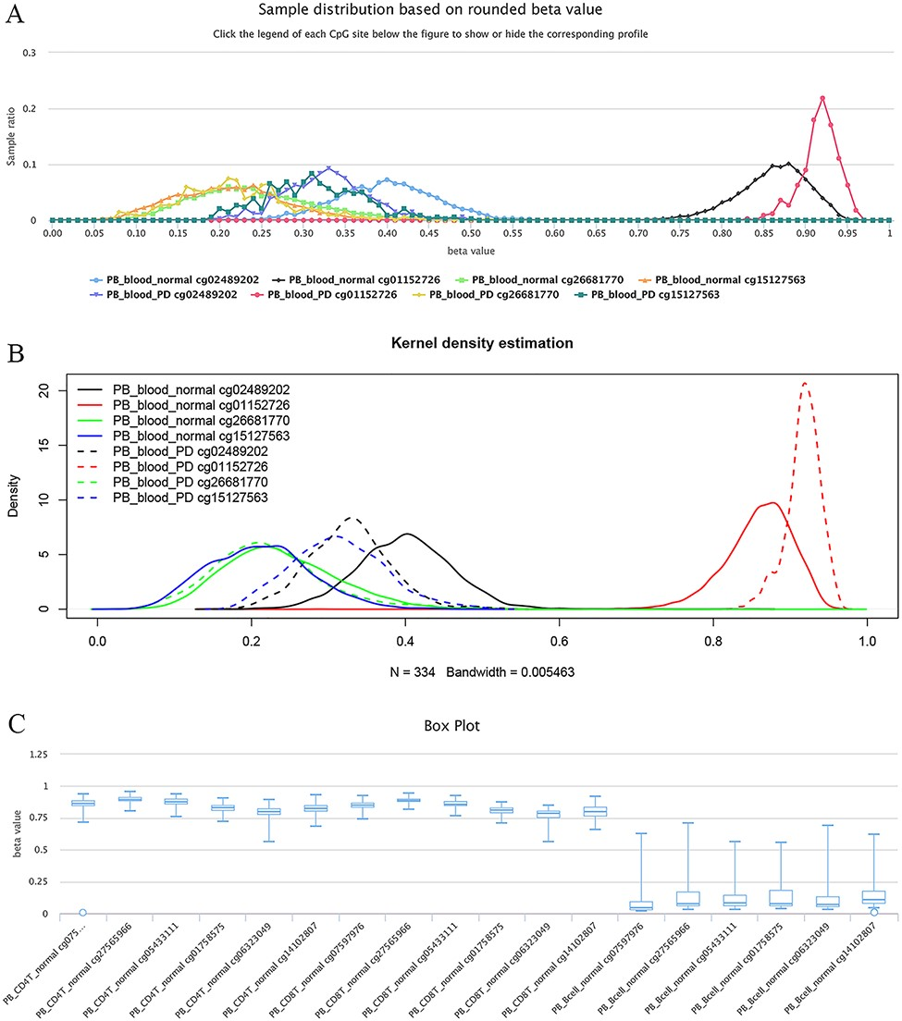
Figure 5. Examples of differential methylation sites. (A) Differentially methylated sites are illustrated by ...
Notes:
Figure 5. Examples of differential methylation sites. (A) Differentially methylated sites are illustrated by methylation profiles. In PD, site cg02489202 is hypomethylated, whereas cg01152726 is hypermethylated. However, there was no apparent differential methylation of cg26681770. Site cg15127563 shows an elevated methylation level in PD patients. The study datasets “PB_blood_normal” and “PB_blood_PD” indicate human peripheral blood samples from normal individuals (n = 5181) or individuals with PD (n = 334). The y-axis represents the sample ratio at an indicated beta value. For example, for cg01152726, there were 73 samples with a rounded beta value of 0.92, and the ratio was 73/334 ∼= 0.21856. Therefore, the accumulated square or ratio covered by each methylation profile curve is equal to 1. (B) Kernel density estimation to show frequency distributions of beta values of the sites in Figure A. Similar distributions of the same sites in Figures A and B can be observed, suggesting the feasibility and reliability of the r-beta curve to show the methylation profile. (C) Box plots showing differentially methylated sites in the CD19 gene in normal peripheral CD8+ T cells (PB_CD8T_normal, n = 161) and B cells (PB_Bcell_normal, n = 125). Datasets are from the 450k platform.
Unless provided in the caption above, the following copyright applies to the content of this slide: © The Author(s) 2022. Published by Oxford University Press.This is an Open Access article distributed under the terms of the Creative Commons Attribution License (https://creativecommons.org/licenses/by/4.0/), which permits unrestricted reuse, distribution, and reproduction in any medium, provided the original work is properly cited.

