Slide 1
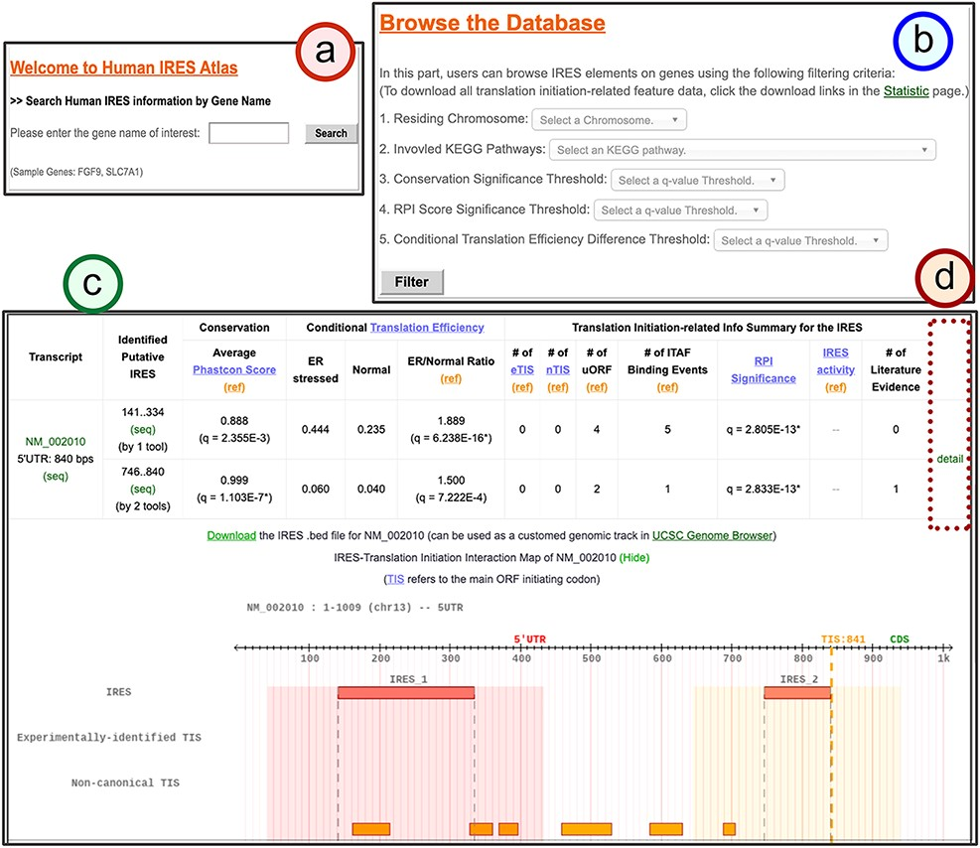
Figure 3. The search result page for the identified IRESs of a given gene.
Notes:
Figure 3. The search result page for the identified IRESs of a given gene. (a) The search mode: users can type in the gene of interest to search for the identified IRESs on the given gene transcripts. (b) The browse mode: users can filter out the IRESs categorized by their residing chromosomes, annotated KEGG pathways of the regulated genes and the thresholds of IRES functionality q-values. (c) The result table for the identified IRES elements in all transcript isoforms of the queried gene. In this table, three IRES functionality test results and other translational regulatory features for each identified IRES element are summarized. (d) The link to the detail page of the selected transcript.
Unless provided in the caption above, the following copyright applies to the content of this slide: © The Author(s) 2021. Published by Oxford University Press.This is an Open Access article distributed under the terms of the Creative Commons Attribution License (http://creativecommons.org/licenses/by/4.0/), which permits unrestricted reuse, distribution, and reproduction in any medium, provided the original work is properly cited.

