Slide 1
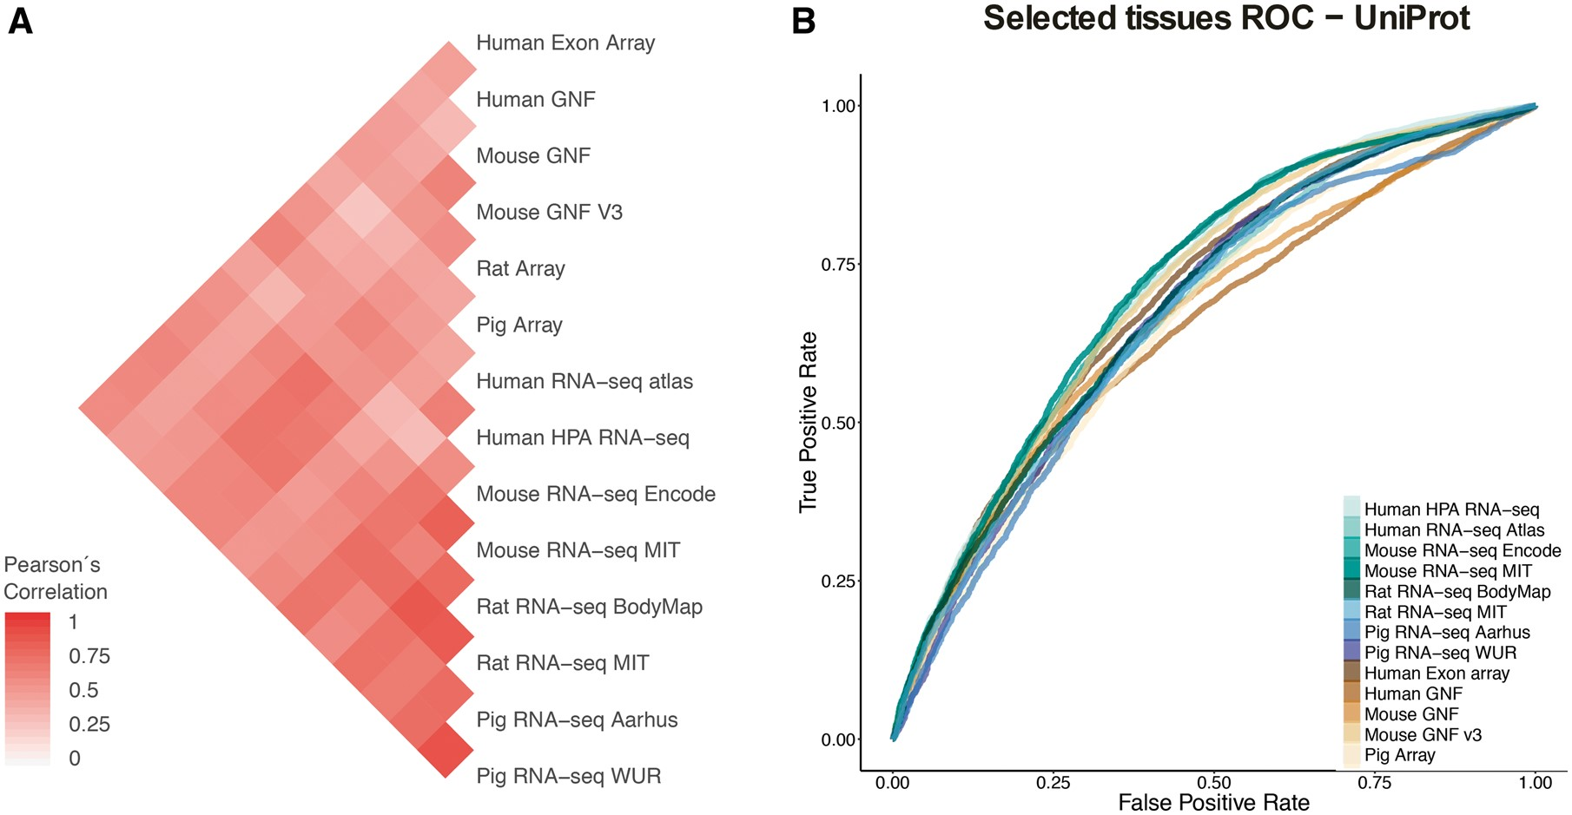
Figure 4. (A) Pearson’s correlation coefficients between final confidence scores of gene–tissue associations across ...
Notes:
Figure 4. (A) Pearson’s correlation coefficients between final confidence scores of gene–tissue associations across datasets. For each pair of datasets, we considered the set of common genes (genes being expressed in at least one tissue in each dataset), and common tissues between the two datasets. (B) In this panel, we compare the rates of True positives and False positives for each dataset for the common tissues to show that the correlation between datasets is mainly influenced by quality rather than by organism or technology.
Unless provided in the caption above, the following copyright applies to the content of this slide: © The Author(s) 2018. Published by Oxford University Press.This is an Open Access article distributed under the terms of the Creative Commons Attribution License (http://creativecommons.org/licenses/by/4.0/), which permits unrestricted reuse, distribution, and reproduction in any medium, provided the original work is properly cited.

