Slide 1
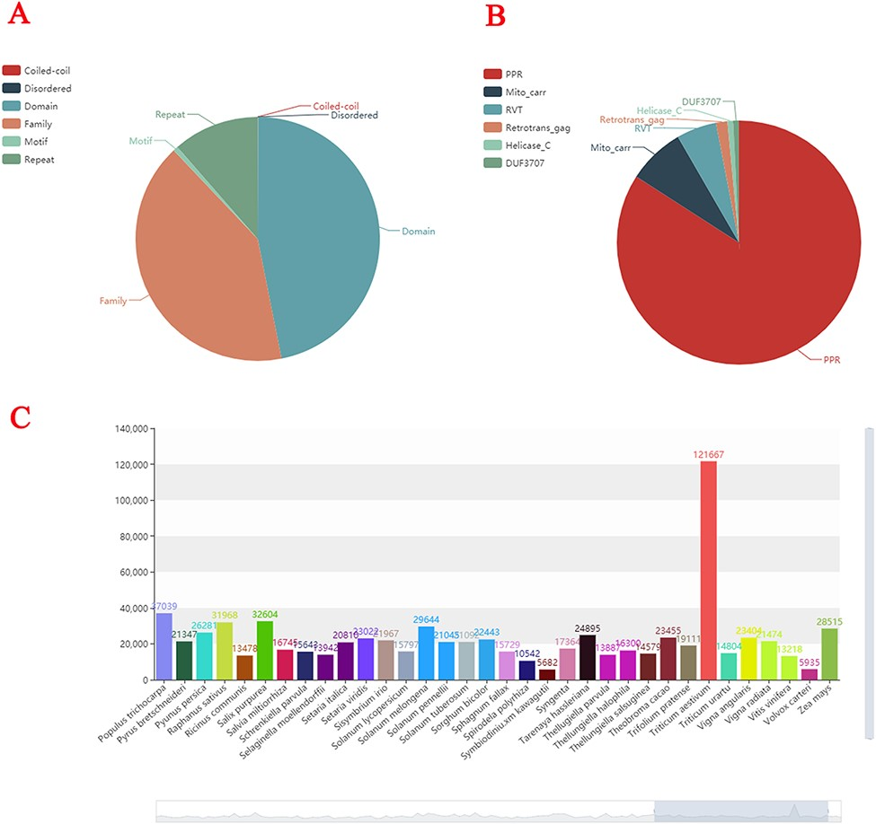
Figure 2. Statistics of plant gene families. (A) The composition structure of 138 plant species’ genes. (B) Statistics ...
Notes:
Figure 2. Statistics of plant gene families. (A) The composition structure of 138 plant species’ genes. (B) Statistics of the largest number of gene families in each species. (C) The number of gene families of each species.
Unless provided in the caption above, the following copyright applies to the content of this slide: © The Author(s) 2022. Published by Oxford University Press.This is an Open Access article distributed under the terms of the Creative Commons Attribution License (https://creativecommons.org/licenses/by/4.0/), which permits unrestricted reuse, distribution, and reproduction in any medium, provided the original work is properly cited.

