Slide 1
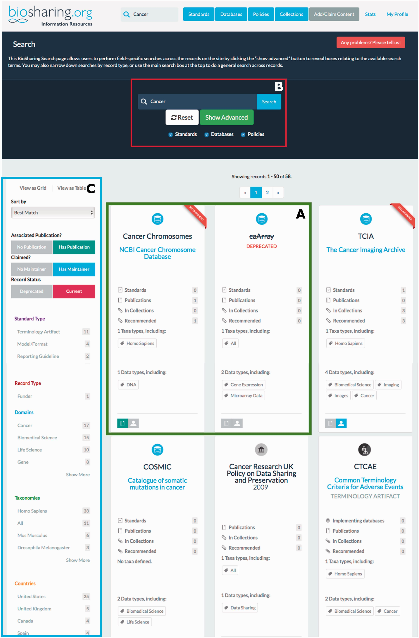
Figure 3 Searching BioSharing. Every search in BioSharing returns a hit list displayed as either a table or grid. In ...
Notes:
Figure 3 Searching BioSharing. Every search in BioSharing returns a hit list displayed as either a table or grid. In this example search, for the text ‘cancer’, 56 records have been retrieved from across the three registries and collections. Each record ‘card’ provides a snapshot of information. Note that the first search hit is recommended, and the second search hit, caArray, is a deprecated database ( A —both highlighted in green). This search can be defined further by clicking on the advanced search option in the top search section ( B —highlighted in red), which leads to a field-specific search. The search can be refined using the filter matrix, found down the left-hand side of the search results ( C —highlighted in blue). This filter allows the selection of records based on a range of information. For example, whether they have a publication associated with them, if they pertain to a particular species or domain, or are associated with a particular country or funding agency.
Unless provided in the caption above, the following copyright applies to the content of this slide: © The Author(s) 2016. Published by Oxford University Press. This is an Open Access article distributed under the terms of the Creative Commons Attribution License ( http://creativecommons.org/licenses/by/4.0/ ), which permits unrestricted reuse, distribution, and reproduction in any medium, provided the original work is properly cited.

Slide 2
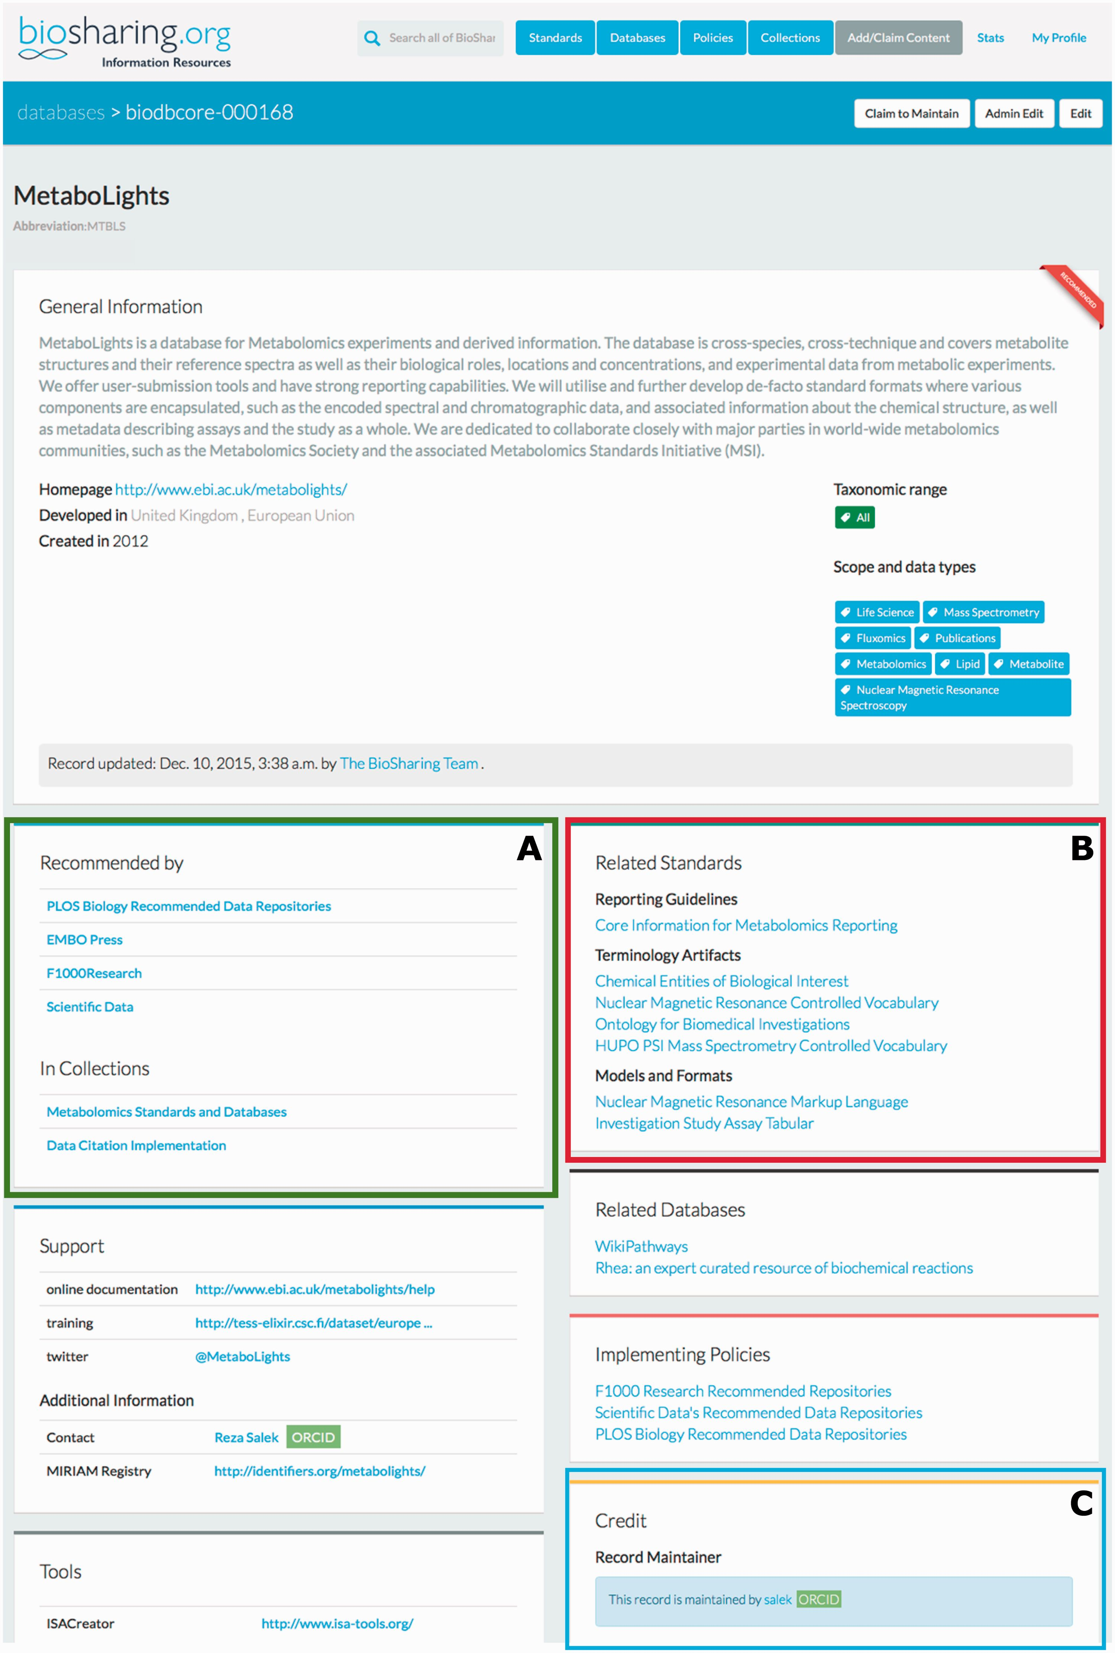
Figure 2 The top section of the BioSharing Metabolights Database Record. Every record on BioSharing starts with a ...
Notes:
Figure 2 The top section of the BioSharing Metabolights Database Record. Every record on BioSharing starts with a general information section, containing a description of the resource, and details of the domains and species that the resource covers. Further, more specific details are found in the boxes beneath this section. If a resource is selected in a Collection or Recommendation, this information is provided in the ‘In Collections’ section ( A —highlighted in green). The standards implemented in the Metabolights database are found in the Related Standards section ( B —highlighted in red), split into the three standard subtypes. The Metabolights database record is maintained by the resource themselves. This information is found in the Credit section ( C —highlighted in blue). Clicking on the maintainer link takes you to the profile for the maintainer, with information linked from their ORCID account, if connected. This section also contains information on the group that has developed the resource and funding information. The Metabolights database is mentioned in four collections (as of November 2015). Clicking on any of the links in this section takes the user directly to the collection.
Unless provided in the caption above, the following copyright applies to the content of this slide: © The Author(s) 2016. Published by Oxford University Press. This is an Open Access article distributed under the terms of the Creative Commons Attribution License ( http://creativecommons.org/licenses/by/4.0/ ), which permits unrestricted reuse, distribution, and reproduction in any medium, provided the original work is properly cited.

Slide 3
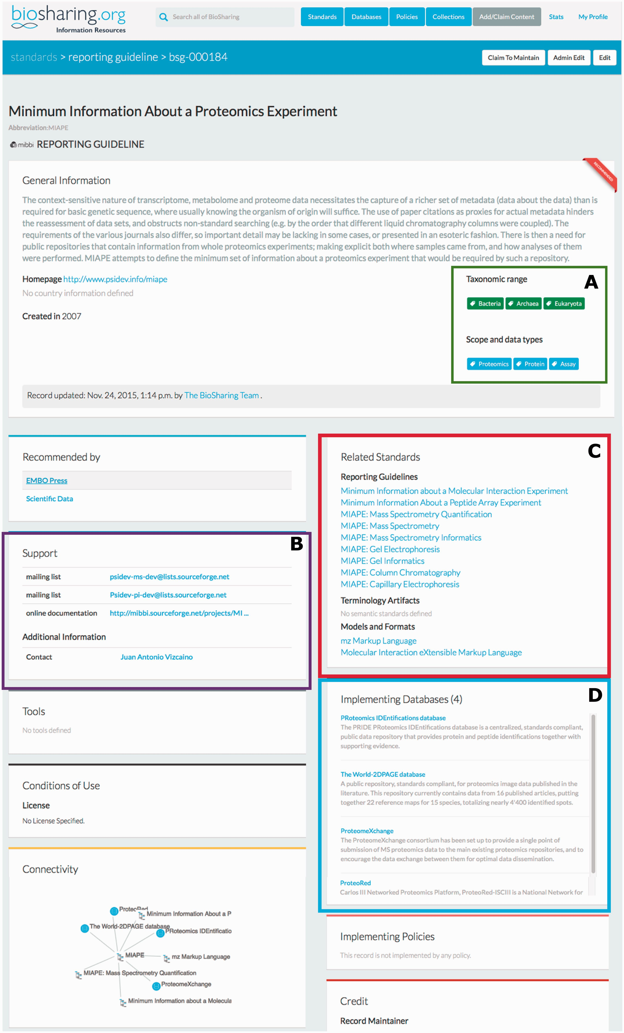
Figure 1 The BioSharing MIAPE Standard Record (top section). In the General Information section, the Taxonomic Range ...
Notes:
Figure 1 The BioSharing MIAPE Standard Record (top section). In the General Information section, the Taxonomic Range and Scope and data types tags are highlighted in a green box (A) . Clicking on a tag from within these two fields initiates a search for all the records annotated with that tag. The Support section (B —highlighted in purple) contains information on help documentation, mailing lists and contact details. The Related Standards section (C —highlighted in red) contains links to other metadata standards, such as the extensions to the initial MIAPE standard. Beneath this section, the implementing databases section (D —highlighted in blue) provides links to those resources that have implemented the MIAPE standard (e.g. The PRIDE database).
Unless provided in the caption above, the following copyright applies to the content of this slide: © The Author(s) 2016. Published by Oxford University Press. This is an Open Access article distributed under the terms of the Creative Commons Attribution License ( http://creativecommons.org/licenses/by/4.0/ ), which permits unrestricted reuse, distribution, and reproduction in any medium, provided the original work is properly cited.

