Slide 1
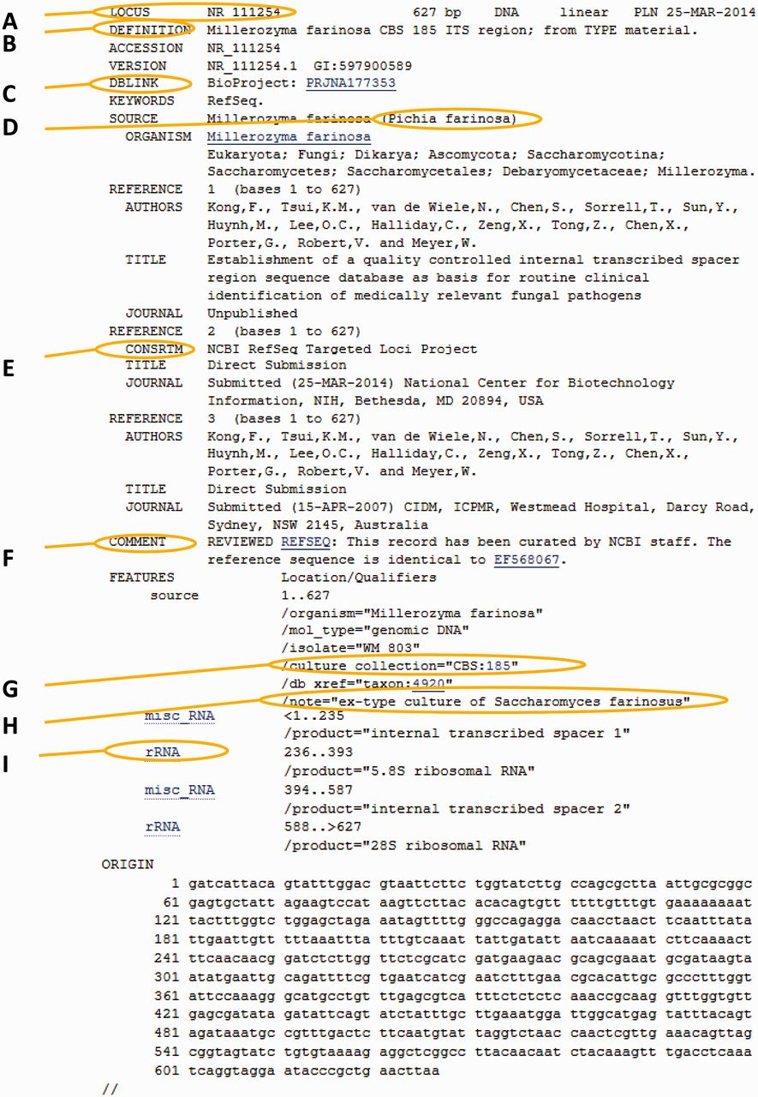
Figure 4. Anatomy of an RTL record. The marked areas indicate most common additions to the original nucleotide record. ...
Notes:
Figure 4. Anatomy of an RTL record. The marked areas indicate most common additions to the original nucleotide record. (A) New RTL accession number; (B) new simplified definition line; (C) Bioproject number for the ITS-targeted loci project; (D) GenBank synonym of current taxonomic name (used in cases of common usage); (E) label indicating that this is a RefSeq record; (F) comment regarding the source of the record; (G) the culture collection or specimen voucher presented as a validated structured triplet or doublet that can link directly to a relevant outside culture or specimen page; (H) additional information on the type and basionym name; (I) the ITS entry of all records was re-annotated to indicate the spacers and ribosomal genes.
Unless provided in the caption above, the following copyright applies to the content of this slide: Published by Oxford University Press 2013. This work is written by US Government employees and is in the public domain in the US.

