Slide 1
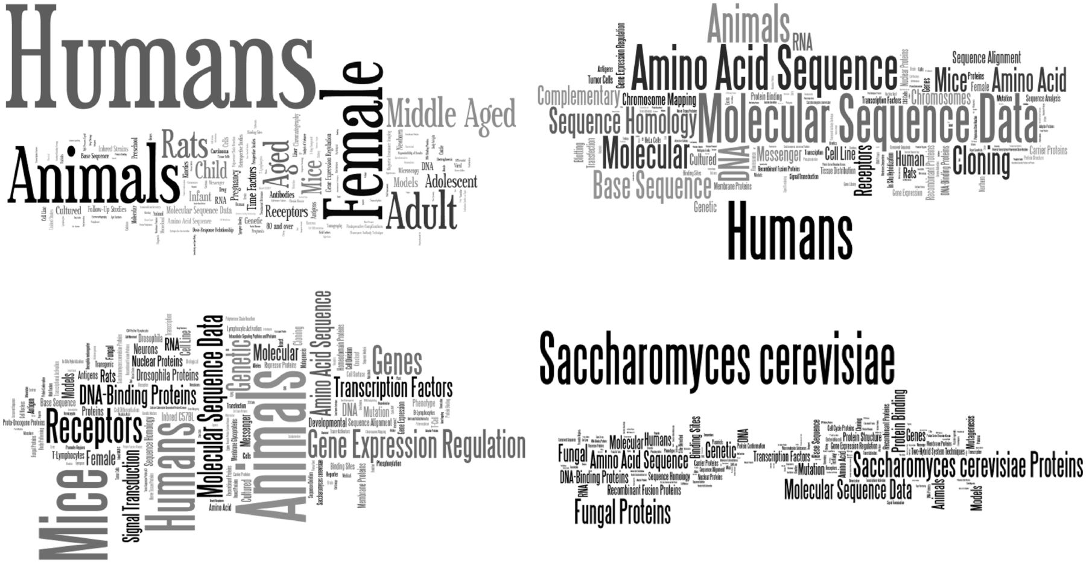
Figure 3 Word cloud ( http://www.wordle.net/create ) representations of MeSH terms found in each corpus: Ab3P (top ...
Notes:
Figure 3 Word cloud ( http://www.wordle.net/create ) representations of MeSH terms found in each corpus: Ab3P (top left), BIOADI (top right), MEDSTRACT (bottom left) and Schwartz and Hearst (bottom right). The MeSH terms confirm each corpus’ original intent: Ab3P was intended as a representation of all biomedical literature in PubMed, BIOADI is the corpus used in the BioCreative II gene normalization challenge, half of MEDSTRACT documents were a result of the search term ‘gene’ on MEDLINE restricted to a small group of biomedical journals and Schwartz and Hearst was a selection of documents returned as a result of the search term ‘yeast’ applied to PubMed.
Unless provided in the caption above, the following copyright applies to the content of this slide: Published by Oxford University Press 2014. This work is written by US Government employees and is in the public domain in the US.

