Slide 1
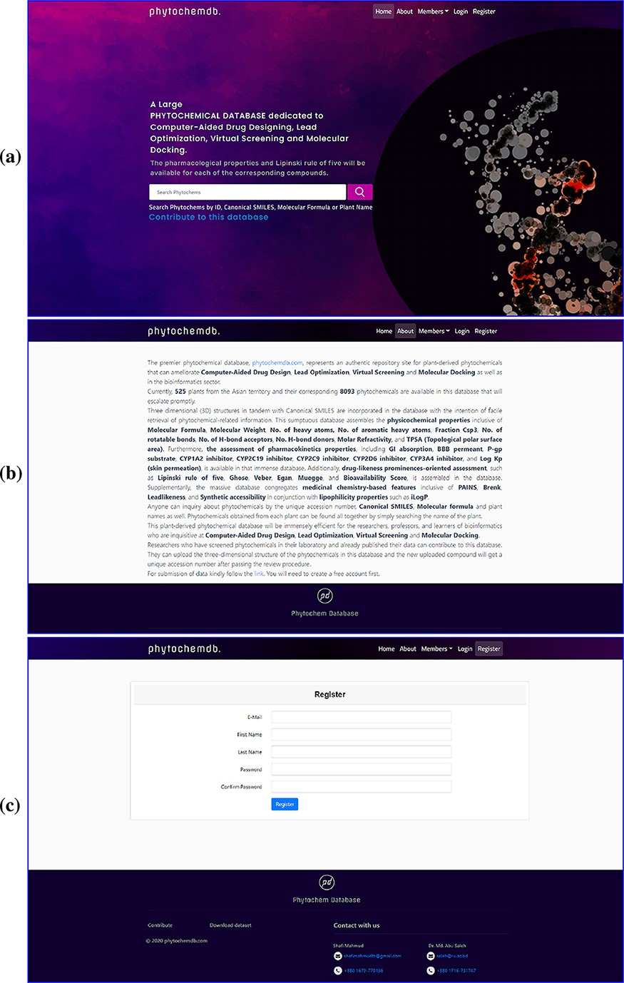
Figure 1. Web interface of the ‘phytochemdb’ database. (a) Demonstration of homepage containing the accessible search ...
Notes:
Figure 1. Web interface of the ‘phytochemdb’ database. (a) Demonstration of homepage containing the accessible search option. (b) ‘About’ web page encompasses a brief description about the database. (c) ‘Register’ web page comprehends the options for creating a free account in the database.
Unless provided in the caption above, the following copyright applies to the content of this slide: © The Author(s) 2022. Published by Oxford University Press.This is an Open Access article distributed under the terms of the Creative Commons Attribution License (https://creativecommons.org/licenses/by/4.0/), which permits unrestricted reuse, distribution, and reproduction in any medium, provided the original work is properly cited.

