Slide 1
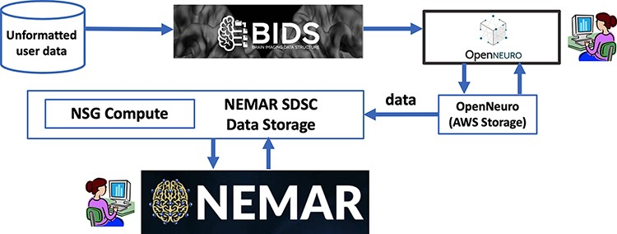
Figure 1. Users first format their data to BIDS and then upload their data to OpenNeuro web interface, which stores it ...
Notes:
Figure 1. Users first format their data to BIDS and then upload their data to OpenNeuro web interface, which stores it on its AWS back end. The NEMAR SDSC Data Storage back end and then automatically sync/download the data from OpenNeuro. Data statistics and visualizations are precomputed for display by NSG Compute. The NEMAR web interface (bottom box) serves the data to NEMAR users. The NEMAR search engine allows users to search through and select data for analysis for their projects. Data identifiers found on NEMAR (for example, OpenNeuro dataset index ds123456) can then be used in analysis scripts the user sends through the NSG to retrieve and process the selected data without requiring data download and subsequent re-upload.
Unless provided in the caption above, the following copyright applies to the content of this slide: © The Author(s) 2022. Published by Oxford University Press.This is an Open Access article distributed under the terms of the Creative Commons Attribution-NonCommercial License (https://creativecommons.org/licenses/by-nc/4.0/), which permits non-commercial re-use, distribution, and reproduction in any medium, provided the original work is properly cited. For commercial re-use, please contact journals.permissions@oup.com

Slide 2
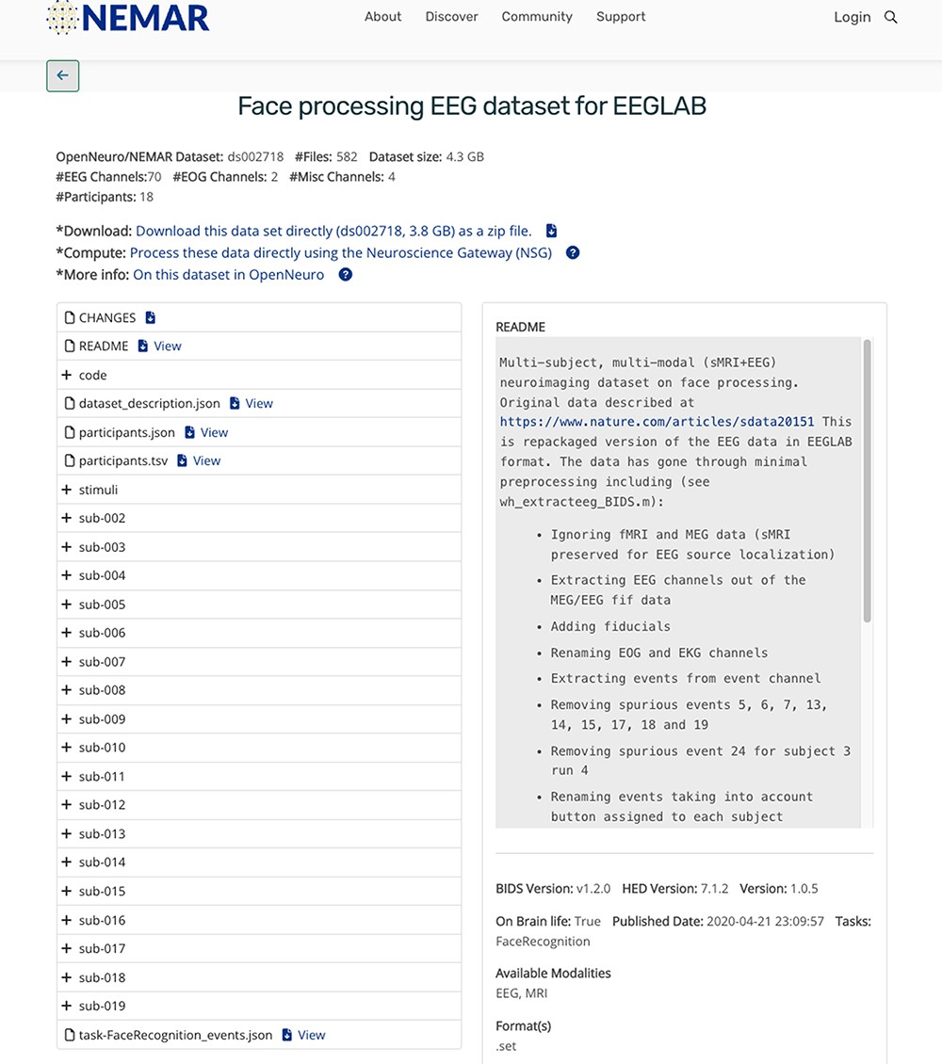
Figure 2. NEMAR dataset interface exposing some of the BIDS-required EEG metadata.
Notes:
Figure 2. NEMAR dataset interface exposing some of the BIDS-required EEG metadata.
Unless provided in the caption above, the following copyright applies to the content of this slide: © The Author(s) 2022. Published by Oxford University Press.This is an Open Access article distributed under the terms of the Creative Commons Attribution-NonCommercial License (https://creativecommons.org/licenses/by-nc/4.0/), which permits non-commercial re-use, distribution, and reproduction in any medium, provided the original work is properly cited. For commercial re-use, please contact journals.permissions@oup.com

Slide 3
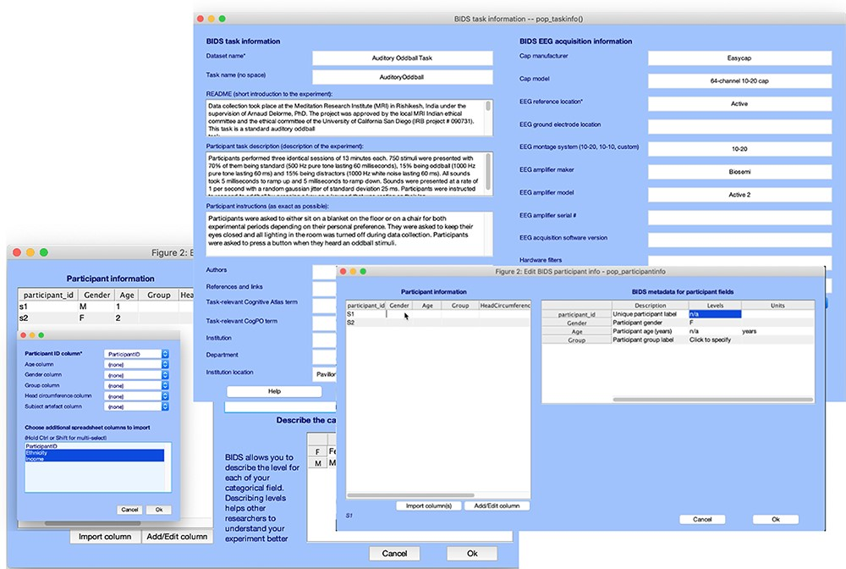
Figure 3. Graphic interface of the bids-matlab-tools plug-in for EEGLAB, a tool to format NEM data in EEGLAB STUDY ...
Notes:
Figure 3. Graphic interface of the bids-matlab-tools plug-in for EEGLAB, a tool to format NEM data in EEGLAB STUDY format to BIDS format for OpenNeuro and NEMAR.
Unless provided in the caption above, the following copyright applies to the content of this slide: © The Author(s) 2022. Published by Oxford University Press.This is an Open Access article distributed under the terms of the Creative Commons Attribution-NonCommercial License (https://creativecommons.org/licenses/by-nc/4.0/), which permits non-commercial re-use, distribution, and reproduction in any medium, provided the original work is properly cited. For commercial re-use, please contact journals.permissions@oup.com

Slide 4
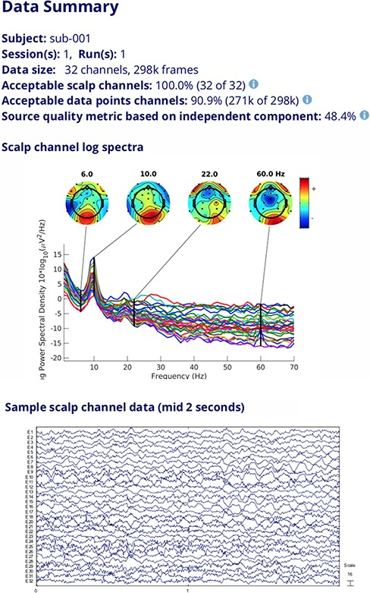
Figure 4. Data quality information, channel log spectra and raw data segment for a selected dataset.
Notes:
Figure 4. Data quality information, channel log spectra and raw data segment for a selected dataset.
Unless provided in the caption above, the following copyright applies to the content of this slide: © The Author(s) 2022. Published by Oxford University Press.This is an Open Access article distributed under the terms of the Creative Commons Attribution-NonCommercial License (https://creativecommons.org/licenses/by-nc/4.0/), which permits non-commercial re-use, distribution, and reproduction in any medium, provided the original work is properly cited. For commercial re-use, please contact journals.permissions@oup.com

Slide 5
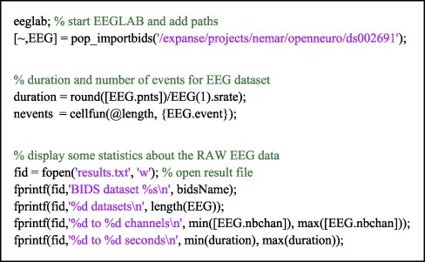
Figure 5. An example MATLAB script running on NSG using OpenNeuro/NEMAR dataset ds002691. The script, submitted by a ...
Notes:
Figure 5. An example MATLAB script running on NSG using OpenNeuro/NEMAR dataset ds002691. The script, submitted by a user through the NSG interface, is executed on the Expanse supercomputer, for which the NEMAR datasets are immediately accessible via their ‘ds’ index (as below).
Unless provided in the caption above, the following copyright applies to the content of this slide: © The Author(s) 2022. Published by Oxford University Press.This is an Open Access article distributed under the terms of the Creative Commons Attribution-NonCommercial License (https://creativecommons.org/licenses/by-nc/4.0/), which permits non-commercial re-use, distribution, and reproduction in any medium, provided the original work is properly cited. For commercial re-use, please contact journals.permissions@oup.com

