Slide 1
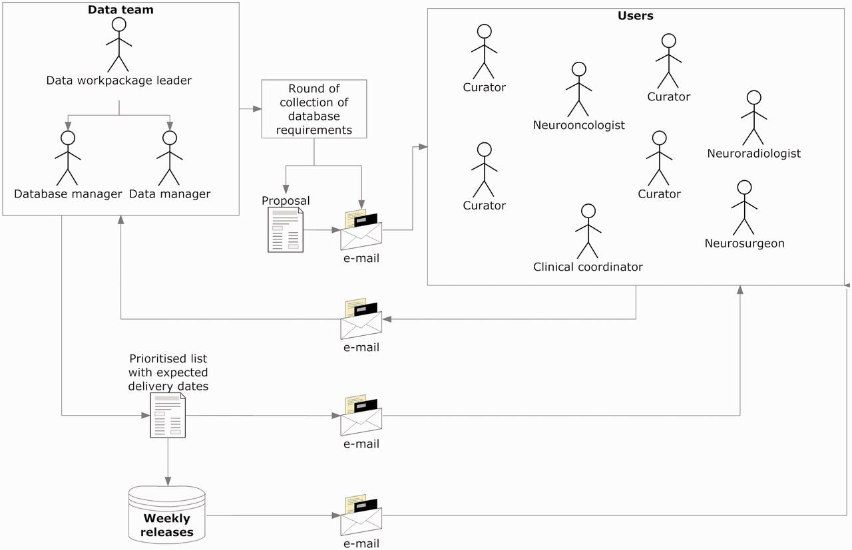
Figure 2 Collecting and implementing specifications. The data manager announced a round of collection of ...
Notes:
Figure 2 Collecting and implementing specifications. The data manager announced a round of collection of specifications, with a deadline for receiving comments and counterproposals (1–2 weeks). Generally, all requirements were incorporated, except those clearly not feasible. In case of conflicting requirements, the data team prioritized after discussion with the users making the request. Implementations were transparent to users, and when the service had to be interrupted to upload the changes, the database manager sent an announcement to the general mailing list.
Unless provided in the caption above, the following copyright applies to the content of this slide: © The Author(s) 2012. Published by Oxford University Press.This is an Open Access article distributed under the terms of the Creative Commons Attribution License (http://creativecommons.org/licenses/by-nc/3.0/), which permits non-commercial reuse, distribution, and reproduction in any medium, provided the original work is properly cited. For commercial re-use, please contact journals.permissions@oup.com.

