Slide 1
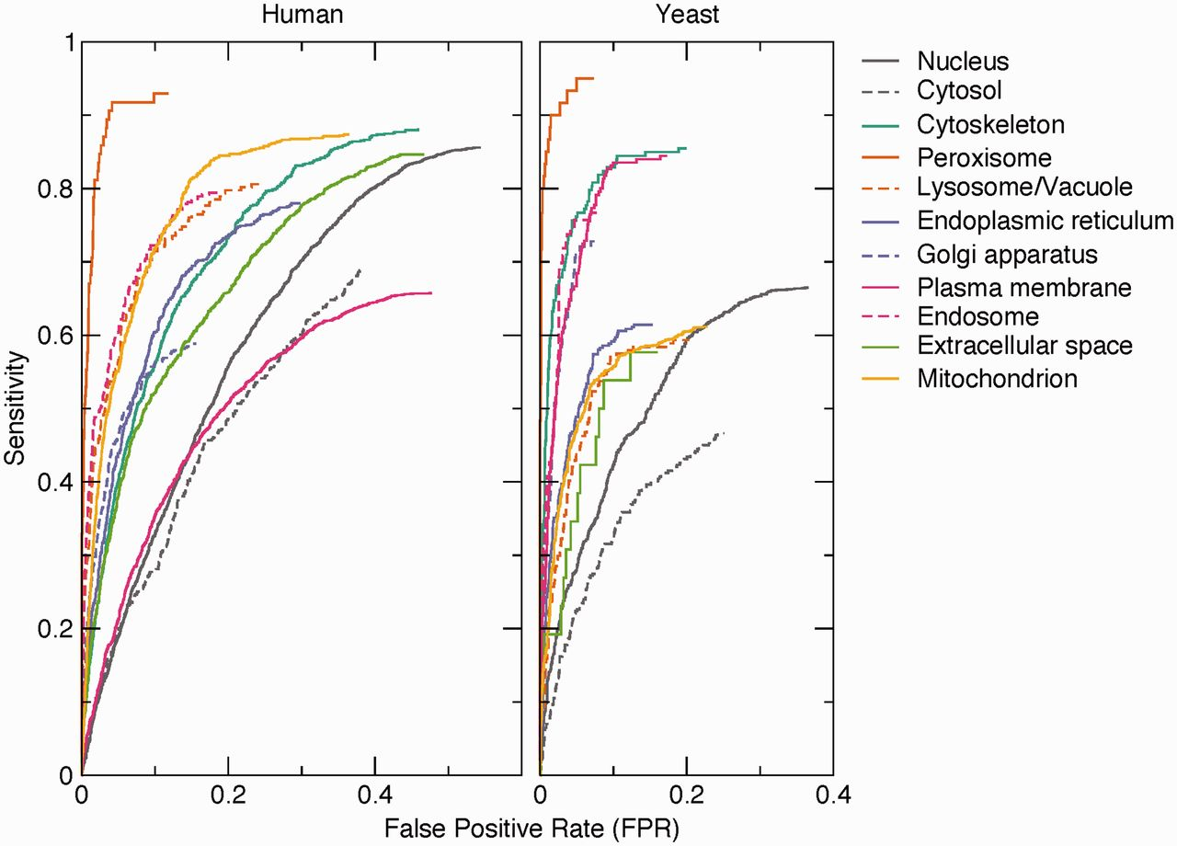
Figure 3. Benchmark of text-mining results. The performance of the text-mining pipeline on human and yeast proteins is ...
Notes:
Figure 3. Benchmark of text-mining results. The performance of the text-mining pipeline on human and yeast proteins is shown as receiver operating characteristics (ROC) curves for each of 11 compartments. The curves do not intercept sensitivity = 1.0 and FPR = 1.0 because many of the protein–compartment pairs in the benchmark set are never found mentioned together in Medline, for which reason they have no text-mining score.
Unless provided in the caption above, the following copyright applies to the content of this slide: © The Author(s) 2014. Published by Oxford University Press.This is an Open Access article distributed under the terms of the Creative Commons Attribution License (http://creativecommons.org/licenses/by/3.0/), which permits unrestricted reuse, distribution, and reproduction in any medium, provided the original work is properly cited.

