Slide 1
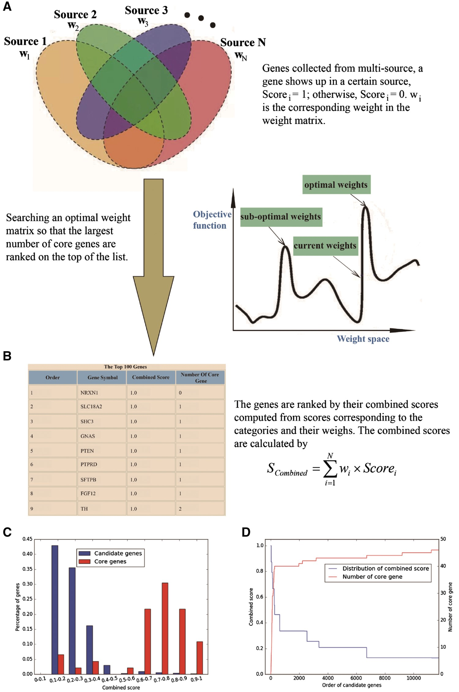
Figure 2. Overview of gene prioritization tool. (A) The algorithm aims at selecting the genes associated with a certain ...
Notes:
Figure 2. Overview of gene prioritization tool. (A) The algorithm aims at selecting the genes associated with a certain phenotype via multi-source prioritization approach. (B) The algorithm prioritizes the candidate genes through searching a set of optimal weights to obtain the combined scores to rank the genes. (C) Graphical presentation of comparative distribution of the scores of the core genes and all genes. (D) Identification of the threshold of prioritized genes.
Unless provided in the caption above, the following copyright applies to the content of this slide: © The Author(s) 2017. Published by Oxford University Press.This is an Open Access article distributed under the terms of the Creative Commons Attribution License (http://creativecommons.org/licenses/by/4.0/), which permits unrestricted reuse, distribution, and reproduction in any medium, provided the original work is properly cited.

