Slide 1
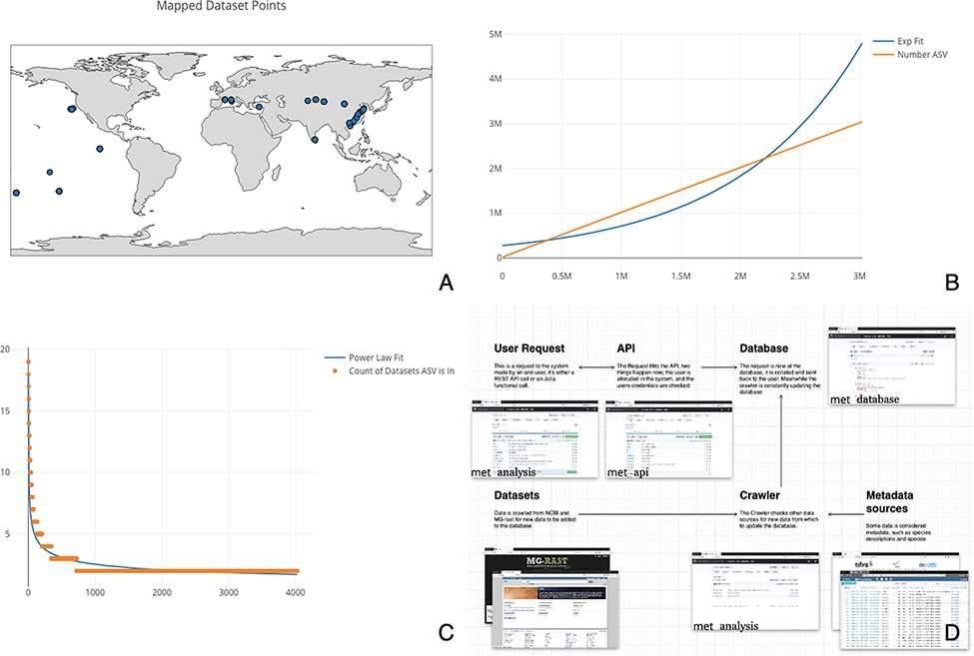
Figure 1. (A) Map of the 515 samples with latitude and longitude data. Samples tended to tightly cluster around ...
Notes:
Figure 1. (A) Map of the 515 samples with latitude and longitude data. Samples tended to tightly cluster around locations, correlating with particular biodiversity assay experiments. (B) Number of sequences found per ASV, sorted by the number of ASVs found. If each ASV was counted across all datasets, it would necessitate an n2 operation of all sequences compared to all other sequences. Most analysis software have some solution to this all-on-all problem. met overcomes this difficulty by storing ASVs in a separate table so that this operation becomes a ‘n’ operation of grouping and counting the ASV’s associated datasets. The inferred ASV diversity followed an exponential function, with a substantially long tail. (C) Cumulative plot of any particular ASV found across samples. The plot is reverse sorted by count of samples in which the ASV is found. Although it may not look like it to the eye, no single sequence was found in over 20 datasets. (D) A diagram of met’s different pieces: met-api is composed of three major components: met-analysis, met-api and met-db. met-analysis is the main point of entry for the framework. Data gathered by crawlers would be inserted via met-analysis, and data for further downstream computation would come out of met-analysis. met-api is the only entry point for met-db, and met-db contains all information an analysis project may be interested in.
Unless provided in the caption above, the following copyright applies to the content of this slide: © The Author(s) 2022. Published by Oxford University Press.This is an Open Access article distributed under the terms of the Creative Commons Attribution-NonCommercial License (https://creativecommons.org/licenses/by-nc/4.0/), which permits non-commercial re-use, distribution, and reproduction in any medium, provided the original work is properly cited. For commercial re-use, please contact journals.permissions@oup.com

