Slide 1
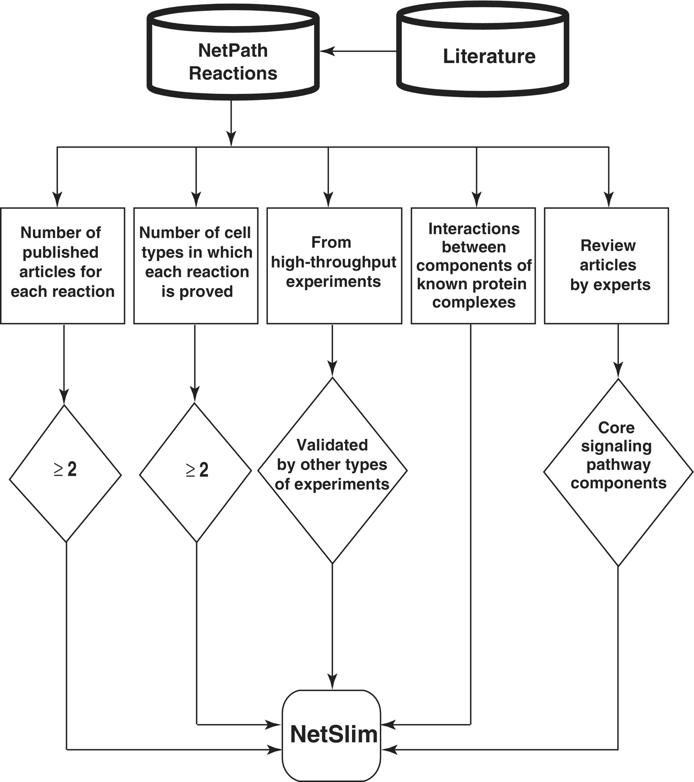
Figure 1. Schematic representation of the criteria used to select high-confidence pathway reactions from NetPath for ...
Notes:
Figure 1. Schematic representation of the criteria used to select high-confidence pathway reactions from NetPath for NetSlim. Reactions supported by at least two research articles are considered confident. Reactions shown to occur in multiple cell types for specific pathways are also included. NetSlim further incorporates reactions reported through high-throughput analyses which were validated by a focused experiment (in the same research article or another research article). The interactions between components of known protein complexes are included to obtain a general view of a pathway. Molecules or reactions established through expert review articles are considered for NetSlim in order to provide the core set of reactions in a given pathway.
Unless provided in the caption above, the following copyright applies to the content of this slide: © The Author(s) 2011. Published by Oxford University Press.This is Open Access article distributed under the terms of the Creative Commons Attribution Non-Commercial License (http://creativecommons.org/licenses/by-nc/2.5), which permits unrestricted non-commercial use, distribution, and reproduction in any medium, provided the original work is properly cited.

