Slide 1
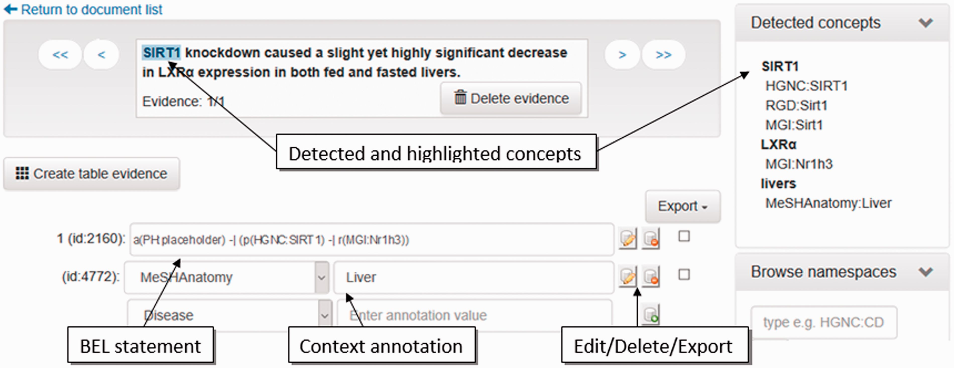
Figure 4 Screenshot of the evidence-centric curation view. In the upper left, the evidence text is visualized. ...
Notes:
Figure 4 Screenshot of the evidence-centric curation view. In the upper left, the evidence text is visualized. Detected concepts in the current evidence text are shown in the upper right. In the bottom left, the curation of BEL statements and their context annotations can be performed.
Unless provided in the caption above, the following copyright applies to the content of this slide: © The Author(s) 2016. Published by Oxford University Press. All rights reserved. For permissions, please e-mail: journals.permissions@oup.com This is an Open Access article distributed under the terms of the Creative Commons Attribution License ( http://creativecommons.org/licenses/by/4.0/ ), which permits unrestricted reuse, distribution, and reproduction in any medium, provided the original work is properly cited.

