Slide 1
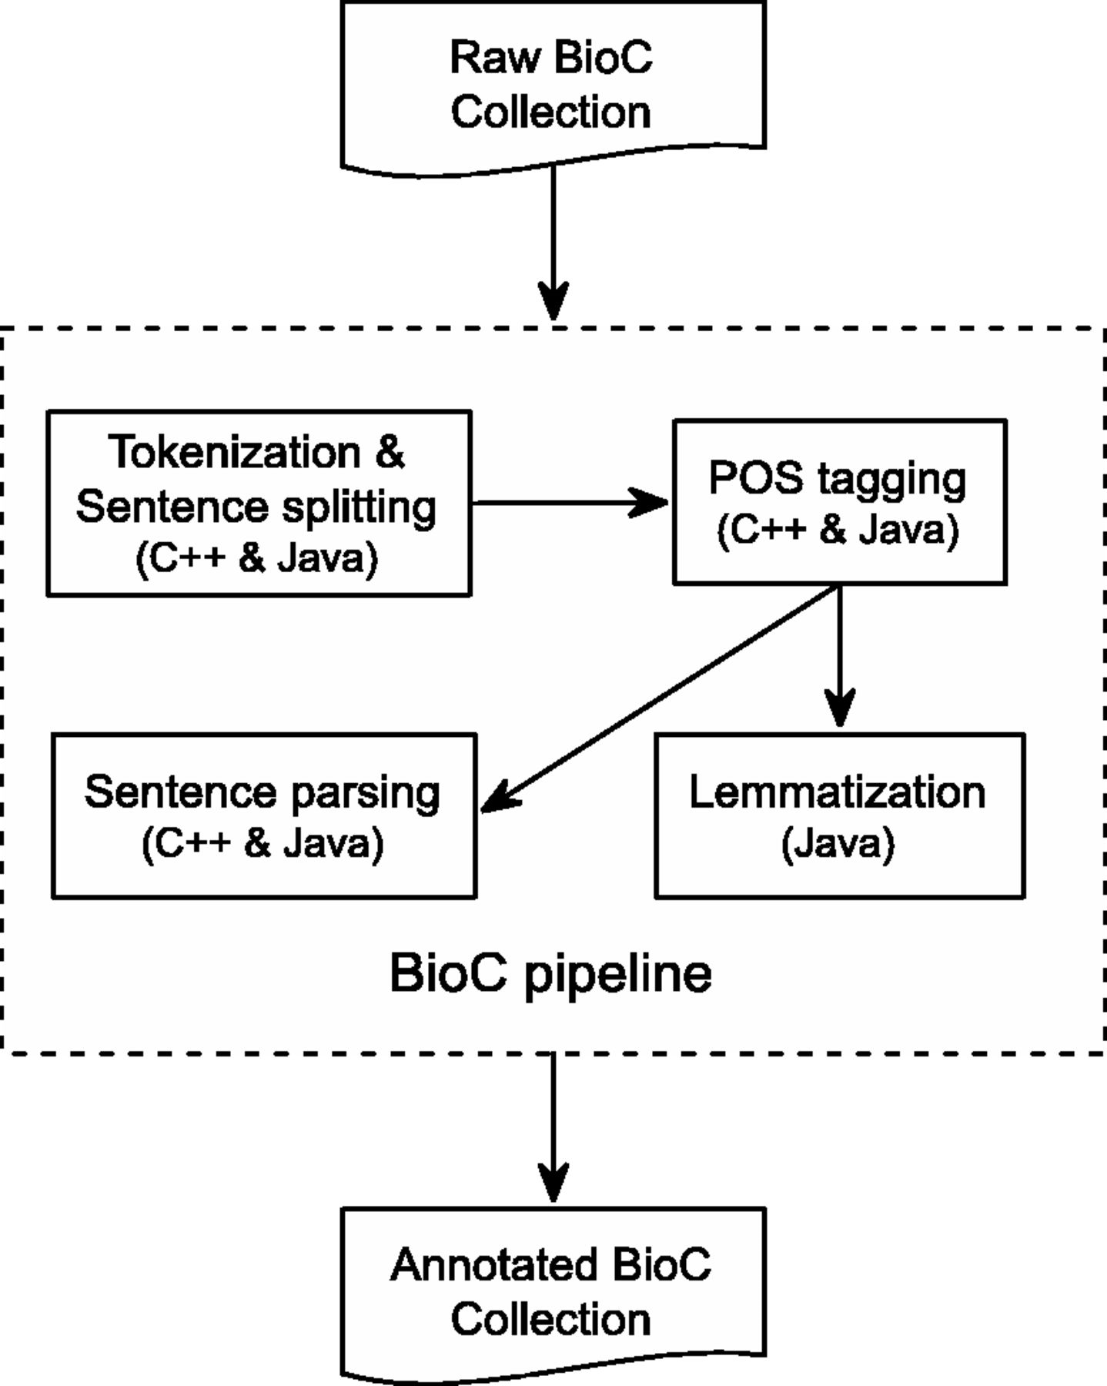
Figure 1. BioC Text-preprocessing Pipeline. All components are available in both C++ and Java, except for ...
Notes:
Figure 1. BioC Text-preprocessing Pipeline. All components are available in both C++ and Java, except for Lemmatization, which is only available in Java.
Unless provided in the caption above, the following copyright applies to the content of this slide: Published by Oxford University Press. This work is written by US Government employees and is in the public domain in the US.

Slide 2
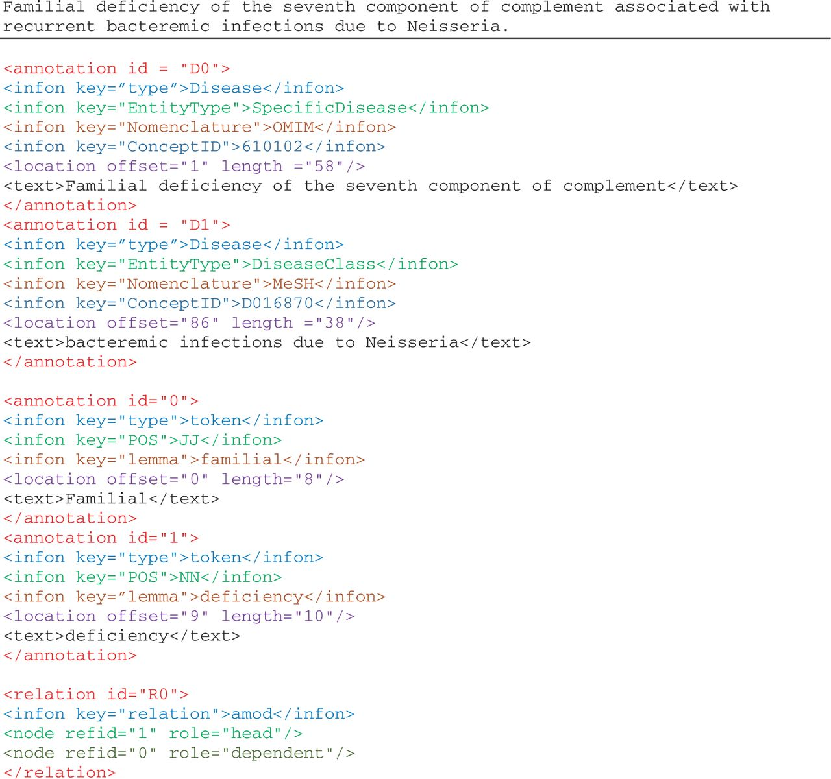
Figure 2. Illustration of annotations in the enriched NCBI disease corpus, manual annotations of disease mentions and ...
Notes:
Figure 2. Illustration of annotations in the enriched NCBI disease corpus, manual annotations of disease mentions and concepts, and BioC-tool-produced annotations from text preprocessing.
Unless provided in the caption above, the following copyright applies to the content of this slide: Published by Oxford University Press. This work is written by US Government employees and is in the public domain in the US.

Slide 3
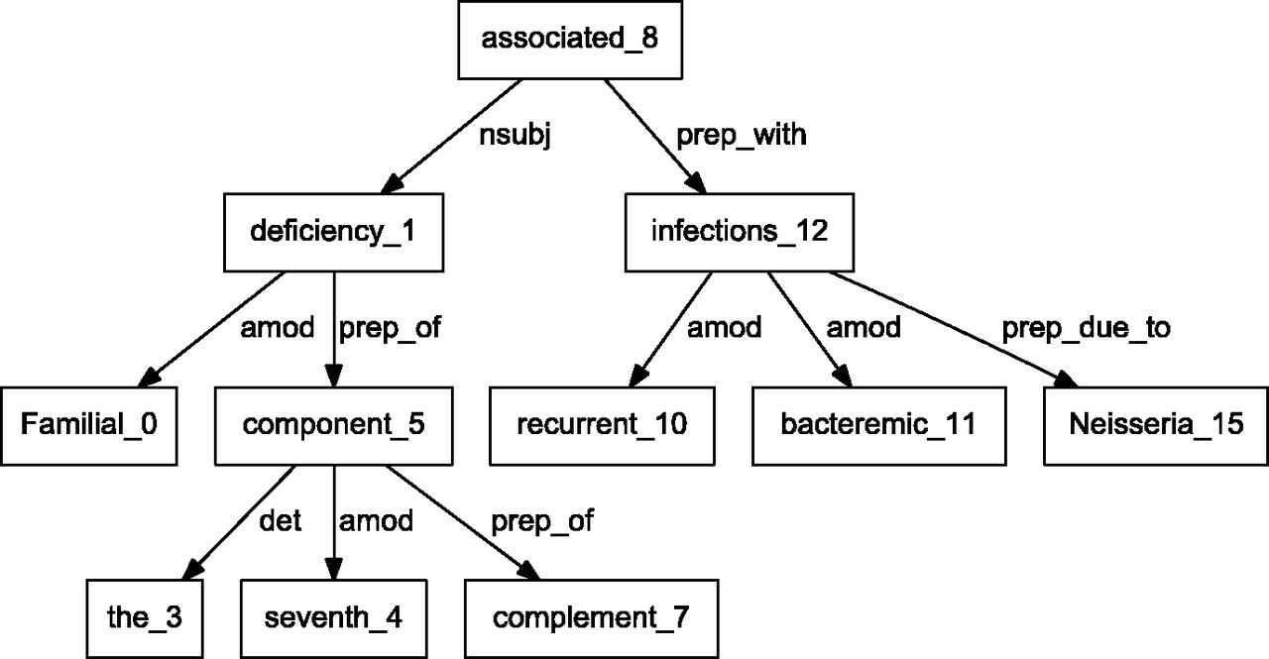
Figure 4. Dependency graph of ‘Familial deficiency of the seventh component of complement associated with recurrent ...
Notes:
Figure 4. Dependency graph of ‘Familial deficiency of the seventh component of complement associated with recurrent bacteremic infections due to Neisseria’ using Stanford parser.
Unless provided in the caption above, the following copyright applies to the content of this slide: Published by Oxford University Press. This work is written by US Government employees and is in the public domain in the US.

Slide 4
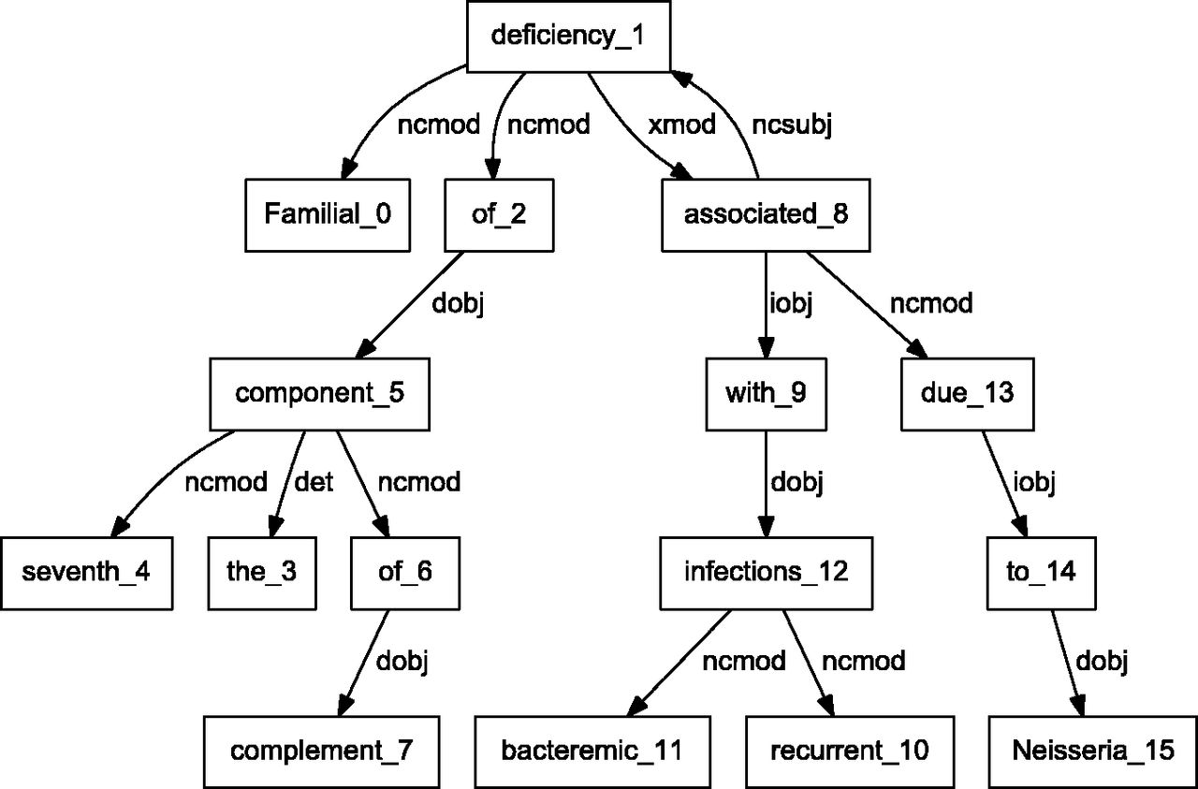
Figure 3. Dependency graph of ‘Familial deficiency of the seventh component of complement associated with recurrent ...
Notes:
Figure 3. Dependency graph of ‘Familial deficiency of the seventh component of complement associated with recurrent bacteremic infections due to Neisseria’ using C&C parser.
Unless provided in the caption above, the following copyright applies to the content of this slide: Published by Oxford University Press. This work is written by US Government employees and is in the public domain in the US.

