Slide 1
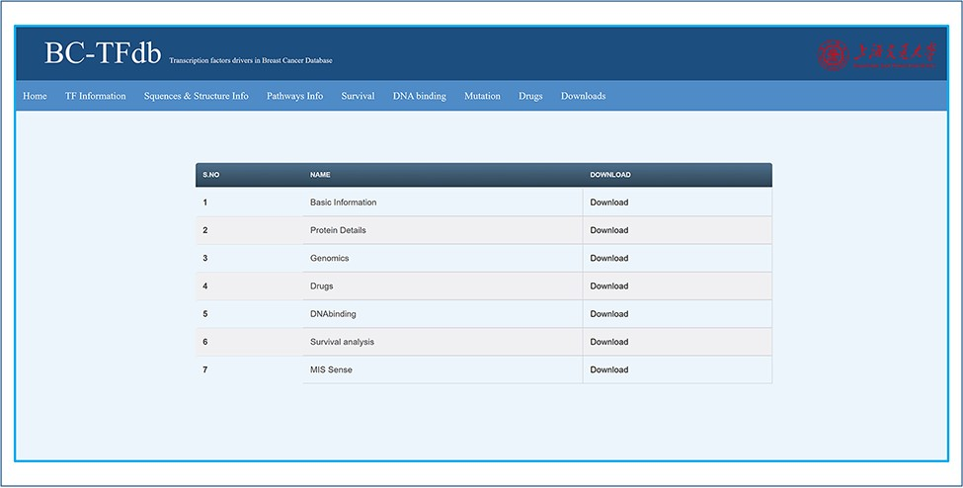
Figure 9. Representative image of the Downloads tab that contains all the files for downloads.
Notes:
Figure 9. Representative image of the Downloads tab that contains all the files for downloads.
Unless provided in the caption above, the following copyright applies to the content of this slide: © Crown copyright 2021.This Open Access article contains public sector information licensed under the Open Government Licence v3.0 (http://www.nationalarchives.gov.uk/doc/open-government-licence/version/3/).

