Slide 1
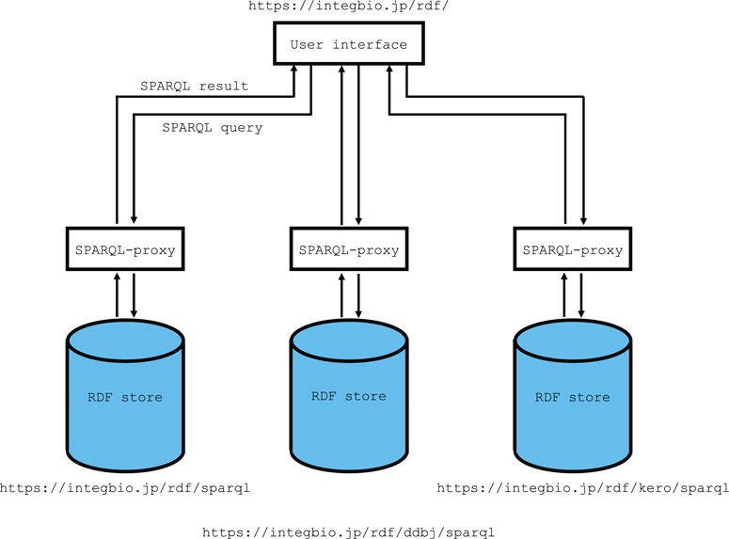
Figure 1 Overview of the system architecture. The RDF portal uses OpenLink Virtuoso as its RDF store. The SPARQL ...
Notes:
Figure 1 Overview of the system architecture. The RDF portal uses OpenLink Virtuoso as its RDF store. The SPARQL endpoint uses the SPARQL-proxy software for its front end. Currently, there are three virtuoso instances for the primary instance, the DDBJ RDF and the DBKERO RDF.
Unless provided in the caption above, the following copyright applies to the content of this slide: © The Author(s) 2018. Published by Oxford University Press. All rights reserved. For Permissions, please email: journals.permissions@oup.comThis article is published and distributed under the terms of the Oxford University Press, Standard Journals Publication Model (https://academic.oup.com/journals/pages/open_access/funder_policies/chorus/standard_publication_model)

Slide 2
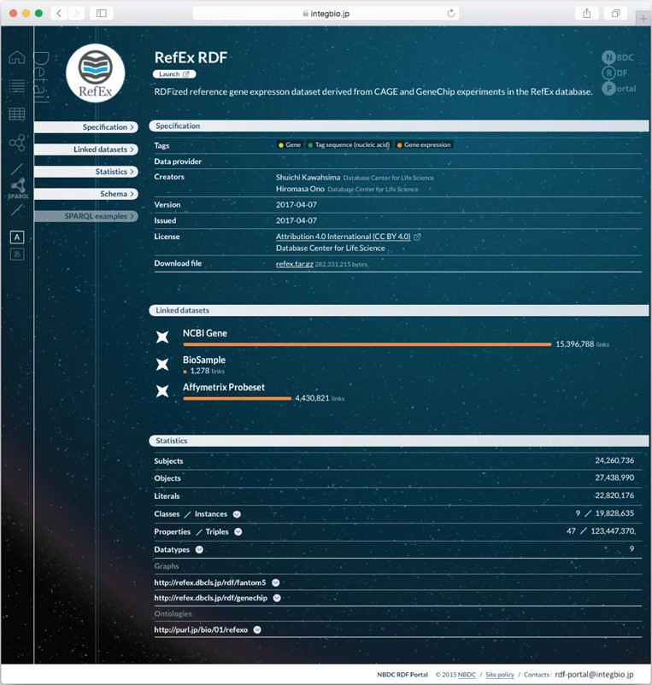
Figure 2 Example dataset page from the NBDC RDF portal. Each RDF dataset has its own page that provides metadata, ...
Notes:
Figure 2 Example dataset page from the NBDC RDF portal. Each RDF dataset has its own page that provides metadata, statistics, links to the RDF files, SPARQL query samples and a link to the SPARQL endpoint.
Unless provided in the caption above, the following copyright applies to the content of this slide: © The Author(s) 2018. Published by Oxford University Press. All rights reserved. For Permissions, please email: journals.permissions@oup.comThis article is published and distributed under the terms of the Oxford University Press, Standard Journals Publication Model (https://academic.oup.com/journals/pages/open_access/funder_policies/chorus/standard_publication_model)

Slide 3
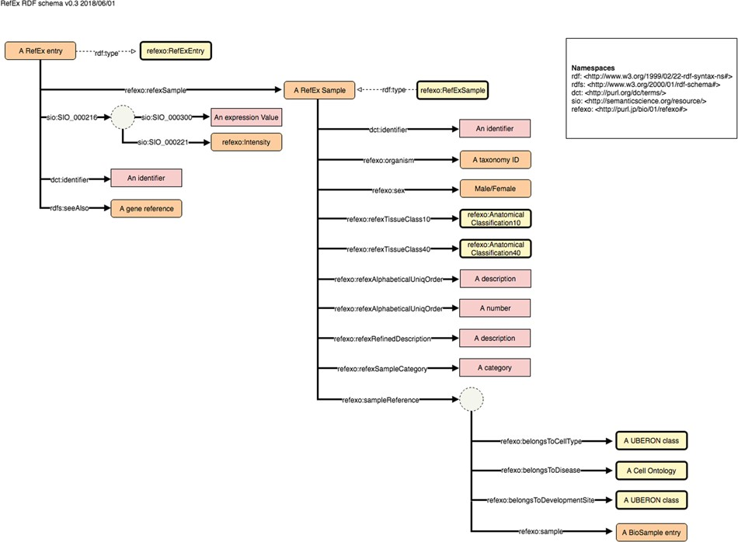
Figure 3 Example schema diagram from the NBDC RDF portal. This example schema diagram is taken from the RefEx RDF. The ...
Notes:
Figure 3 Example schema diagram from the NBDC RDF portal. This example schema diagram is taken from the RefEx RDF. The orange, yellow and pink rectangles represent instances, ontology classes and literals, respectively; the solid and dashed arrows represent properties and rdf:type relationships; the dotted circles represent blank nodes.
Unless provided in the caption above, the following copyright applies to the content of this slide: © The Author(s) 2018. Published by Oxford University Press. All rights reserved. For Permissions, please email: journals.permissions@oup.comThis article is published and distributed under the terms of the Oxford University Press, Standard Journals Publication Model (https://academic.oup.com/journals/pages/open_access/funder_policies/chorus/standard_publication_model)

Slide 4
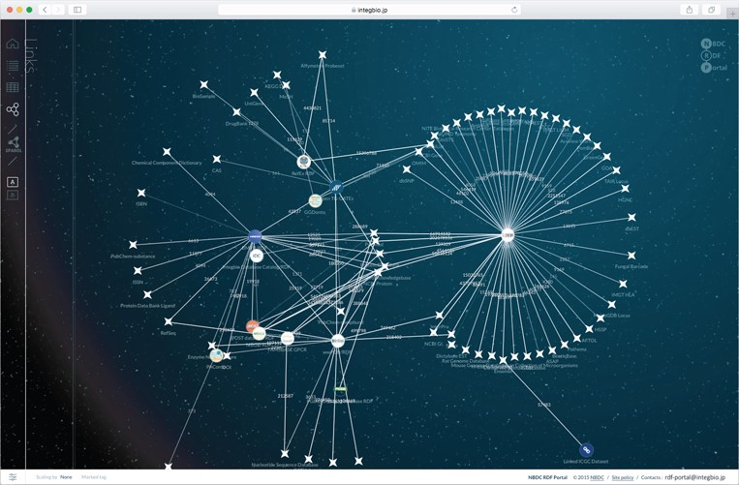
Figure 4 Network view of the NBDC RDF portal. This network view dynamically shows how the datasets are connected. The ...
Notes:
Figure 4 Network view of the NBDC RDF portal. This network view dynamically shows how the datasets are connected. The circles represent datasets registered with the RDF portal, while the stars represent external datasets. When two datasets are linked, they are connected by a straight line, and the number on the line represents the number of links.
Unless provided in the caption above, the following copyright applies to the content of this slide: © The Author(s) 2018. Published by Oxford University Press. All rights reserved. For Permissions, please email: journals.permissions@oup.comThis article is published and distributed under the terms of the Oxford University Press, Standard Journals Publication Model (https://academic.oup.com/journals/pages/open_access/funder_policies/chorus/standard_publication_model)

Slide 5
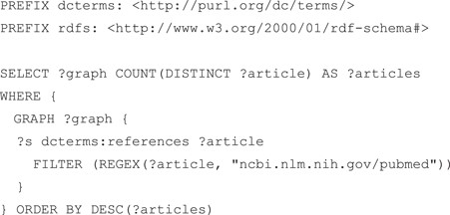
Figure 5 SPARQL query that counts the references in each RDF graph. According to guideline 4, all datasets refer to ...
Notes:
Figure 5 SPARQL query that counts the references in each RDF graph. According to guideline 4, all datasets refer to the PubMed literature using the dcterms:references property.
Unless provided in the caption above, the following copyright applies to the content of this slide: © The Author(s) 2018. Published by Oxford University Press. All rights reserved. For Permissions, please email: journals.permissions@oup.comThis article is published and distributed under the terms of the Oxford University Press, Standard Journals Publication Model (https://academic.oup.com/journals/pages/open_access/funder_policies/chorus/standard_publication_model)

Slide 6
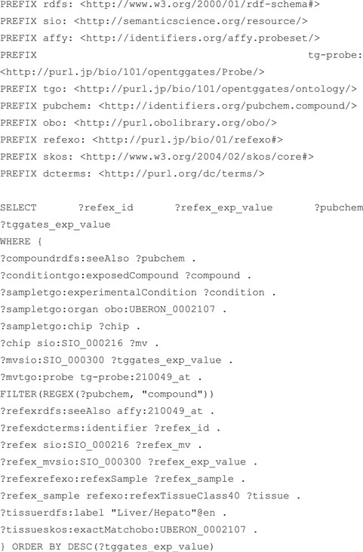
Figure 6 SPARQL query that performs an integrated search of the RefEx and KERO RDFs. Both RefEx and Open TG-GATEs RDF ...
Notes:
Figure 6 SPARQL query that performs an integrated search of the RefEx and KERO RDFs. Both RefEx and Open TG-GATEs RDF include transcriptome data measured using the same GeneChip technology and use the RDF model defined in guideline 11 to describe measured numerical data.
Unless provided in the caption above, the following copyright applies to the content of this slide: © The Author(s) 2018. Published by Oxford University Press. All rights reserved. For Permissions, please email: journals.permissions@oup.comThis article is published and distributed under the terms of the Oxford University Press, Standard Journals Publication Model (https://academic.oup.com/journals/pages/open_access/funder_policies/chorus/standard_publication_model)

