Slide 1
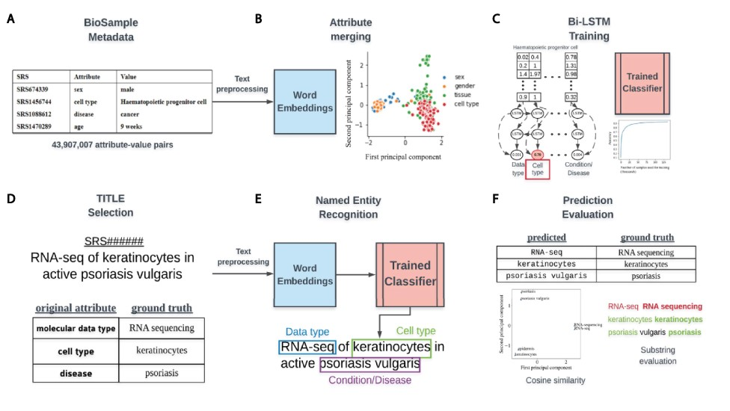
Figure 1. Overview of classifier training and metadata prediction workflow. (A) A few examples of the 44 million ...
Notes:
Figure 1. Overview of classifier training and metadata prediction workflow. (A) A few examples of the 44 million attribute-value pairs in SRA BioSample. (B) Word embeddings of preprocessed values allowed for the clustering and merging of attributes that were similar in the embedding space. (C) A subset of attribute-value pairs was split into a training and test set and a bi-LSTM classifier was trained to identify 11 metadata categories. (D) TITLEs were selected as the free-text for NER using the trained model. An example TITLE with associated ground truth labels is shown. (E) These TITLEs were preprocessed into n-grams and fed into the trained classifier after word embedding to generate metadata predictions for the 11 categories. (F) Comparisons to ground truth metadata were done using substring matching and cosine similarity in the word embedding space.
Unless provided in the caption above, the following copyright applies to the content of this slide: © The Author(s) 2021. Published by Oxford University Press.This is an Open Access article distributed under the terms of the Creative Commons Attribution License (http://creativecommons.org/licenses/by/4.0/), which permits unrestricted reuse, distribution, and reproduction in any medium, provided the original work is properly cited.

Slide 2
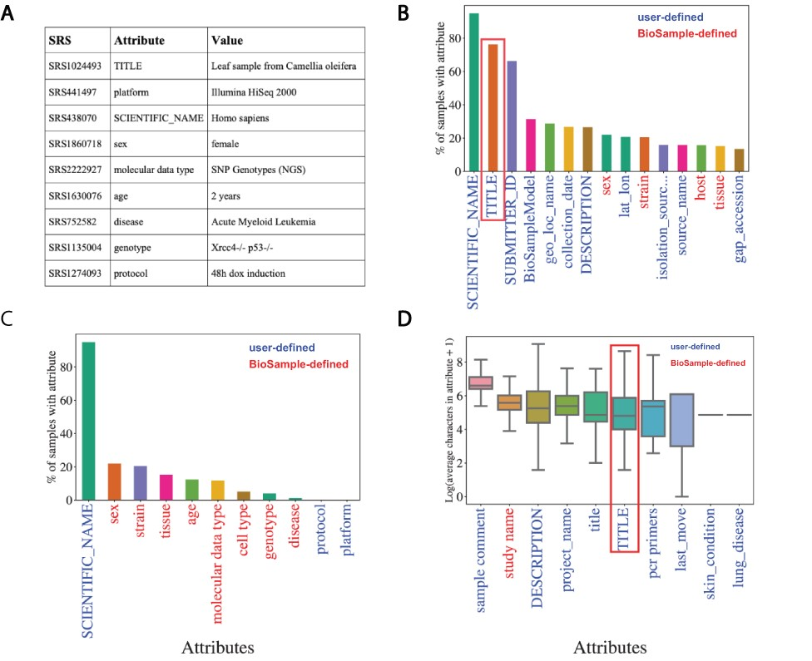
Figure 2. Missing metadata in SRA. (A) Examples of SRA attribute-value pairs. Percentage of all samples that contained ...
Notes:
Figure 2. Missing metadata in SRA. (A) Examples of SRA attribute-value pairs. Percentage of all samples that contained annotations for the (B) top 15 most used attributes and (C) the 11 selected attributes. X-axis shows attribute type and y-axis shows the percentage of total samples that used the given attribute. (D) Distributions of the average number of characters for the 10 longest (by mean) attributes in BioSample annotations of SRA. X-axis shows attribute type and y-axis shows the Log2(average characters) for a given attribute. Blue labels indicate a user defined attribute, red labels indicate a BioSample defined attribute. TITLE attribute in panels (B) and (D) is highlighted.
Unless provided in the caption above, the following copyright applies to the content of this slide: © The Author(s) 2021. Published by Oxford University Press.This is an Open Access article distributed under the terms of the Creative Commons Attribution License (http://creativecommons.org/licenses/by/4.0/), which permits unrestricted reuse, distribution, and reproduction in any medium, provided the original work is properly cited.

Slide 3
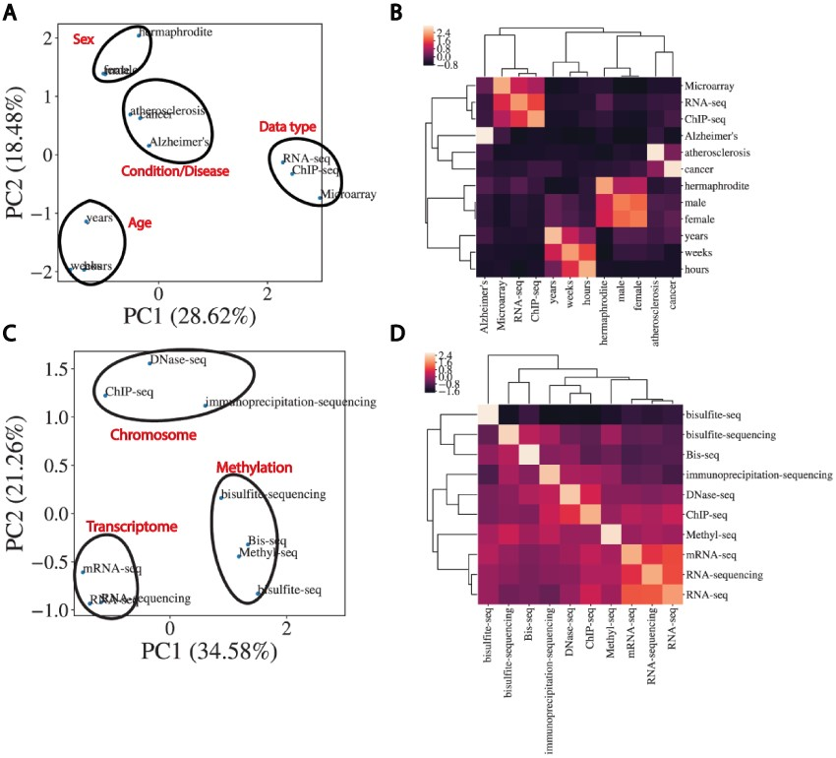
Figure 3. Word embeddings capture semantic similarities between words. (A) Dimensional reduction using PCA to visualize ...
Notes:
Figure 3. Word embeddings capture semantic similarities between words. (A) Dimensional reduction using PCA to visualize vectorized representation of a set of words encapsulating disease, age, data type and sex. (B) Corresponding correlation heatmap of the z-scored cosine similarity between words, with hierarchical clustering shown. (C) Same as (A) for data types. (D) Corresponding correlation heatmap of z-scored cosine similarity between words in (C).
Unless provided in the caption above, the following copyright applies to the content of this slide: © The Author(s) 2021. Published by Oxford University Press.This is an Open Access article distributed under the terms of the Creative Commons Attribution License (http://creativecommons.org/licenses/by/4.0/), which permits unrestricted reuse, distribution, and reproduction in any medium, provided the original work is properly cited.

Slide 4
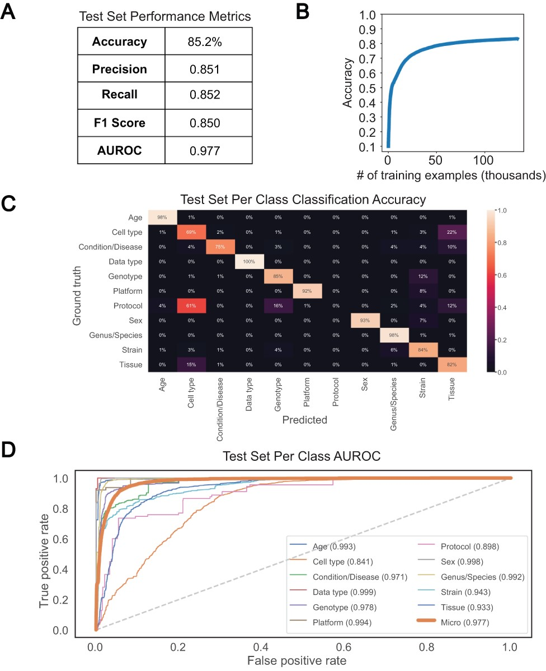
Figure 4. Performance of bi-LSTM in metadata category classification. (A) Accuracy, precision, recall, F1 score, and ...
Notes:
Figure 4. Performance of bi-LSTM in metadata category classification. (A) Accuracy, precision, recall, F1 score, and average AUROC calculated for all categories combined on held-out test set. (B) Accuracy of model classification on training set (y-axis) plotted against the number of training examples input (in thousands). (C) Percentage of each category correctly classified on held-out test set, shown as a heatmap, with predicted values on the x-axis and ground truth labels on the y-axis. (D) Receiver operating characteristic (ROC) curves for each category along with the average over all test set examples (micro average).
Unless provided in the caption above, the following copyright applies to the content of this slide: © The Author(s) 2021. Published by Oxford University Press.This is an Open Access article distributed under the terms of the Creative Commons Attribution License (http://creativecommons.org/licenses/by/4.0/), which permits unrestricted reuse, distribution, and reproduction in any medium, provided the original work is properly cited.

