Slide 1
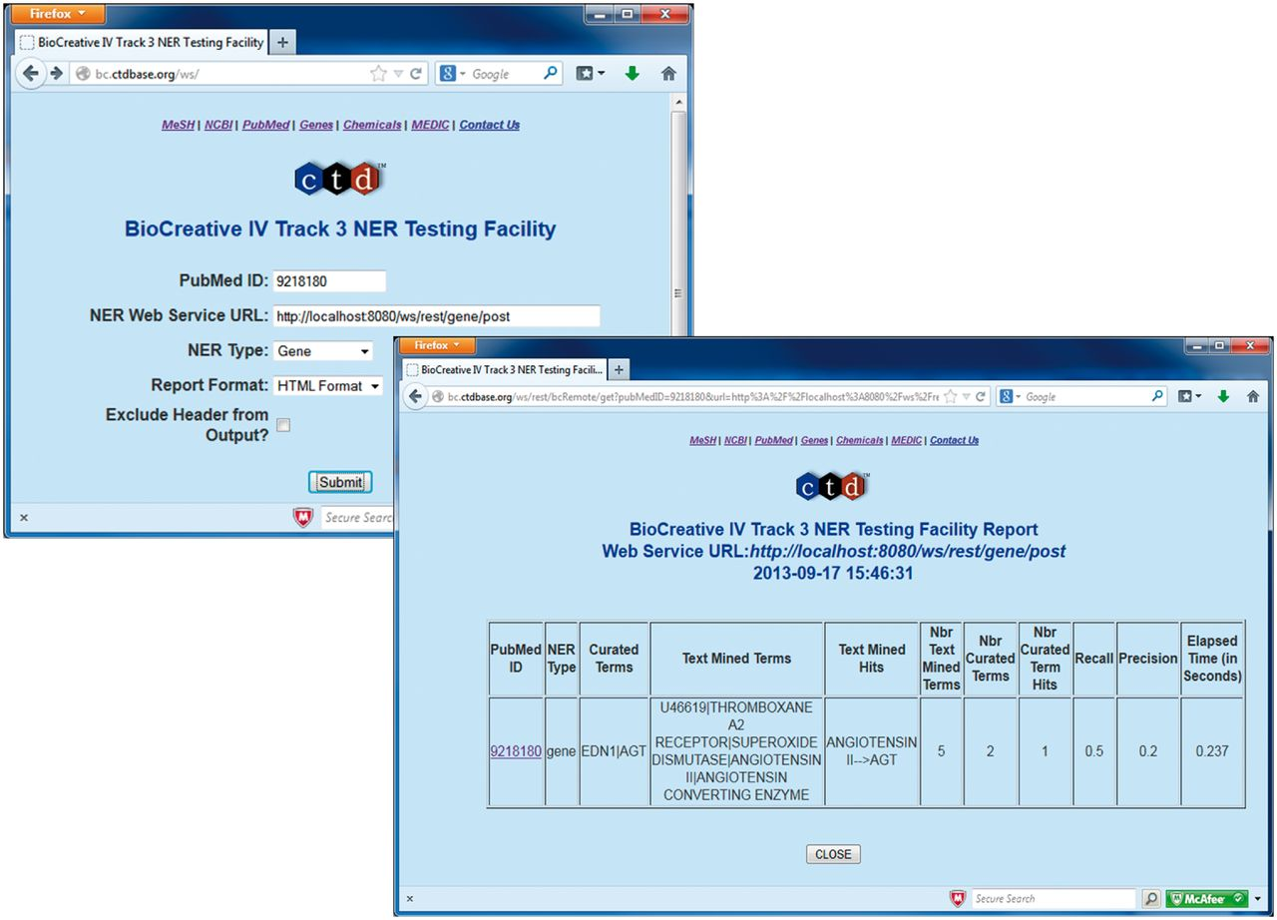
Figure 3. BioCreative IV Track 3 NER Testing Facility. Participants were provided with the BioCreative IV Track 3 NER ...
Notes:
Figure 3. BioCreative IV Track 3 NER Testing Facility. Participants were provided with the BioCreative IV Track 3 NER Testing Facility developed by CTD. This testing facility provided a front-end to a CTD Web service that on execution called the participant's Web service using BioC XML associated with a specified PubMed ID for inter-process communications (top left screenshot). CTD's Web service would in turn receive text-mined annotations from the participant's Web service (using BioC XML). CTD's Web service then processed the annotations and computed the results against the curated data set, providing the user with recall, precision, response time and a detailed list of curated terms, text-mined terms and text-mined term hits (bottom right screenshot).
Unless provided in the caption above, the following copyright applies to the content of this slide: © The Author(s) 2014. Published by Oxford University Press.This is an Open Access article distributed under the terms of the Creative Commons Attribution License (http://creativecommons.org/licenses/by/3.0/), which permits unrestricted reuse, distribution, and reproduction in any medium, provided the original work is properly cited.

