Slide 1
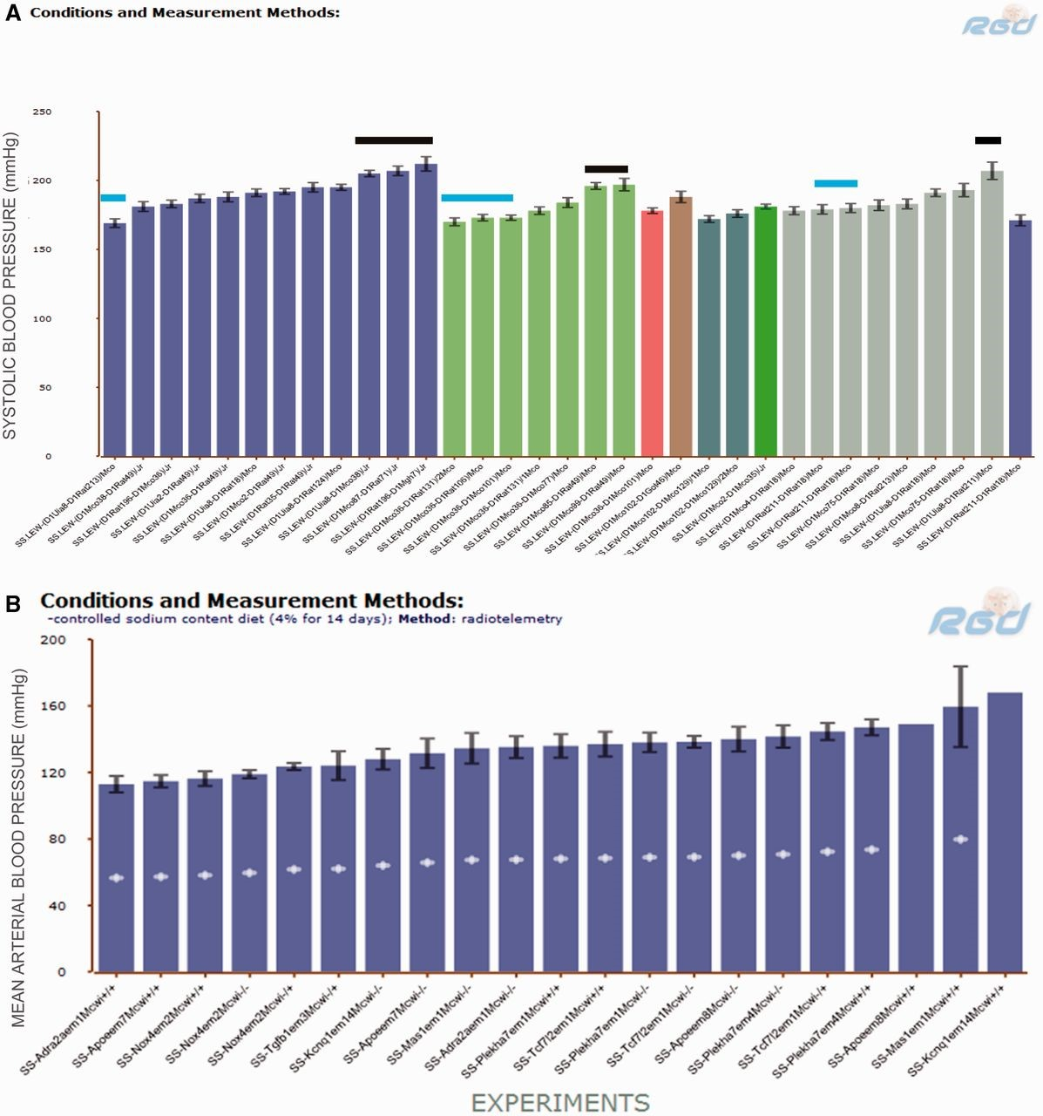
Figure 3. ( A ) SBP of SS.LEW congenic rats from PhenoMiner. Black horizontal bars indicate congenics that had ...
Notes:
Figure 3. ( A ) SBP of SS.LEW congenic rats from PhenoMiner. Black horizontal bars indicate congenics that had comparable SBP to the parents and blue horizontal bars indicate congenics that had lower SBP than the parents. ( B ) MAP of SS chromosome 1 mutants from PhenoMiner. −\−, homozygous mutant; −\+, heterozygous mutant; +\+, wild-type control.
Unless provided in the caption above, the following copyright applies to the content of this slide: © The Author(s) 2015. Published by Oxford University Press.This is an Open Access article distributed under the terms of the Creative Commons Attribution License (http://creativecommons.org/licenses/by/4.0/), which permits unrestricted reuse, distribution, and reproduction in any medium, provided the original work is properly cited.

