Slide 1
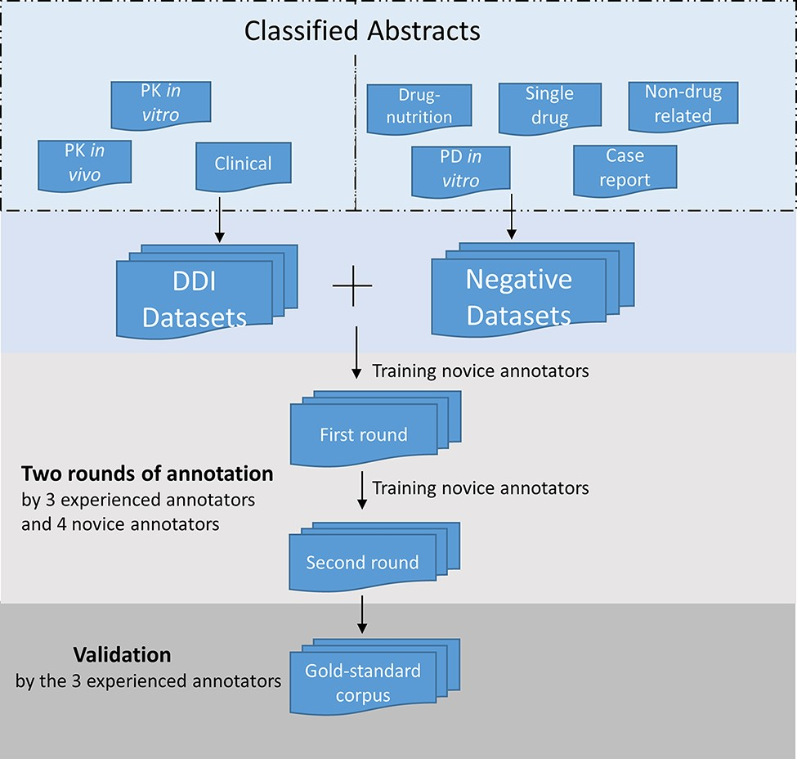
Figure 2. Annotation process for the corpus development. The DDI corpus was constructed by three experienced annotators ...
Notes:
Figure 2. Annotation process for the corpus development. The DDI corpus was constructed by three experienced annotators and four novice annotators. Novice annotators received two rounds of training of sentence-level annotation. After the initial training, each abstract in the corpus was assigned randomly to two annotators for the first-round annotation. Then the novice annotators underwent additional training. In the second-round annotation, the annotators reviewed and revised their annotation. The annotations were validated and finalized by the experienced annotators.
Unless provided in the caption above, the following copyright applies to the content of this slide: © The Author(s) 2022. Published by Oxford University Press.This is an Open Access article distributed under the terms of the Creative Commons Attribution-NonCommercial License (https://creativecommons.org/licenses/by-nc/4.0/), which permits non-commercial re-use, distribution, and reproduction in any medium, provided the original work is properly cited. For commercial re-use, please contact journals.permissions@oup.com

