Slide 1
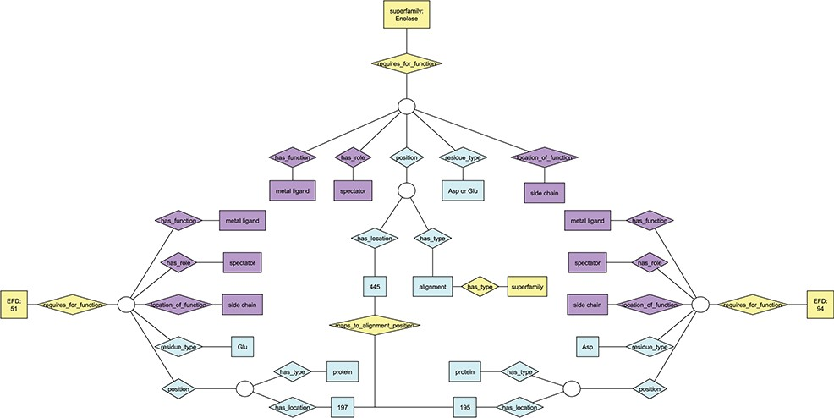
Figure 1 Ontology view of annotation for functional residues. Diamonds represent relationships; rectangles represent ...
Notes:
Figure 1 Ontology view of annotation for functional residues. Diamonds represent relationships; rectangles represent terms in the ontologies. Purple nodes, annotation details from EMO; yellow nodes, annotation details from the EFSO; blue nodes, details of specific residue location and type. EFDs shown in this figure are the same as those describing UniProtKB protein Q97U27 (EFD:51, gluconate dehydratase family) and UniProtKB protein P11444 (EFD:94, mandelate racemase family) in Figure S1. Though each of the two EFDs shown has multiple functional residues, only one is shown in the figure due to space constraints. The chosen residue has the same functional role in each EFD (and maps to the same position in the MSAs for the subgroup and superfamily that include both EFDs), though the amino acid type differs (Asp at position 195 for EFD 94, Glu at position 197 for EFD 51).
Unless provided in the caption above, the following copyright applies to the content of this slide: © The Author(s) 2020. Published by Oxford University Press.This is an Open Access article distributed under the terms of the Creative Commons Attribution License (http://creativecommons.org/licenses/by/4.0/), which permits unrestricted reuse, distribution, and reproduction in any medium, provided the original work is properly cited.

