Slide 1
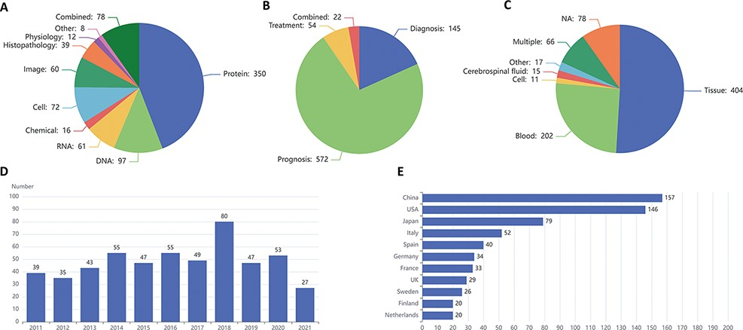
Figure 3. Statistics of lymphoma biomarkers. (A) Biomarker distribution by biomarker types. (B) Biomarker distribution ...
Notes:
Figure 3. Statistics of lymphoma biomarkers. (A) Biomarker distribution by biomarker types. (B) Biomarker distribution by biomarker applications. (C) Biomarker distribution by sample types. (D) Tendency for the number of articles published in the last 10 years. (E) Top 11 countries with the largest number of articles of lymphoma biomarkers.
Unless provided in the caption above, the following copyright applies to the content of this slide: © The Author(s) 2022. Published by Oxford University Press.This is an Open Access article distributed under the terms of the Creative Commons Attribution-NonCommercial License (https://creativecommons.org/licenses/by-nc/4.0/), which permits non-commercial re-use, distribution, and reproduction in any medium, provided the original work is properly cited. For commercial re-use, please contact journals.permissions@oup.com

