Slide 1
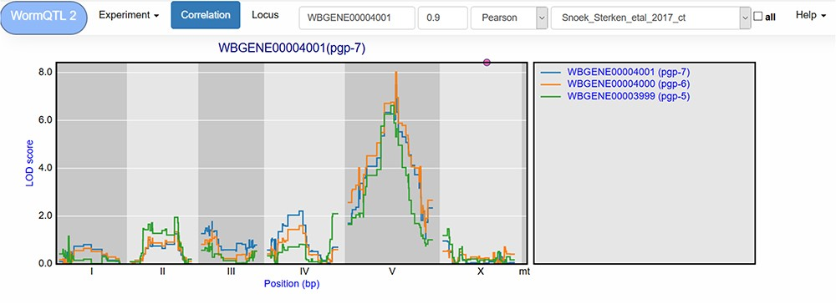
Figure 3 Correlation between eQTL profiles of pgp-7, pgp-6 and pgp-5. Correlation between the eQTL profile of pgp-7 ...
Notes:
Figure 3 Correlation between eQTL profiles of pgp-7, pgp-6 and pgp-5. Correlation between the eQTL profile of pgp-7 and the other genes was set to report those profiles with a Pearson correlation >0.9, see navigation bar at the top. Genes are shown in different colors. The legend is shown on the right. Chromosomes are indicated by different gray backgrounds and below the x-axis. The web-based plot is interactive; a mouse over provides the exact base pair position of each QTL or other point on the profile.
Unless provided in the caption above, the following copyright applies to the content of this slide: © The Author(s) 2020. Published by Oxford University Press.This is an Open Access article distributed under the terms of the Creative Commons Attribution License (http://creativecommons.org/licenses/by/4.0/), which permits unrestricted reuse, distribution, and reproduction in any medium, provided the original work is properly cited.

