Slide 1
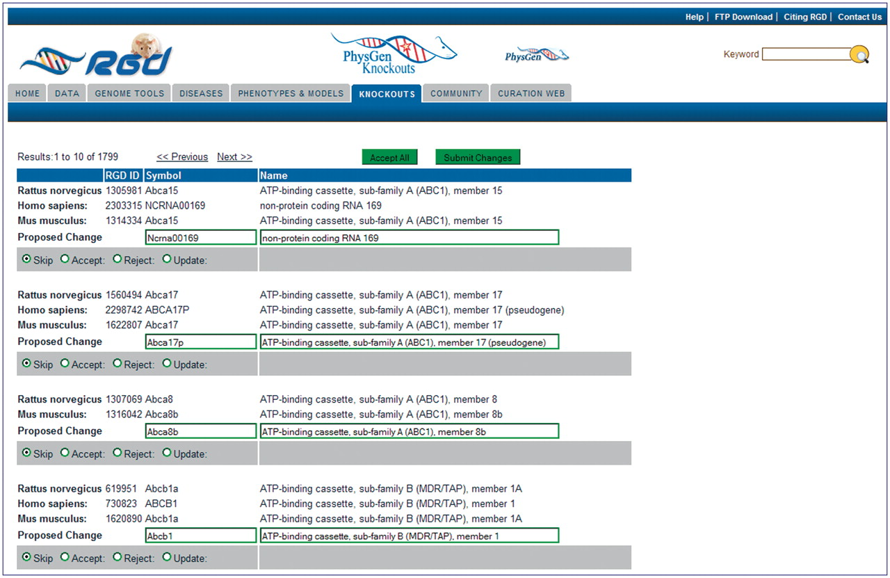
Figure 2. Editing page of the Gene Nomenclature Tool. All ortholog groups are listed in matched sets to simplify ...
Notes:
Figure 2. Editing page of the Gene Nomenclature Tool. All ortholog groups are listed in matched sets to simplify comparison of the rat nomenclature to the mouse and human nomenclature. The proposed change/editing text boxes and action selection radio buttons are at the bottom of every ortholog group. An ‘Accept All’ button is located at the top and bottom of every editing page so that all proposed changes on the page can be approved at once if the curator decides they are acceptable. ‘Submit Changes’ buttons are located next to the ‘Accept All’ buttons to send the changes to the database.
Unless provided in the caption above, the following copyright applies to the content of this slide: © The Author(s) 2011. Published by Oxford University Press.This is Open Access article distributed under the terms of the Creative Commons Attribution Non-Commercial License (http://creativecommons.org/licenses/by-nc/2.5), which permits unrestricted non-commercial use, distribution, and reproduction in any medium, provided the original work is properly cited.

