Slide 1
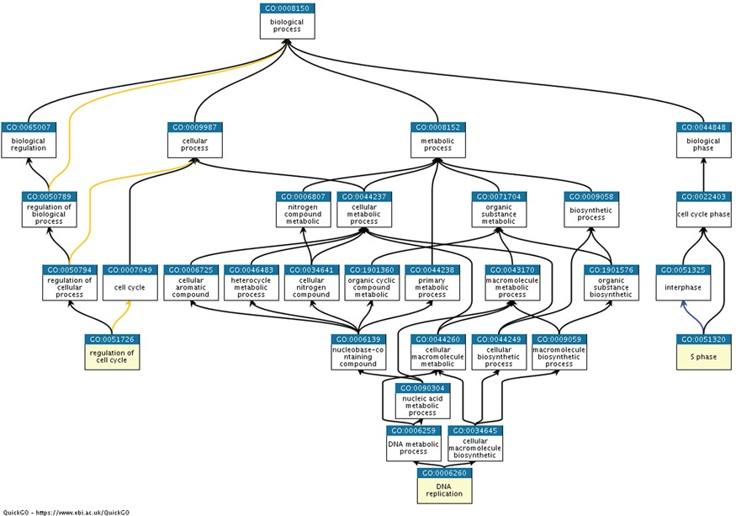
Figure 4 Ancestor charts of the GO terms from semantic classification 2, shown in Table 2 [S phase (GO:0051320), DNA ...
Notes:
Figure 4 Ancestor charts of the GO terms from semantic classification 2, shown in Table 2 [S phase (GO:0051320), DNA replication (GO:0006260) and regulation of cell cycle (GO:0051726)], using https://www.ebi.ac.uk/QuickGO/.
Unless provided in the caption above, the following copyright applies to the content of this slide: © The Author(s) 2018. Published by Oxford University Press.This is an Open Access article distributed under the terms of the Creative Commons Attribution License (http://creativecommons.org/licenses/by/4.0/), which permits unrestricted reuse, distribution, and reproduction in any medium, provided the original work is properly cited.

