Slide 1
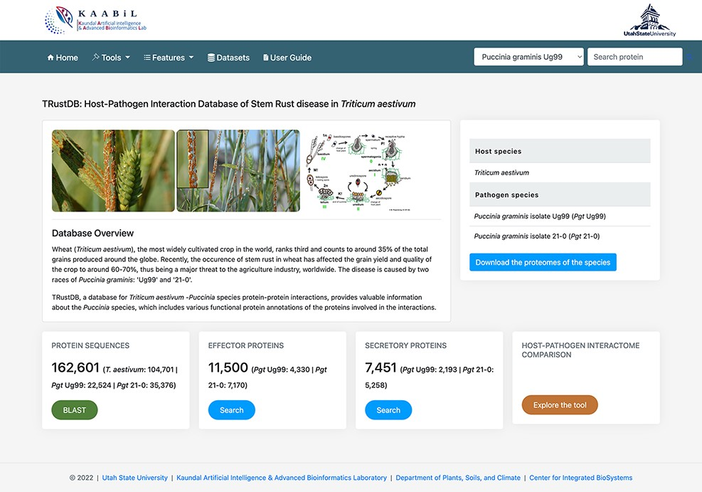
Figure 1. The ‘Homepage’ of TRustDB database server.
Notes:
Figure 1. The ‘Homepage’ of TRustDB database server.
Unless provided in the caption above, the following copyright applies to the content of this slide: © The Author(s) 2022. Published by Oxford University Press.This is an Open Access article distributed under the terms of the Creative Commons Attribution License (https://creativecommons.org/licenses/by/4.0/), which permits unrestricted reuse, distribution, and reproduction in any medium, provided the original work is properly cited.

Slide 2
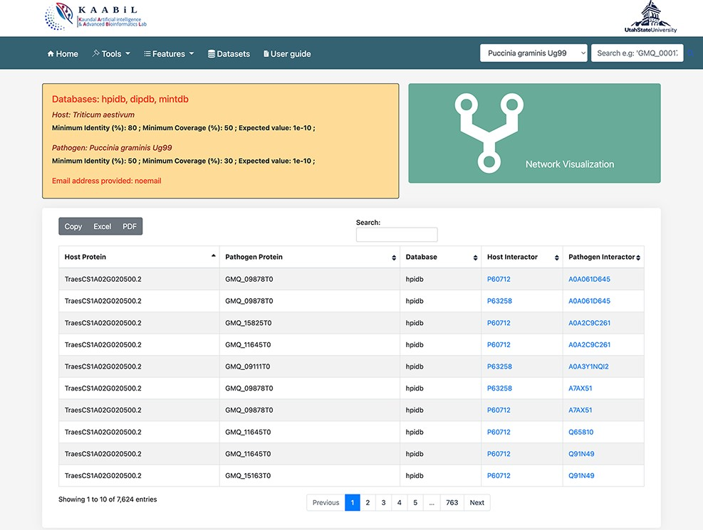
Figure 2. The ‘Table’ view of resulting host–pathogen interactions. The interologs of the corresponding host and ...
Notes:
Figure 2. The ‘Table’ view of resulting host–pathogen interactions. The interologs of the corresponding host and pathogen query proteins are also provided. Results can be downloaded in an Excel or PDF format or can be copied to the clipboard.
Unless provided in the caption above, the following copyright applies to the content of this slide: © The Author(s) 2022. Published by Oxford University Press.This is an Open Access article distributed under the terms of the Creative Commons Attribution License (https://creativecommons.org/licenses/by/4.0/), which permits unrestricted reuse, distribution, and reproduction in any medium, provided the original work is properly cited.

Slide 3
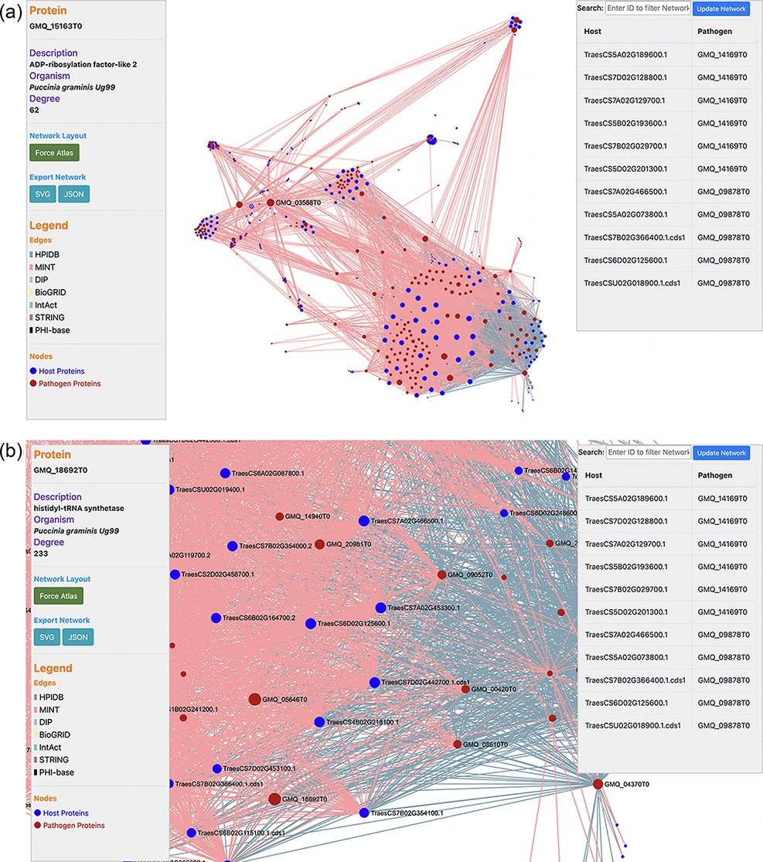
Figure 3. (a) Network visualization of the predicted interactome from the ‘Interactomics’ tool; (b) A zoomed-in version ...
Notes:
Figure 3. (a) Network visualization of the predicted interactome from the ‘Interactomics’ tool; (b) A zoomed-in version of the network to view proteins of interest. Users can click (or hover) on any node to view the description of a particular host/pathogen protein in the predicted network.
Unless provided in the caption above, the following copyright applies to the content of this slide: © The Author(s) 2022. Published by Oxford University Press.This is an Open Access article distributed under the terms of the Creative Commons Attribution License (https://creativecommons.org/licenses/by/4.0/), which permits unrestricted reuse, distribution, and reproduction in any medium, provided the original work is properly cited.

Slide 4
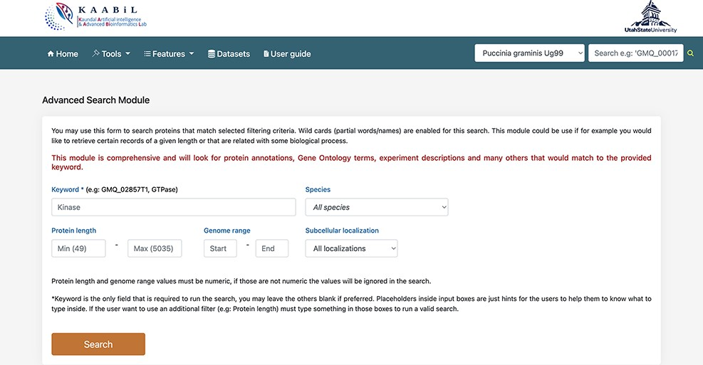
Figure 4. A snapshot of the ‘Advanced search’ module of TRustDB; users can search the database using specific keywords, ...
Notes:
Figure 4. A snapshot of the ‘Advanced search’ module of TRustDB; users can search the database using specific keywords, protein IDs and/or other genomic information of the proteins.
Unless provided in the caption above, the following copyright applies to the content of this slide: © The Author(s) 2022. Published by Oxford University Press.This is an Open Access article distributed under the terms of the Creative Commons Attribution License (https://creativecommons.org/licenses/by/4.0/), which permits unrestricted reuse, distribution, and reproduction in any medium, provided the original work is properly cited.

Slide 5
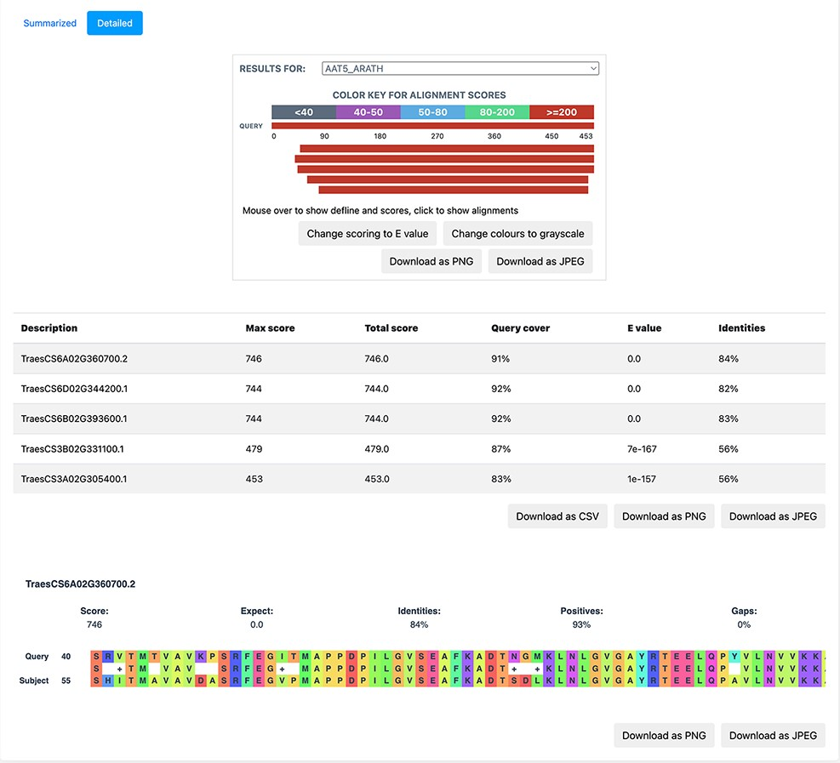
Figure 5. A detailed view of the BLAST result alignments.
Notes:
Figure 5. A detailed view of the BLAST result alignments.
Unless provided in the caption above, the following copyright applies to the content of this slide: © The Author(s) 2022. Published by Oxford University Press.This is an Open Access article distributed under the terms of the Creative Commons Attribution License (https://creativecommons.org/licenses/by/4.0/), which permits unrestricted reuse, distribution, and reproduction in any medium, provided the original work is properly cited.

Slide 6
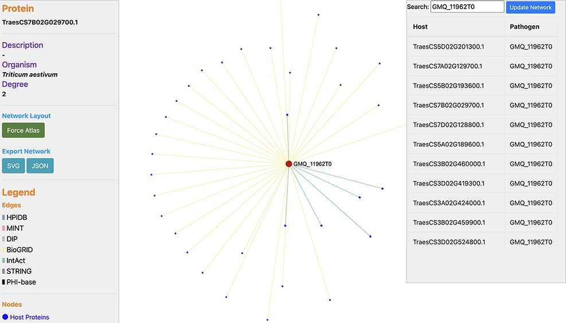
Figure 6. Network visualization of an Ug99 effector protein, GMQ_11962T0, interacting with 34 T. aestivum proteins as ...
Notes:
Figure 6. Network visualization of an Ug99 effector protein, GMQ_11962T0, interacting with 34 T. aestivum proteins as predicted by TRustDB (Supplementary Material, Sheet 4). GMQ_11962T0 has been shown to be involved in hydrolase activity (GO:0016817) and spliceosome (ko03040), which plays a role in the colonization and pathogenicity of the fungal pathogens.
Unless provided in the caption above, the following copyright applies to the content of this slide: © The Author(s) 2022. Published by Oxford University Press.This is an Open Access article distributed under the terms of the Creative Commons Attribution License (https://creativecommons.org/licenses/by/4.0/), which permits unrestricted reuse, distribution, and reproduction in any medium, provided the original work is properly cited.

