Slide 1
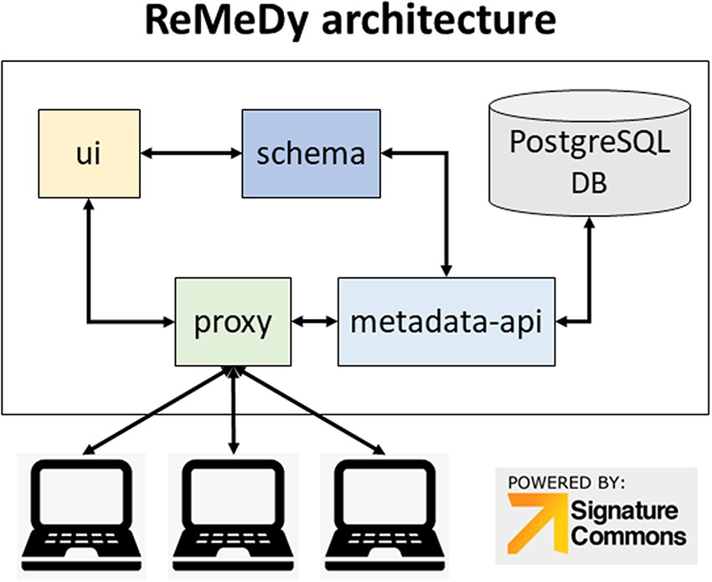
Figure 1. ReMeDy platform architecture that is based on an implementation of the NIH BD2K-LINCS DDCIC developed ...
Notes:
Figure 1. ReMeDy platform architecture that is based on an implementation of the NIH BD2K-LINCS DDCIC developed Signature Commons platform, installed through Docker. The figure illustrates the interaction between the Docker packages and the PostgreSQL database.
Unless provided in the caption above, the following copyright applies to the content of this slide: © The Author(s) 2021. Published by Oxford University Press.This is an Open Access article distributed under the terms of the Creative Commons Attribution License (http://creativecommons.org/licenses/by/4.0/), which permits unrestricted reuse, distribution, and reproduction in any medium, provided the original work is properly cited.

Slide 2
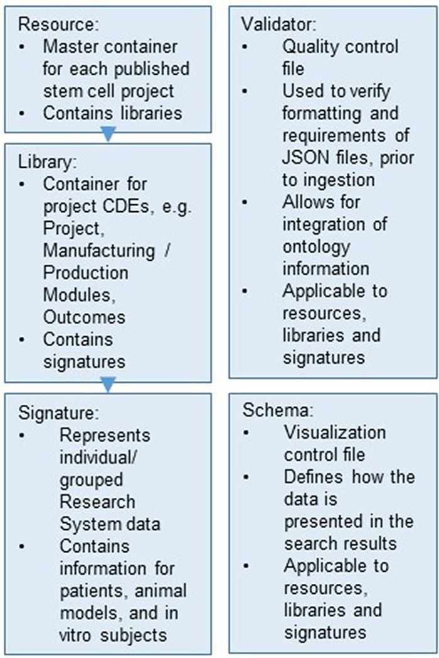
Figure 2. Hierarchical organization of the data stored within the ReMeDy platform.
Notes:
Figure 2. Hierarchical organization of the data stored within the ReMeDy platform.
Unless provided in the caption above, the following copyright applies to the content of this slide: © The Author(s) 2021. Published by Oxford University Press.This is an Open Access article distributed under the terms of the Creative Commons Attribution License (http://creativecommons.org/licenses/by/4.0/), which permits unrestricted reuse, distribution, and reproduction in any medium, provided the original work is properly cited.

Slide 3
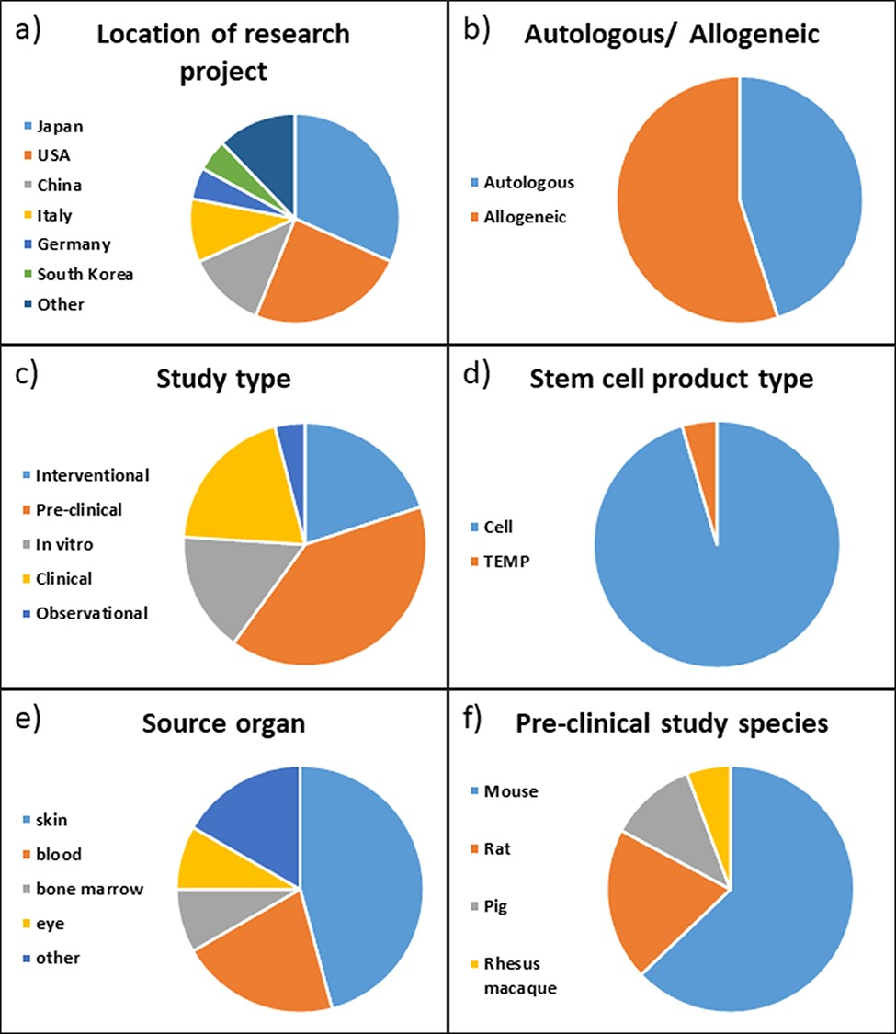
Figure 3. Distribution of projects in ReMeDy database by (a) location of the rearch project, (b) autologous or ...
Notes:
Figure 3. Distribution of projects in ReMeDy database by (a) location of the rearch project, (b) autologous or allogeneic treatment type, (c) study type, (d) stem cell product type, (e) source organ for iPSCs and (f) pre-clinical study species.
Unless provided in the caption above, the following copyright applies to the content of this slide: © The Author(s) 2021. Published by Oxford University Press.This is an Open Access article distributed under the terms of the Creative Commons Attribution License (http://creativecommons.org/licenses/by/4.0/), which permits unrestricted reuse, distribution, and reproduction in any medium, provided the original work is properly cited.

Slide 4
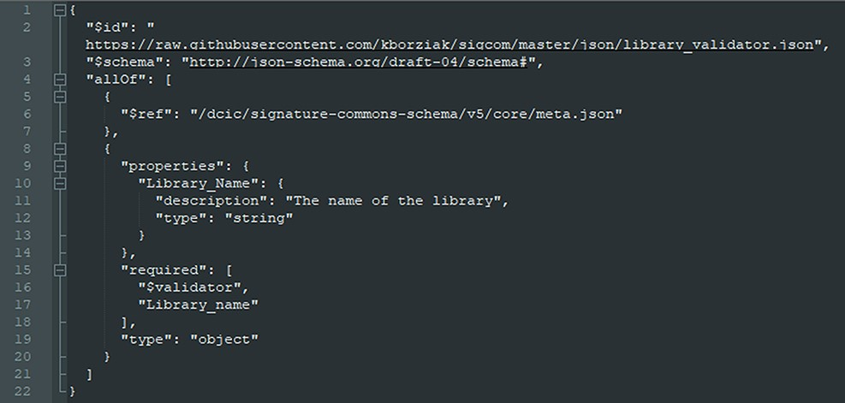
Figure 4. Example JSON format file used for interface with ReMeDy API.
Notes:
Figure 4. Example JSON format file used for interface with ReMeDy API.
Unless provided in the caption above, the following copyright applies to the content of this slide: © The Author(s) 2021. Published by Oxford University Press.This is an Open Access article distributed under the terms of the Creative Commons Attribution License (http://creativecommons.org/licenses/by/4.0/), which permits unrestricted reuse, distribution, and reproduction in any medium, provided the original work is properly cited.

Slide 5
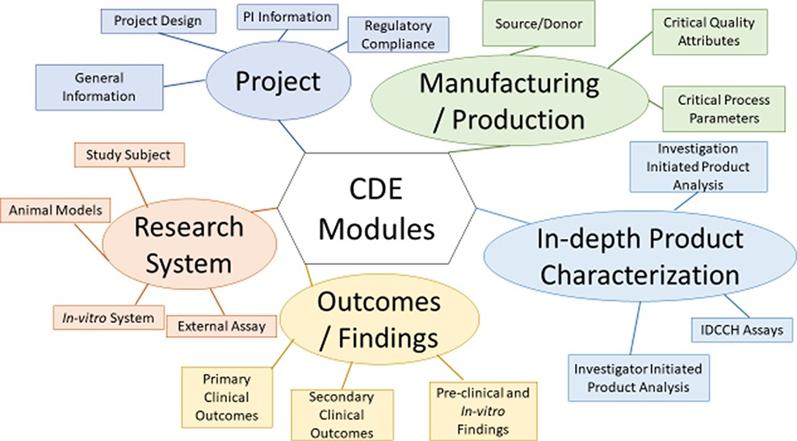
Figure 5. Organization of the Multi-modular CDE Framework used for extracting data from published iPSC projects.
Notes:
Figure 5. Organization of the Multi-modular CDE Framework used for extracting data from published iPSC projects.
Unless provided in the caption above, the following copyright applies to the content of this slide: © The Author(s) 2021. Published by Oxford University Press.This is an Open Access article distributed under the terms of the Creative Commons Attribution License (http://creativecommons.org/licenses/by/4.0/), which permits unrestricted reuse, distribution, and reproduction in any medium, provided the original work is properly cited.

Slide 6
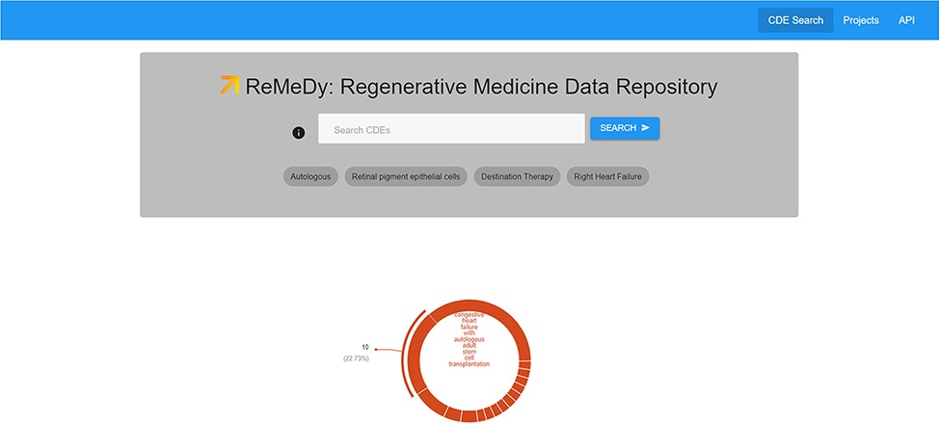
Figure 6. ReMeDy landing page. This image shows the search space, visualization tools, the API platform and Project ...
Notes:
Figure 6. ReMeDy landing page. This image shows the search space, visualization tools, the API platform and Project links functionalities accessible though the landing page.
Unless provided in the caption above, the following copyright applies to the content of this slide: © The Author(s) 2021. Published by Oxford University Press.This is an Open Access article distributed under the terms of the Creative Commons Attribution License (http://creativecommons.org/licenses/by/4.0/), which permits unrestricted reuse, distribution, and reproduction in any medium, provided the original work is properly cited.

Slide 7
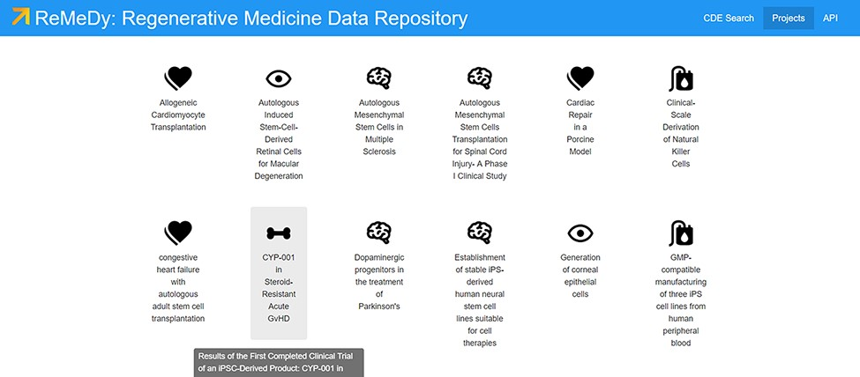
Figure 7. Projects page for ReMeDy, highlighting a subset of published projects currently in the database.
Notes:
Figure 7. Projects page for ReMeDy, highlighting a subset of published projects currently in the database.
Unless provided in the caption above, the following copyright applies to the content of this slide: © The Author(s) 2021. Published by Oxford University Press.This is an Open Access article distributed under the terms of the Creative Commons Attribution License (http://creativecommons.org/licenses/by/4.0/), which permits unrestricted reuse, distribution, and reproduction in any medium, provided the original work is properly cited.

Slide 8
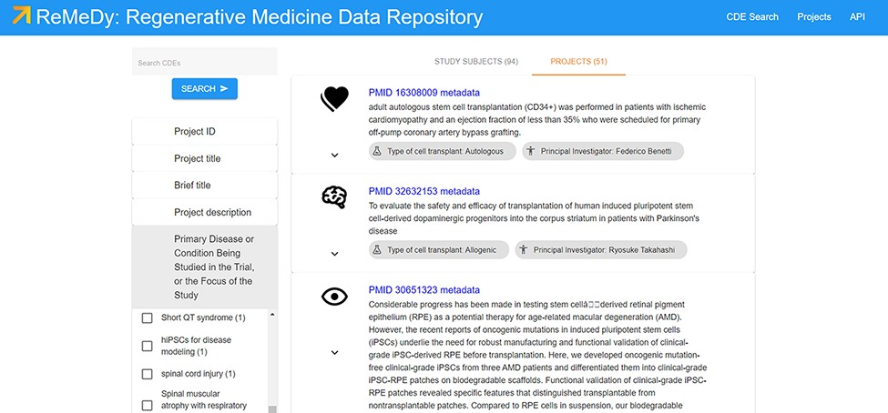
Figure 8. Search results page, displaying all the data currently in the ReMeDy database and highlighting the ...
Notes:
Figure 8. Search results page, displaying all the data currently in the ReMeDy database and highlighting the implemented filtering functionality.
Unless provided in the caption above, the following copyright applies to the content of this slide: © The Author(s) 2021. Published by Oxford University Press.This is an Open Access article distributed under the terms of the Creative Commons Attribution License (http://creativecommons.org/licenses/by/4.0/), which permits unrestricted reuse, distribution, and reproduction in any medium, provided the original work is properly cited.

Slide 9
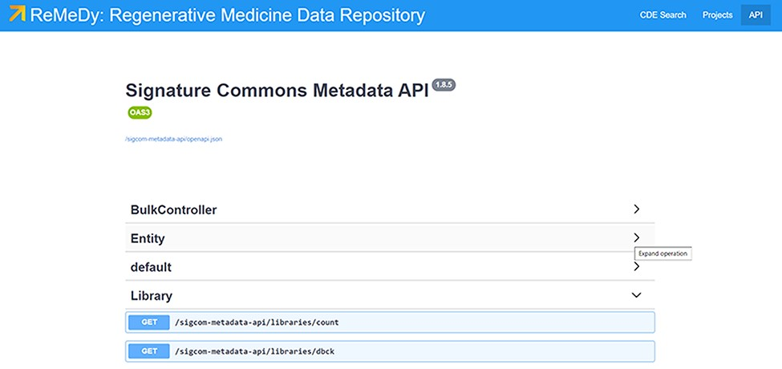
Figure 9. ReMeDy API. The ReMeDy API is based on the underlying Signature Commons architecture, which provides ...
Notes:
Figure 9. ReMeDy API. The ReMeDy API is based on the underlying Signature Commons architecture, which provides extensive documentation of the API functionalities.
Unless provided in the caption above, the following copyright applies to the content of this slide: © The Author(s) 2021. Published by Oxford University Press.This is an Open Access article distributed under the terms of the Creative Commons Attribution License (http://creativecommons.org/licenses/by/4.0/), which permits unrestricted reuse, distribution, and reproduction in any medium, provided the original work is properly cited.

Slide 10
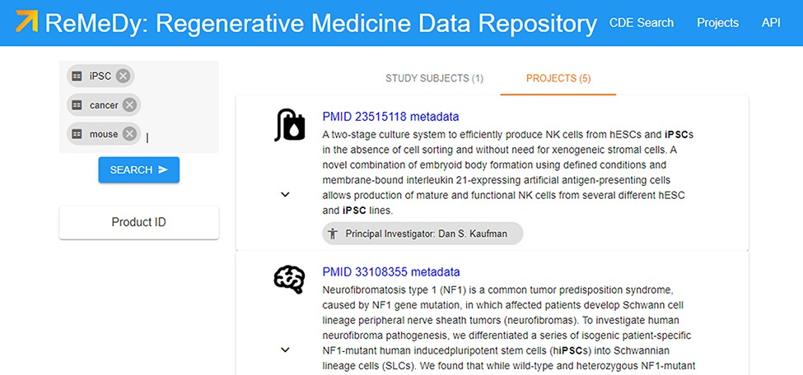
Figure 10. Demonstration of a search query used to collect cohorts for further analysis.
Notes:
Figure 10. Demonstration of a search query used to collect cohorts for further analysis.
Unless provided in the caption above, the following copyright applies to the content of this slide: © The Author(s) 2021. Published by Oxford University Press.This is an Open Access article distributed under the terms of the Creative Commons Attribution License (http://creativecommons.org/licenses/by/4.0/), which permits unrestricted reuse, distribution, and reproduction in any medium, provided the original work is properly cited.

