Slide 1
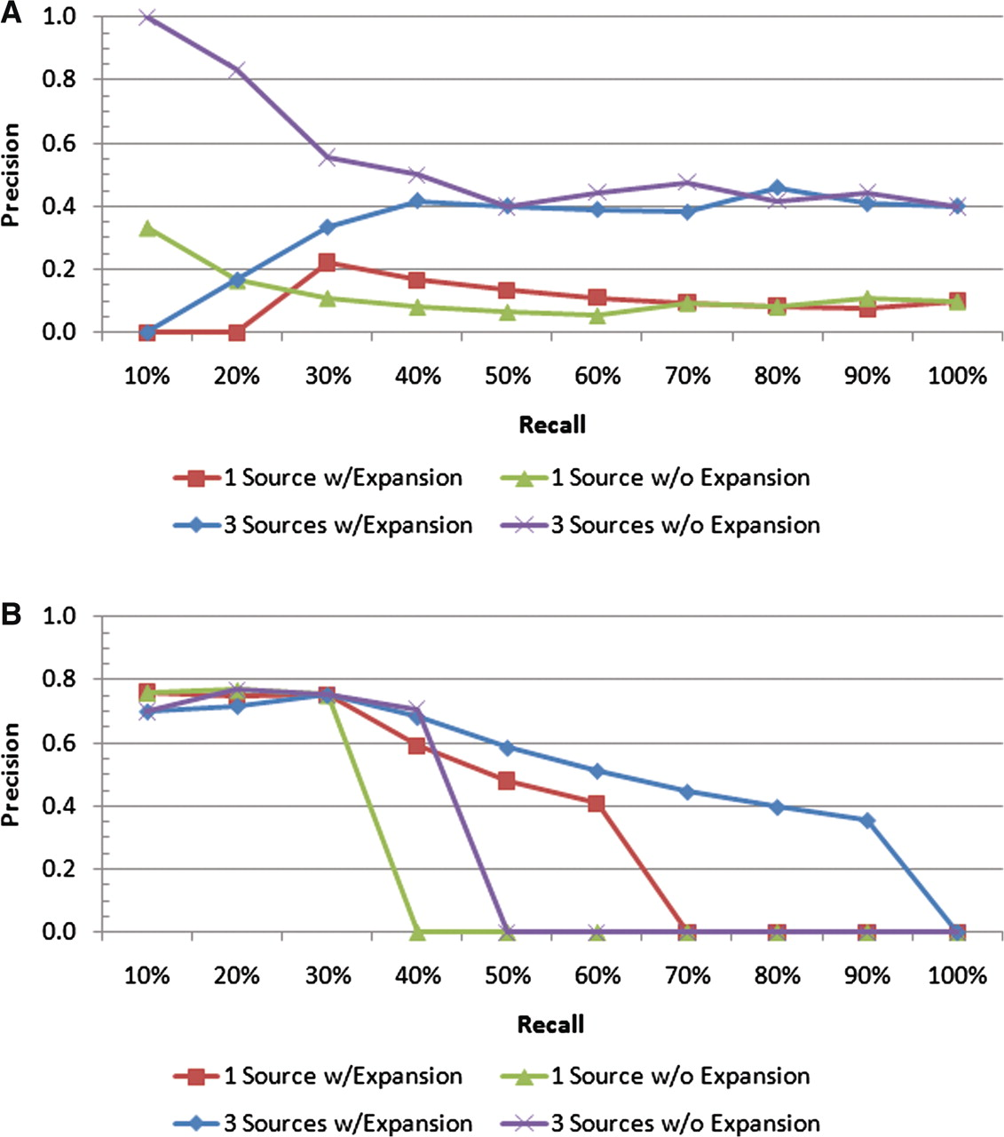
Figure 7. Precision–recall plots for two individual queries: (A) ‘ear’ and (B) ‘endosperm’. For the ‘endosperm query, ...
Notes:
Figure 7. Precision–recall plots for two individual queries: (A) ‘ear’ and (B) ‘endosperm’. For the ‘endosperm query, all four scenarios have similar precision values at low recall levels; however, the scenario with all the text sources and query expansion includes many more of the relevant documents in the result sets than the others, as indicated by the higher precision at the higher recall levels. For the ‘ear’ query, the best performance is achieved by all the text sources with no query expansion.
Unless provided in the caption above, the following copyright applies to the content of this slide: © The Author(s) 2011. Published by Oxford University Press.This is Open Access article distributed under the terms of the Creative Commons Attribution Non-Commercial License (http://creativecommons.org/licenses/by-nc/2.5), which permits unrestricted non-commercial use, distribution, and reproduction in any medium, provided the original work is properly cited.

