Slide 1
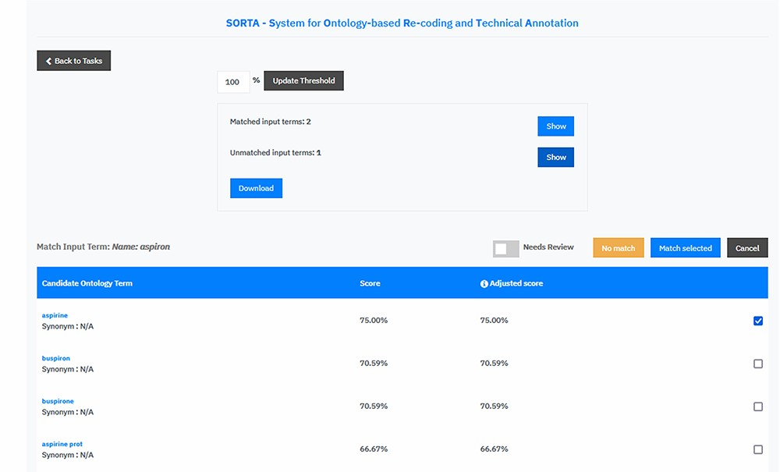
Figure 4. Screen capture of the SORTA 2.0 user interface. In contrast to the original version of SORTA, the SORTA 2.0 ...
Notes:
Figure 4. Screen capture of the SORTA 2.0 user interface. In contrast to the original version of SORTA, the SORTA 2.0 user interface allows users to map multiple terms at once and to flag a term for a manual review.
Unless provided in the caption above, the following copyright applies to the content of this slide: © The Author(s) 2023. Published by Oxford University Press.This is an Open Access article distributed under the terms of the Creative Commons Attribution License (https://creativecommons.org/licenses/by/4.0/), which permits unrestricted reuse, distribution, and reproduction in any medium, provided the original work is properly cited.

