Slide 1
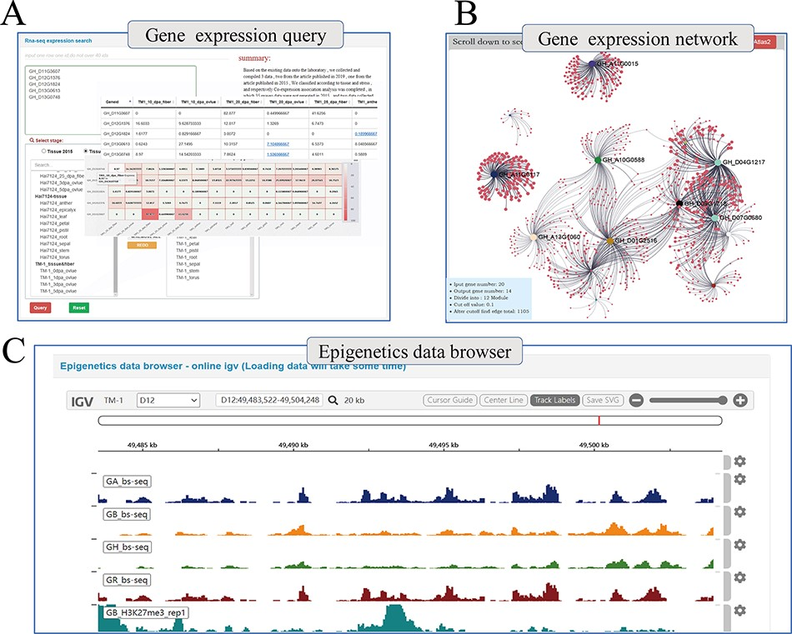
Figure 4. Whole genome-wide transcriptome and epigenome query interface. (A) The interface uses heatmap to show the ...
Notes:
Figure 4. Whole genome-wide transcriptome and epigenome query interface. (A) The interface uses heatmap to show the expression levels of multi-genes in different states. (B) Co-expression relationship visualization of query genes; each dot represents a gene related to the query genes. The size of the gene is proportional to the number of related genes, and the thickness of the line is proportional to the association between the genes. (C) Gene browser for epigenetic data; users can perform operations of coloring, zooming and position jump to the data just like operating the local igv tool.
Unless provided in the caption above, the following copyright applies to the content of this slide: © The Author(s) 2022. Published by Oxford University Press.This is an Open Access article distributed under the terms of the Creative Commons Attribution-NonCommercial License (https://creativecommons.org/licenses/by-nc/4.0/), which permits non-commercial re-use, distribution, and reproduction in any medium, provided the original work is properly cited. For commercial re-use, please contact journals.permissions@oup.com

