Slide 1
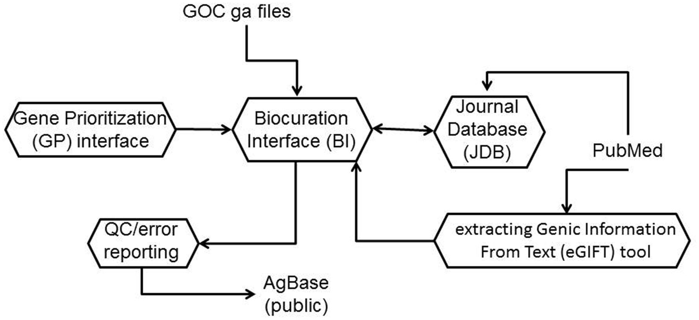
Figure 1 The AgBase biocuration pipeline. The AgBase biocuration pipeline draws from GO Consortium gene association ...
Notes:
Figure 1 The AgBase biocuration pipeline. The AgBase biocuration pipeline draws from GO Consortium gene association files and from PubMed data, and the output is the AgBase public gene association files. Briefly, genes to be annotated are prioritized as a ranked list in the GP interface, which are linked to records in the main BI. The eGIFT tool enhances the ability for biocurators to identify and curate appropriate literature while the JDB records reviewed literature. Biocuration must pass standard GO Consortium error and quality checks before public release.
Unless provided in the caption above, the following copyright applies to the content of this slide: © The Author(s) 2012. Published by Oxford University Press.This is an Open Access article distributed under the terms of the Creative Commons Attribution License (http://creativecommons.org/licenses/by-nc/3.0/), which permits non-commercial reuse, distribution, and reproduction in any medium, provided the original work is properly cited. For commercial re-use, please contact journals.permissions@oup.com.

