Slide 1
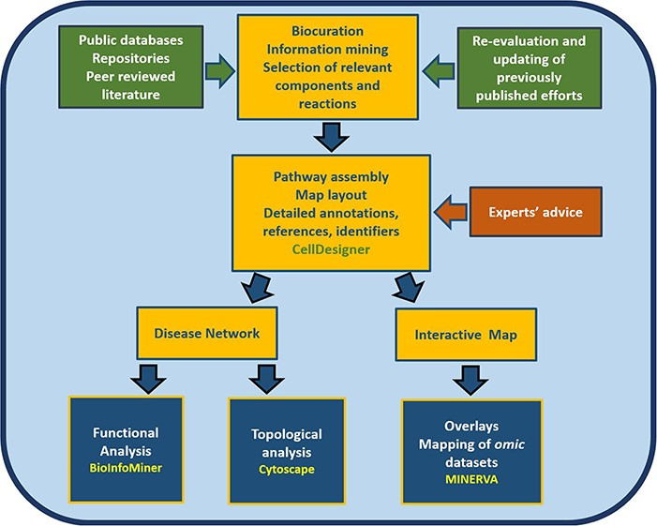
Figure 1 Workflow for the construction and use of the RA map. The assembly of the signalling and molecular pathways ...
Notes:
Figure 1 Workflow for the construction and use of the RA map. The assembly of the signalling and molecular pathways implicated in RA involves exhaustive manual curation and information mining from literature, public databases and repositories and the use of the software CellDesigner (18). The RA map contains mechanisms reported in the most recently published studies, after validation from RA experts. The map can be transformed into an online interactive knowledge base using the platform MINERVA (19). Functional enrichment and topological analysis is possible using the software BioInfoMiner (16) (https://bioinfominer.com) and Cytoscape (17), respectively.
Unless provided in the caption above, the following copyright applies to the content of this slide: © The Author(s) 2020. Published by Oxford University Press.This is an Open Access article distributed under the terms of the Creative Commons Attribution License (http://creativecommons.org/licenses/by/4.0/), which permits unrestricted reuse, distribution, and reproduction in any medium, provided the original work is properly cited.

