Slide 1
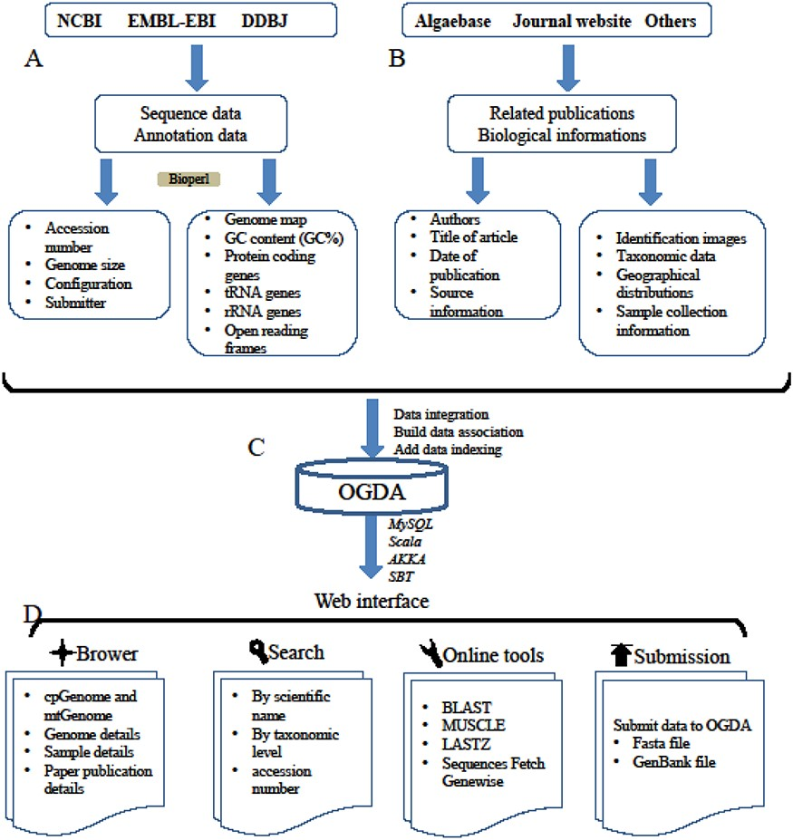
Figure 1. A schematic diagram of data processing for the OGDA database. (A) Data collection and data preprocessing. (B) ...
Notes:
Figure 1. A schematic diagram of data processing for the OGDA database. (A) Data collection and data preprocessing. (B) Collection of biological information. (C) Building data association, adding data indexing and data storage in a MySQL database. (D) Overview of the web interface and usage of OGDA.
Unless provided in the caption above, the following copyright applies to the content of this slide: © The Author(s) 2020. Published by Oxford University Press.This is an Open Access article distributed under the terms of the Creative Commons Attribution License (http://creativecommons.org/licenses/by/4.0/), which permits unrestricted reuse, distribution, and reproduction in any medium, provided the original work is properly cited.

