Slide 1
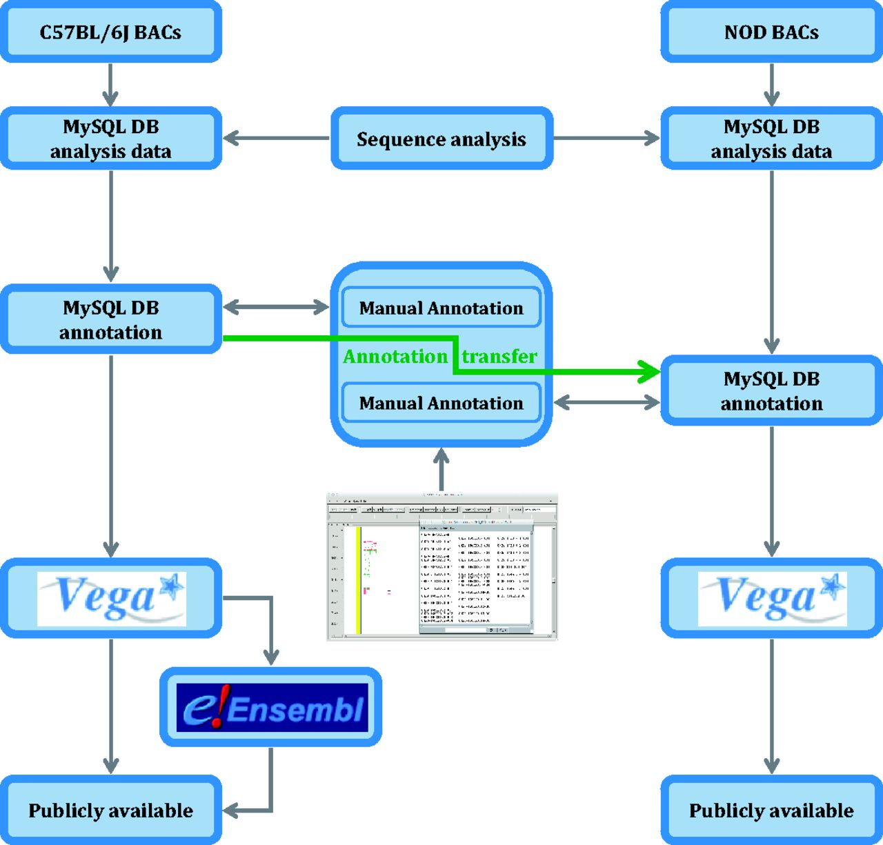
Figure 7. Analysis pipeline for the NOD mouse project. C57BL/6J genomic sequence in Idd regions is annotated before an ...
Notes:
Figure 7. Analysis pipeline for the NOD mouse project. C57BL/6J genomic sequence in Idd regions is annotated before an annotation transfer using exonerate, shown here by the orange arrow. Transcript objects are then manually inspected again in the NOD mouse and further manual annotation carried out where appropriate. Unlike the C57BL/6J annotation, the NOD mouse annotation is only available in Vega.
Unless provided in the caption above, the following copyright applies to the content of this slide: © The Author(s) 2013. Published by Oxford University Press.This is an Open Access article distributed under the terms of the Creative Commons Attribution License (http://creativecommons.org/licenses/by/3.0/), which permits unrestricted reuse, distribution, and reproduction in any medium, provided the original work is properly cited.

