Slide 1
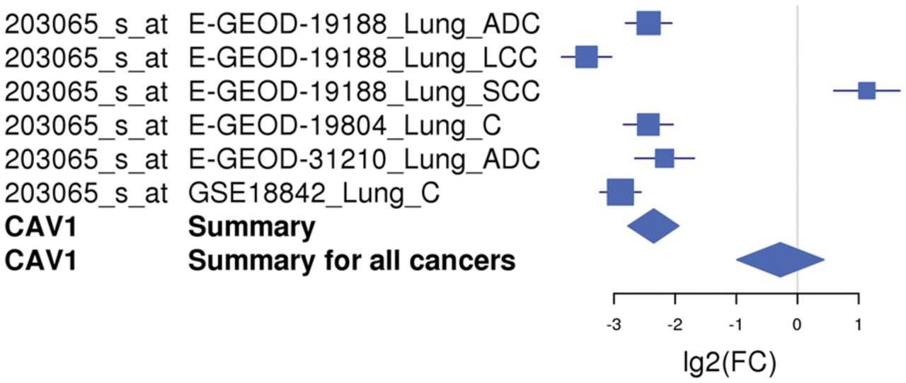
Figure 3 An example of a forest plot showing the expression of gene CAV1 downregulated in lung cancer. The expression ...
Notes:
Figure 3 An example of a forest plot showing the expression of gene CAV1 downregulated in lung cancer. The expression of the CAV1 gene is downregulated in five of six microarray studies and upregulated in one study. The forest plot shows the meta-log 2-fold change values for the individual studies as well as the total values for lung cancer and for all cancer types combined. Each study is illustrated by a square; the position on the x-axis representing the measure estimate (lg2FC ratio), the size proportional to the weight of the study and the horizontal line through it reflecting the confidence interval of the estimate.
Unless provided in the caption above, the following copyright applies to the content of this slide: © The Author(s) 2012. Published by Oxford University Press.This is an Open Access article distributed under the terms of the Creative Commons Attribution Non-Commercial License (http://creativecommons.org/licenses/by-nc/3.0/), which permits unrestricted non-commercial use, distribution, and reproduction in any medium, provided the original work is properly cited.

