Slide 1
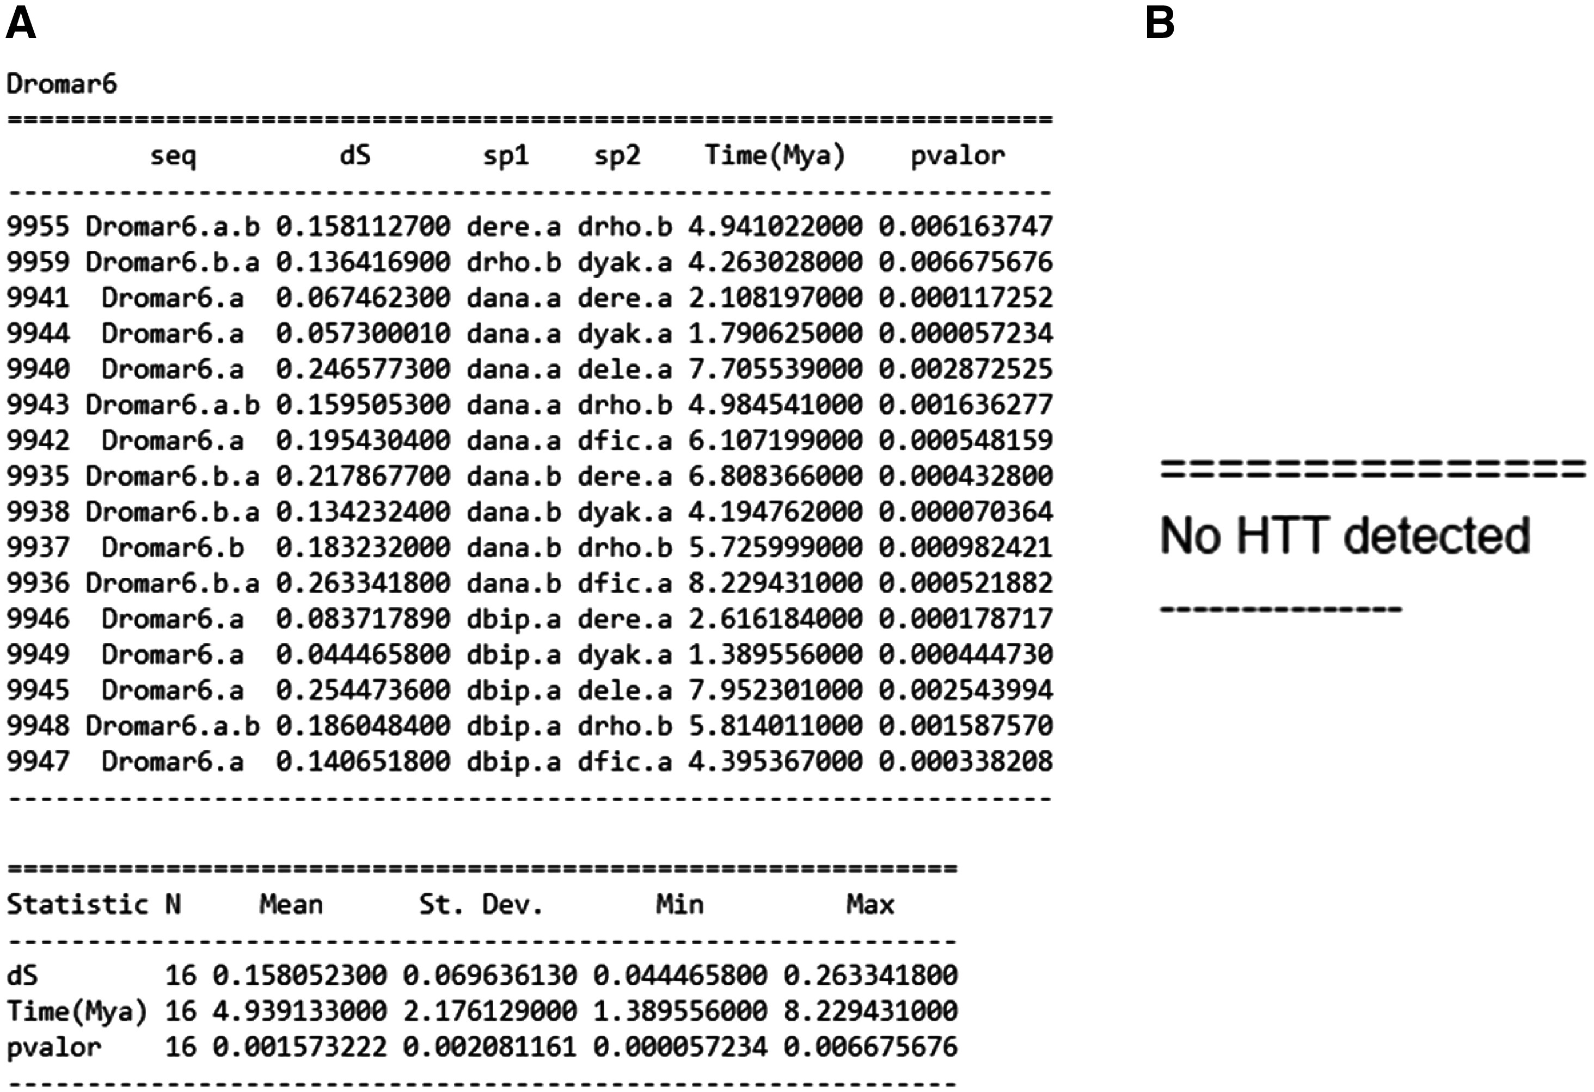
Figure 3. Three possible VHICA outputs. (A) Summary of all statistically supported HTT cases and associated data. (B) ...
Notes:
Figure 3. Three possible VHICA outputs. (A) Summary of all statistically supported HTT cases and associated data. (B) Resulting output when no significant HTT signal is detected. (C) Graphical output showing all host species and the significant pairwise comparison following P-value the legend colour.
Unless provided in the caption above, the following copyright applies to the content of this slide: © The Author(s) 2018. Published by Oxford University Press.This is an Open Access article distributed under the terms of the Creative Commons Attribution License (http://creativecommons.org/licenses/by/4.0/), which permits unrestricted reuse, distribution, and reproduction in any medium, provided the original work is properly cited.

