Slide 1
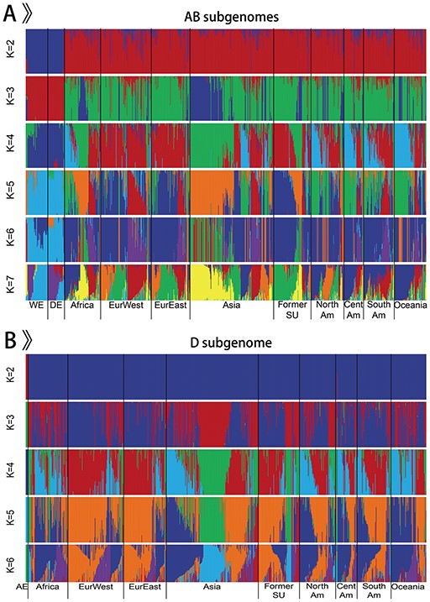
Figure 2. Population structure of 968 accessions.
Notes:
Figure 2. Population structure of 968 accessions. A. Population structure of 963 emmer wheat and bread wheat accessions on AB subgenomes. B. Population structure of 875 Ae. tauschii and bread wheat accessions on D subgenome.
Unless provided in the caption above, the following copyright applies to the content of this slide: © The Author(s) 2020. Published by Oxford University Press.This is an Open Access article distributed under the terms of the Creative Commons Attribution License (http://creativecommons.org/licenses/by/4.0/), which permits unrestricted reuse, distribution, and reproduction in any medium, provided the original work is properly cited.

